Slide 1
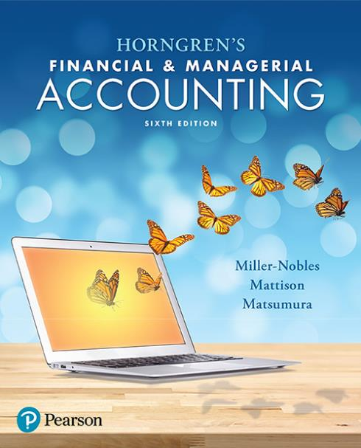

Chapter 24
Responsibility Accounting and Performance Evaluation

Slide 2

Chapter 24 Learning Objectives
Explain why companies decentralize and use responsibility accounting
Describe the purpose of performance evaluation systems and how the balanced scorecard helps companies evaluate performance

Slide 3
Chapter 24 Learning Objectives
Use responsibility reports to evaluate cost, revenue, and profit centers
Use return on investment (ROI) and residual income (RI) to evaluate investment centers
Determine how transfer pricing affects decentralized companies

Slide 4
Learning Objective 1
Explain why companies decentralize and use responsibility accounting

Slide 5
WHY DO DECENTRALIZED COMPANIES NEED RESPONSIBILITY ACCOUNTING?
Small companies are most often considered to be centralized companies.
When a company grows, it is impossible for a single person to manage the operations.
Companies decentralize as they grow.
Decentralized companies split their operations into different segments, such as departments and divisions.
Notes:
In a small company, the owner or top manager often makes all planning and controlling decisions. Small companies are most often considered to be centralized companies because centralized decision making is easier due to the smaller scope of their operations. A centralized company is a company in which major planning and controlling decisions are made by top management. However, when a company grows, it is impossible for a single person to manage the entire organization’s daily operations. Decentralized companies split their operations into different segments, such as departments and divisions. A decentralized company is a company that is divided into business segments, with segment managers making planning and controlling decisions for their segments.

Slide 6
Advantages of Decentralization
Decentralization offers several advantages to large companies:
  Frees top management time.
  Supports use of expert knowledge.
  Improves customer relations.
  Provides training.
  Improves motivation and retention.
Notes:
The advantages of decentralization include:
Frees top management time―By delegating responsibility for daily operations to business segment managers, top management can concentrate on long-term strategic planning and higher-level decisions that affect the entire company.
Supports use of expert knowledge―Decentralization allows top management to hire the expertise each business segment needs to excel in its own specific operations.
Improves customer relations―A segment manager focuses on just one segment of the company. Therefore, segment managers can maintain closer contact with important customers than can upper management. Thus, decentralization often leads to improved customer relations and quicker customer response time.
Provides training―Decentralization also provides segment managers with the training and experience they need to become effective top managers.
Improves motivation and retention―Empowering segment managers to make decisions increases managers’ motivation and retention. This improves job performance and satisfaction.

Slide 7
Disadvantages of Decentralization
Despite its advantages, decentralization can cause potential problems:
  Duplication of costs
  Problems achieving goal congruence
    Goal congruence occurs when segment managers’ goals align with top management’s goals.
Notes:
Disadvantages of decentralization include:
Duplication of cost―Decentralization may cause the company to duplicate certain costs or assets. Companies can often avoid duplication by providing centralized services.
Problems achieving goal congruence―Goal congruence means aligning the goals of business segment managers and other subordinates with the goals of top management. Decentralized companies often struggle to achieve goal congruence. Segment managers may not fully understand the “big picture” of the company. They may make decisions that are good for their division but that could harm another division or the rest of the company.

Slide 8
Responsibility Accounting
Decentralized companies delegate responsibility for specific decisions to each subunit.
A responsibility center is a part of the organization for which a manager has decision-making authority and accountability for the results of those decisions.
A responsibility accounting system is a system for evaluating the performance of each responsibility center and its manager.
Notes:
Decentralized companies delegate responsibility for specific decisions to each subunit, creating responsibility centers. A responsibility center is a part of the organization for which a manager has decision-making authority and accountability for the results of those decisions. Each manager is responsible for planning and controlling some part of the company’s activities. Lower-level managers are often responsible for budgeting and controlling costs of a single value-chain function.

Slide 9
Responsibility Centers
Cost center: The manager is only responsible for controlling costs.
Revenue center: The manager is only responsible for generating revenues.
Profit center: The manager is responsible for generating revenues and controlling costs.
Investment center: The manager is responsible for the center’s invested capital.
Notes:
A cost center is a responsibility center whose manager is only responsible for controlling costs. Manufacturing operations, such as the tablet computer production line at Smart Touch Learning, are cost centers.
A revenue center is a responsibility center whose manager is only responsible for generating revenue. A kiosk that sells sunglasses at a local mall is an example of a revenue center. The business is part of a chain, so the local manager does not control costs.
A profit center is a responsibility center whose manager is responsible for generating revenue, controlling costs, and producing profits. The manager responsible for a grocery store is accountable for increasing sales revenue and controlling costs to achieve the profit goals. Profit center responsibility reports include both revenues and expenses to show the profit centers’ operating income.
An investment center is a responsibility center whose manager is responsible for generating profits and efficiently managing the center’s invested capital, or assets. Managers of investment centers, such as division managers of chain stores, are responsible for (1) generating sales, (2) controlling expenses, (3) managing the amount of capital required to earn the income, and (4) planning future investments for growth and expansion of the company.

Slide 10
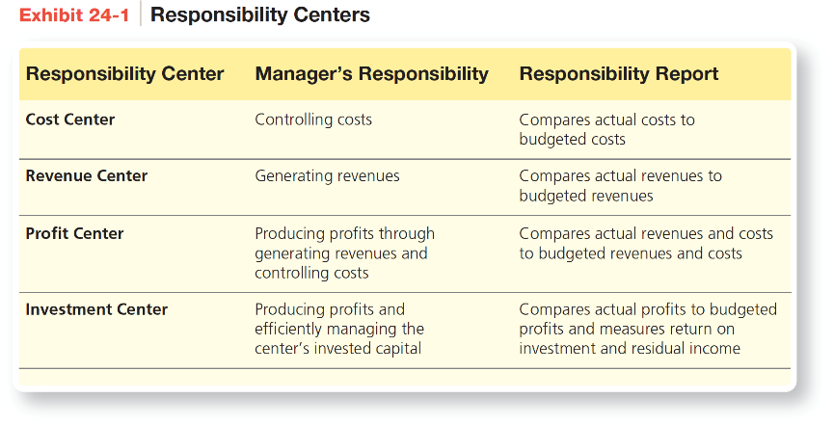
Responsibility Centers
Notes:
Exhibit 24-1 summarizes the types of responsibility centers, their managers’ responsibilities, and their responsibility reports.

Slide 11
Notes:
Exhibit 24-2 shows how an organization like Smart Touch Learning might assign responsibility. At the top level, the President—Chief Executive Officer (CEO) oversees the two vice presidents. The Vice President—Chief Operating Officer (COO) oversees two divisions. Division managers generally have broad responsibility, including deciding how to use assets to maximize return on investment. Most companies classify divisions as investment centers.
Each division manager supervises all the activities in that division. Product lines are generally considered profit centers. Thus, the manager of the standard tablets product line is responsible for evaluating lower-level managers of both cost centers (such as plants that make standard tablets) and revenue centers (such as managers responsible for selling standard tablets).

Slide 12
Learning Objective 2
Describe the purpose of performance evaluation systems and how the balanced scorecard helps companies evaluate performance

Slide 13
WHAT IS A PERFORMANCE EVALUATION SYSTEM, AND HOW IS IT USED?
Once a company decentralizes operations, top management is no longer involved in running the subunits’ day-to-day operations.
A performance evaluation system is a system that provides top management with a framework for maintaining control over the entire organization.
Notes:
Once a company decentralizes operations, top management is no longer involved in running the subunits’ day-to-day operations. A performance evaluation system provides top management with a framework for maintaining control over the entire organization.

Slide 14
Goals of Performance
Evaluation Systems
The primary goals of a performance evaluation system are:
  Promoting goal congruence and coordination
  Communicating expectations
  Motivating segment managers
  Providing feedback
  Benchmarking
Notes:
When companies decentralize, top management needs a system to communicate its goals to subunit managers. In addition, top management needs to determine whether the decisions being made at the subunit level are effectively meeting company goals. Goals of performance evaluation systems include:
Promoting goal congruence and coordination―A company will be able to achieve its goals only if each unit moves, in a synchronized fashion, toward the overall company goals.
Communicating expectations―To make decisions that are consistent with the company’s goals, segment managers must know the goals and the specific part their unit plays in attaining those goals.
Motivating segment managers―Segment managers are usually motivated to make decisions that will help achieve top management’s expectations. For additional motivation, upper management may offer bonuses to segment managers who meet or exceed performance targets.
Providing feedback―Performance evaluation systems provide upper management with the feedback it needs to maintain control over the entire organization, even though it has delegated responsibility and decision-making authority to segment managers.
Benchmarking―Performance evaluation results are often used for benchmarking, which is the practice of comparing the company’s achievements against best practices in the industry. Companies also benchmark performance against their own past performance.

Slide 15
Limitations of Financial
Performance Measurement
Financial performance measures are lag indicators. Lag indicators reveal past performance. Managers need lead indicators as well.
  Financial performance measures have a short-term focus. Managers should have a long-term focus as well.
Operational performance measures are nonfinancial measures that evaluate a firm’s performance on the basis of effectiveness and efficiency to ensure that all segments of the business are working together to achieve the company’s goals.
Notes:
In the past, performance measurement revolved almost entirely around financial performance. On the one hand, this focus makes sense because the ultimate goal of a company is to generate profit. On the other hand, current financial performance tends to reveal the results of past actions rather than indicate future performance. For this reason, financial measures tend to be lag indicators (after the fact) rather than lead indicators (future predictors). Management needs to know the results of past decisions, but managers also need to know how current decisions may affect the future. To adequately assess the company, managers need both lead indicators and lag indicators.
Another limitation of financial performance measures is that they tend to focus on the company’s short-term achievements rather than long-term performance because financial statements are prepared on a monthly, quarterly, or annual basis. To remain competitive, top management needs clear signals that assess and predict the company’s performance over longer periods of time.

Slide 16
The Balanced Scorecard
A balanced scorecard is a performance evaluation system that requires management to consider both financial performance measures and operational performance measures.
Management uses key performance indicators (KPIs) to assess whether the company is achieving its goals.
Notes:
The balanced scorecard requires managers to consider financial performance measures (lag indicators) and nonfinancial performance measures (lead indicators) when judging the performance of a company and its subunits. These measures should be linked with the company’s goals and its strategy for achieving those goals. Keeping score of operating measures and traditional financial measures gives management a “balanced” view of the organization because management needs to consider other critical factors, such as customer satisfaction, operational efficiency, and employee excellence.
Key performance indicators (KPIs) are used to evaluate the different perspectives in the balanced scorecard. A KPI is a summary performance measure that helps managers assess whether the company is achieving its goals.

Slide 17
The Balanced Scorecard
The balanced scorecard views the company from four different perspectives:
  Financial perspective
  Customer perspective
  Internal business perspective
  Learning and growth perspective
Notes:
To evaluate a company, the balanced scorecard requires managers to look at four different perspectives: (1) financial, (2) customer, (3) internal business, and (4) learning and growth. The company’s strategy affects and, in turn, is affected by all four perspectives. A cause-and-effect relationship links the four perspectives.

Slide 18
Notes:
Exhibit 24-3 summarizes the balanced scorecard and gives examples of KPIs for each perspective.

Slide 19
Learning Objective 3
Use responsibility reports to evaluate cost, revenue, and profit centers

Slide 20
HOW DO COMPANIES USE RESPONSIBILITY ACCOUNTING TO EVALUATE PERFORMANCE IN COST, REVENUE, AND PROFIT CENTERS?
Responsibility reports are performance reports that capture the financial performance of cost, revenue, and profit centers with a focus on responsibility and control.
The focus is only on what the manager has responsibility for and control over.
A manager should not be evaluated on items he or she cannot control.
Notes:
Responsibility accounting performance reports capture the financial performance of cost, revenue, and profit centers. A unique factor of responsibility accounting performance reports is the focus on responsibility and controllability. Because responsibility accounting performance reports are used for performance evaluation, the focus is only on what the manager has responsibility for and control over. It is not logical to evaluate a manager on items he or she cannot control or is not responsible for.

Slide 21
Controllable Versus
Noncontrollable Costs
A controllable cost is a cost that a manager has the power to influence by his or her decisions.
Upper-level management has control over more costs than lower-level management.
Lower-level managers have responsibility for a limited number of costs.
Notes:
A controllable cost is a cost that a manager has the power to influence by his or her decisions. All costs are ultimately controllable at the upper levels of management, but controllability decreases as responsibility decreases. This means lower-level management has responsibility for a limited number of costs. Responsibility accounting attempts to associate costs with the manager who has control over the cost.

Slide 22
Responsibility Reports
Responsibility reports are completed for the manager of each business segment.
Responsibility accounting attempts to associate costs with the manager who has control over each cost.
Responsibility reports are used to evaluate the performance of a manager. Only costs controllable by the manager are included.
Notes:
Performance reports are prepared for each segment of a business. Performance reports include all the expenses the segment manager may or may not be able to control. For example, allocated corporate costs are included in the performance report, but they are not controlled by the segment manager.
Responsibility reports are also prepared for each segment of a business. Responsibility reports only include expenses that the manager has control over because these reports are used to evaluate the performance of the segment manager. If a segment manager cannot control a cost, it is not included in the responsibility report. For example, allocated corporate costs are not included in the responsibility report.

Slide 23
Cost Centers
Cost center responsibility reports focus on costs or expenses.
They focus on the flexible budget variance for each cost. The flexible budget variance highlights differences caused by changes in costs, not by changes in sales or production volume.
Notes:
Cost center responsibility reports typically focus on the flexible budget variance—the difference between actual results and the flexible budget. The performance report shows all costs incurred by the department. Such a report is useful when management needs to know the full cost of operating the department.

Slide 24
Cost Centers
Notes:
Exhibit 24-4 illustrates the difference between a performance report and a responsibility report for a cost center, using the regional payroll processing department of Smart Touch Learning. The flexible budget variance is the difference between the actual cost and the flexible budget cost for each cost examined. The flexible budget cost is the standard cost per unit times the actual number of units sold. The actual cost is the actual cost per unit times the actual number of units sold. The variance is favorable when actual costs are less than flexible budget costs. In the example, this is the case for supplies. The variance is unfavorable when actual costs exceed flexible budget costs. In this example, this is the case for wages and other expenses.

Slide 25
Revenue Centers
Revenue center responsibility reports focus on revenues.
They focus on flexible budget variance and sales volume variance for revenue.
The sales volume variance is due to volume differences—selling more or fewer units than planned.
The flexible budget variance is due to differences in the sales price—selling units for a higher or lower price than planned.
Notes:
Since revenue centers focus on revenues only, responsibility reports for revenue centers also focus on revenues. The sales volume variance reveals the effect of sales volume differences on revenues. The sales volume variance looks at the number of units actually sold versus the number of units expected to be sold.
The flexible budget variance looks at differences in the sales price. The flexible budget variance takes the difference between the number of units actually sold times the actual selling price and the number of units actually sold times the budgeted selling price.

Slide 26
Revenue Centers
Notes:
Exhibit 24-5 details sales volume and revenue for each type of premium tablet computer sold. Responsibility reports for revenue centers report a flexible budget variance and a sales volume variance for sales revenue. If the actual sales price exceeds the budgeted sales price, the flexible budget variance is favorable. If the actual number of units sold exceeds the budgeted number of units to be sold under the static budget, the sales volume variance is favorable.

Slide 27
Profit Centers
Profit center responsibility reports focus on generating revenues and controlling costs.
They focus on flexible budget variances for revenues and expenses.
Notes:
Managers of profit centers are responsible for both generating revenue and controlling costs, so their performance reports include both revenues and expenses.

Slide 28
Profit Centers
Notes:
Exhibit 24-6 shows an example of a profit center performance report for the Standard Tablet Department. Since the report is for a profit center that is responsible for revenues, expenses, and contribution margin, we see all these elements reported and flexible budget variances for revenue, expenses, and contribution margin.
Notice that this profit center performance report contains the line Traceable Fixed Expenses. Recall that one drawback of decentralization is that subunits may duplicate costs or assets. Many companies avoid this problem by providing centralized service departments where several subunits, such as profit centers, share assets or costs. The Traceable Fixed Expenses account allocates the portion of costs that can be allocated to this department.

Slide 29
Profit Centers
Notes:
Responsibility accounting holds the manager with the most influence for the cost accountable for the cost. The manager for the Standard Tablet Department would most likely not have any control over cost decisions made for the Payroll Processing Department. Exhibit 24-7 shows the responsibility report for the department. Notice that the traceable fixed expenses are not included.

Slide 30
Learning Objective 4
Use return on investment (ROI) and residual income (RI) to evaluate investment centers

Slide 31
HOW DOES PERFORMANCE
EVALUATION IN INVESTMENT CENTERS DIFFER FROM OTHER CENTERS?
The evaluation of investment centers must include two factors:
  Maximizing the amount of operating income the center is generating
  Efficiently using the center’s assets
Notes:
Investment centers are typically large divisions of a company. The duties of an investment center manager are similar to those of a CEO. The CEO is responsible for maximizing income, in relation to the company’s invested capital, by using company assets efficiently. Likewise, investment center managers are responsible for not only generating profit but also making the best use of the investment center’s assets. The financial evaluation of investment centers must measure two factors: (1) how much operating income the segment is generating and (2) how efficiently the segment is using its assets.

Slide 32
HOW DOES PERFORMANCE
EVALUATION IN INVESTMENT CENTERS DIFFER FROM OTHER CENTERS?
Consider Smart Touch Learning. In addition to its Tablet Computer Division, it also has an online
e-Learning Division.
Operating income, average total assets, and net sales revenue for the two divisions for July follow:
Notes:
Based on operating income alone, the Tablet Computer Division (with operating income of $975,800) appears to be more profitable than the e-Learning Division (with operating income of $450,000). However, this comparison is misleading because it does not consider the assets invested in each division. The Tablet Computer Division has more assets than does the e-Learning Division.
To adequately evaluate an investment center’s financial performance, companies need summary performance measures—or KPIs—that include both the division’s operating income and its assets.

Slide 33
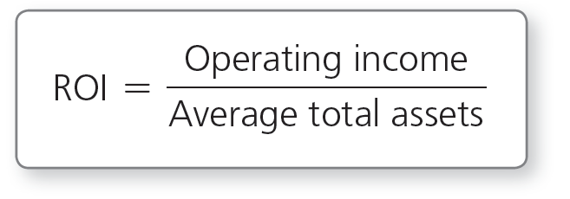
Return on Investment
Return on investment (ROI) is one of the most commonly used KPIs for evaluating an investment center’s financial performance.
ROI is a measure of profitability and efficiency.
Notes:
Return on investment (ROI) is one the most commonly used KPIs for evaluating an investment center’s financial performance. ROI is a measure of profitability and efficiency. Companies typically define ROI as follows: Operating income / Average total assets. ROI measures the amount of operating income an investment center earns relative to the amount of its average total assets.

Slide 34
Return on Investment
Each division of Smart Touch Learning has ROI calculated as follows:
Notes:
Although the Tablet Computer Division has a higher operating income than the e-Learning Division, the Tablet Computer Division is actually less profitable than the e-Learning Division when we consider that the Tablet Computer Division does not utilize its average total assets as efficiently.

Slide 35
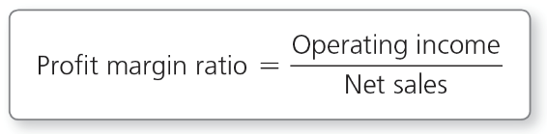
Return on Investment
Profit margin ratio is a measure of profitability.
Each division’s profit margin ratio is calculated as follows:
Notes:
To determine what is driving a division’s ROI, management often restates the ROI equation in its expanded form. Return on investment equals the profit margin ratio times the asset turnover ratio. The expanded form of return on investment reveals that profitability and the efficiency of asset usage are driving the ratio.
The profit margin ratio is a profitability measure that shows how much operating income is earned on every dollar of net sales. Profit margin ratio = Operating income / Net sales. To increase the profit margin ratio, management must increase the operating income earned on every dollar of sales. Management may cut product costs or selling and administrative costs, but it needs to be careful when trimming costs. Cutting costs in the short-term can hurt long-term ROI.
The e-Learning Division has a profit margin ratio of 6%, meaning that it earns operating income of $0.06 on every $1.00 of sales. The Tablet Computer Division, however, is much more profitable, with a profit margin ratio of 19%, earning $0.19 on every $1.00 of sales.

Slide 36
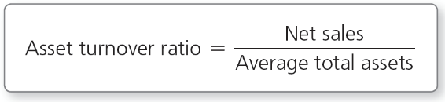
Return on Investment
Asset turnover ratio is a measure of efficiency.
Each division’s asset turnover ratio is calculated as follows:
Notes:
The asset turnover ratio measures how efficiently a business uses its average total assets to generate sales. Asset turnover ratio = Net sales / Average total assets. If managers are not satisfied with their division’s asset turnover ratio rate, how can they improve it? They might try to eliminate nonproductive assets, such as by being more aggressive in collecting accounts receivables, decreasing inventory levels, or disposing of unnecessary plant assets.
The e-Learning Division has an asset turnover ratio of 3. This means that the e-Learning Division generates $3.00 of sales with every $1.00 of average total assets. The Tablet Computer Division’s asset turnover ratio is only 0.81. The Tablet Computer Division generates only $0.81 of sales with every $1.00 of average total assets. The e-Learning Division uses its average total assets much more efficiently in generating sales than the Tablet Computer Division.
ROI has one major drawback: Evaluating division managers solely on ROI gives them an incentive to adopt only projects that will maintain or increase their current ROI.

Slide 37
Residual Income (RI)
Residual income (RI) is another commonly used KPI for evaluating an investment center’s financial performance.
RI considers both the division’s operating income and average total assets.
RI achieves goal congruence better than ROI.
Notes:
Residual income (RI) is another commonly used KPI for evaluating an investment center’s financial performance. Similar to ROI, RI considers both the division’s operating income and its average total assets. RI considers both the division’s profitability and the efficiency with which the division uses its average total assets. RI also incorporates another piece of information: top management’s target rate (such as the 16% target rate of return in the previous example). The target rate of return is the minimum acceptable rate of return that top management expects a division to earn with its average total assets.

Slide 38
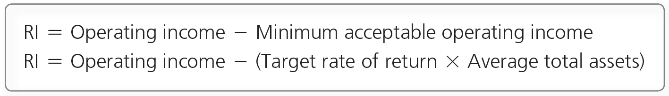
Residual Income (RI)
RI is a measure of profitability and efficiency computed as actual operating income less a specified minimum acceptable operating income.
The acceptable operating income is the target rate of return times average total assets.
Notes:
Residual income (RI) is a measure of profitability and efficiency computed as actual operating income less a specified minimum acceptable operating income. RI compares the division’s actual operating income with the minimum operating income expected by top management, given the size of the division’s average total assets. RI is the “extra” operating income above the minimum operating income. A positive RI means that the division’s operating income exceeds management’s target rate of return. A negative RI means the division is not meeting the target rate of return.

Slide 39
Residual Income (RI)
RI for the e-Learning Division:
RI for the Tablet Computer Division:
Notes:
The positive RI indicates that the e-Learning Division exceeded top management’s 16% target rate of return expectations. The RI calculation also confirms what we learned about the e-Learning Division’s ROI. Recall that the e-Learning Division’s ROI was 18%, which is higher than the target rate of return of 16%.
The Tablet Computer Division’s RI is negative. This means that the Tablet Computer Division did not use its average total assets as effectively as top management expected. Recall that the Tablet Computer Division’s ROI of 15% fell short of the target rate of return of 16%.
A company may prefer to use RI over ROI for performance evaluation because RI is more likely than ROI to lead to goal congruence.

Slide 40
Notes:
Exhibit 24-8 summarizes the KPIs for investment centers.

Slide 41
Limitations of Financial
Performance Measures
Management should keep in mind the drawbacks of ROI and RI:
  Measurement issues:
    Average total assets are measured at a point in time.
    Nonproductive assets may be ignored in calculating average total assets.
  Short-term focus:
    Decisions that benefit the company in the long-term may be ignored for short-term gains.
Notes:
A company may prefer to use RI over ROI for performance evaluation because RI is more likely than ROI to lead to goal congruence. Recall that total assets is a balance sheet amount, which means that it is a snapshot at any given point in time. Because the total assets amount will be different at the beginning of the period than at the end of the period, most companies choose to use a simple average of the two amounts in their ROI and RI calculations. Not all assets are used in ROI and RI as nonproductive assets may skew the ROI and RI results.
One serious drawback of financial performance measures is their short-term focus. Companies usually prepare responsibility reports and calculate ROI and RI figures over a one-year time frame or less. If upper management uses a short time frame, division managers have an incentive to take actions that will lead to an immediate increase in these measures, even if such actions may not be in the company’s long-term interest.

Slide 42
Learning Objective 5
Determine how transfer pricing affects decentralized companies

Slide 43
HOW DO TRANSFER PRICES AFFECT DECENTRALIZED COMPANIES?
When companies decentralize, one responsibility center may transfer goods to another responsibility center within the company.
The transfer price is the transaction amount for one unit of goods when the transaction occurs between divisions within the same company.
Notes:
When companies decentralize, one responsibility center may transfer goods to another responsibility center within the company. For example, the e-Learning Division at Smart Touch Learning transfers e-learning software to the Tablet Computer Division. When this happens, a transaction must be recorded for each division, and the company must determine the amount of the transaction. The transfer price is the transaction amount of one unit of goods when the transaction occurs between divisions within the same company.

Slide 44
Objectives in Setting Transfer Prices
There are two main objectives in setting transfer prices:
  To achieve goal congruence by selecting a price that will maximize overall company profits
  To evaluate the managers of the responsibility centers involved
Notes:
The primary objective in setting transfer prices is to achieve goal congruence by selecting a price that will maximize overall company profits. A secondary objective is to evaluate the managers of the responsibility centers involved.

Slide 45
Setting Transfer Prices
The transfer price can be in a range that extends from:
  Variable cost to outside market price
The minimum transfer price is the variable cost per unit.
The maximum transfer price is the outside market price.
Notes:
When setting the transfer price, division managers usually consider two factors: (1) the variable cost to make the unit transferred and (2) the market price they could get if they sold the unit outside the company. The transfer price can be in the range from variable cost per unit to outside market price per unit.
The e-Learning Division of Smart Touch Learning develops and sells courses in accounting, economics, marketing, and management. The courses sell for $100 each; therefore, the market price is $100. Based on current production, the total cost of production is $80, of which $60 is variable cost and $20 is fixed costs. The range for the transfer price is the variable cost of $60 per unit to the outside sales price of $100 per unit. The transfer price can be $60 to $100.

Slide 46
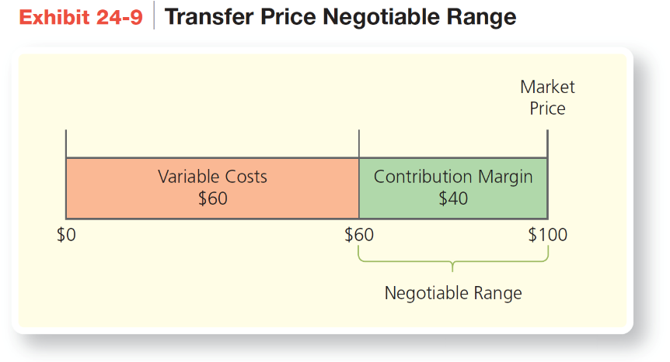
Setting Transfer Prices
Notes:
The transfer price should be an amount between the market price of $100 and the variable cost of $60. The Tablet Computer Division would not be willing to pay more than the $100 as that is the amount the product can be purchased for in the market. The e-Learning Division would not be willing to sell for less than $60 because any amount less than that will cause a negative contribution margin. The range of $60 to $100 is the negotiable range for the transfer price. Exhibit 24-9 illustrates the negotiable range using the e-Learning Division of Smart Touch Learning.

Slide 47
Operating at Capacity
If the selling division is operating at capacity, we use the outside sales price, the market-based transfer price.
An opportunity cost is the benefit given up by choosing an alternative course of action.
Notes:
If the selling division is operating at capacity, it is producing and selling all the courses it is capable of without expanding the facility and adding more employees and/or equipment. In this case, the division has to make a choice about whom to sell to: customers outside the company or the Tablet Computer Division. Because the division has a choice of customers, the transfer price should be a market-based transfer price. The market-based transfer price is a transfer price based on the current market value of the goods. If the e-Learning Divisions sells for less than the market price, then it will have a decrease in contribution margin, and company profits will decrease. The lost contribution margin becomes an opportunity cost for the division. An opportunity cost is the benefit given up by choosing an alternative course of action.

Slide 48
Operating Below Capacity
If the selling division has excess capacity, the division should use a cost-based transfer price.
Other issues:
  Tax consequences between international locations
  Difficulty determining market price in some cases
Notes:
If the e-Learning Division is operating below capacity, then it should be willing to sell courses to the Tablet Computer Division at any amount equal to or above the variable cost of $60. Selling at any price above $60 will create more contribution margin for the division to help cover fixed costs and therefore increase profits. A cost-based transfer price is a transfer price based on the cost of producing the goods.

Slide 49


