Slide 1


Chapter 23
Flexible Budgets and Standard
Cost Systems

Slide 2
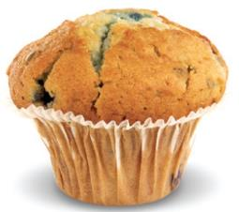
Chapter 23 Learning Objectives
Prepare flexible budgets and performance reports using static and flexible budgets
Identify the benefits of a standard cost system and understand how standards are set

Slide 3
Chapter 23 Learning Objectives
Compute the standard cost variances for direct materials and direct labor
Compute the standard cost variances for manufacturing overhead

Slide 4
Chapter 23 Learning Objectives
Describe the relationship among and responsibility for the product cost variances
Record transactions in a standard cost system and prepare a standard cost income statement

Slide 5
Learning Objective 1
Prepare flexible budgets and performance reports using static and flexible budgets

Slide 6
HOW DO MANAGERS USE BUDGETS TO CONTROL BUSINESS ACTIVITIES?
Managers use budgets for planning and controlling business activities.
The master budget focuses on the planning step.
The controlling step involves the decisions managers make during and after the budgeting period, based on the actual results.
Notes:
Previously, we discussed how managers use budgets for planning and controlling business activities. The master budget focuses on the planning step. In this chapter, we focus on the controlling step, as we look at the decisions managers make during and after the budgeting period, based on actual results. Managers may ask: (1) Did my division meets its sales goals? (2) Have costs increased? and (3) Sales have dropped, so how do we need to adjust spending?
Businesses often have to make difficult decisions. An economic downtown or increased competition may cause a decrease in sales. In such a situation, spending must also decrease in order for the company to remain profitable.

Slide 7
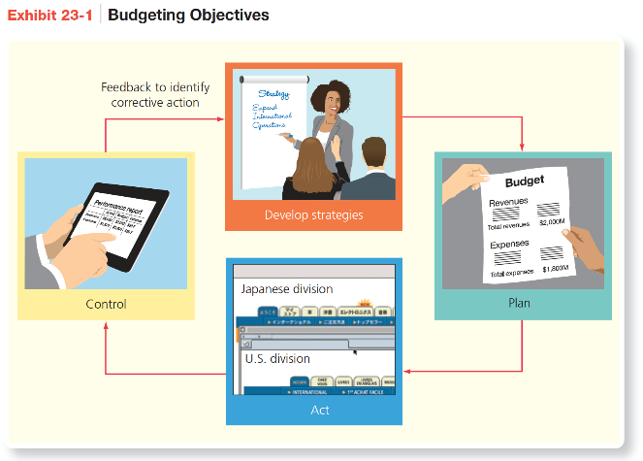
HOW DO MANAGERS USE BUDGETS TO CONTROL BUSINESS ACTIVITIES?
Notes:
Exhibit 23-1 illustrates budgeting objectives discussed in a prior chapter.

Slide 8
Performance Reports Using
Static Budgets
The master budget is a static budget, which means it is prepared for only one level of sales volume.
A budget performance report is a report that summarizes the actual results, budgeted amounts, and the differences.
A variance is the difference between an actual amount and the budgeted amount.
A static budget variance is the difference between actual results and the expected results in the static budget.
Notes:
A static budget is a budget prepared for only one level of sales volume. A static budget does not change after it is developed. A budget performance report is a report that summarizes the actual results, budgeted amounts, and the differences. A variance is the difference between an actual amount and a budgeted amount. A variance is considered favorable if it increases operating income and unfavorable if it decreases operating income. A static budget variance is the difference between actual results and the expected results in the static budget.
This chapter shows how managers use variances to control business activities. It is important to know why actual amounts differ from the budget. Knowing this enables managers to identify problems and decide what action to take.

Slide 9
Performance Reports Using
Static Budgets
Variances are:
  Favorable (F) if an actual amount increases operating income:
    Actual revenue > Budgeted revenue
    Actual expense < Budgeted expense
  Unfavorable (U) if an actual amount decreases operating income:
    Actual revenue < Budgeted revenue
    Actual expense > Budgeted expense
Notes:
The variances in the third column of Exhibit 23-2 are favorable (indicated by an F) if an actual amount increases operating income. This occurs when actual revenue is greater than budgeted revenue or when an actual expense is less than a budgeted expense. A variance is unfavorable (indicated by a U) when an actual amount decreases operating income. This occurs when actual revenue is less than budgeted revenue or when an actual expense is greater than a budgeted expense.

Slide 10
Performance Reports Using
Flexible Budgets
Notes:
The variances in Exhibit 23-2 are called static budget variances. A static budget variance is the difference between actual results and the expected results in the static budget. Cheerful Colors’s static budget variance for operating income is favorable primarily because Cheerful Colors sold 52,000 batches of crayons rather than the 50,000 batches it budgeted to sell during 2019. But there is more to this story. A static budget performance report is useful in evaluating a manager’s effectiveness when the actual level of sales closely approximates the budgeted amount. It is also useful in evaluating the manager’s ability to control fixed manufacturing costs and fixed selling and administrative expenses.
A static budget performance report, though, is not helpful in evaluating variable costs because as production changes, variable costs should change accordingly. Cheerful Colors needs a better tool to examine budgeted income at different sales levels.

Slide 11
Preparing Flexible Budgets
A flexible budget summarizes revenues and expenses for various levels of sales volume within a relevant range.
Flexible budgets separate variable costs from fixed costs.
The variable costs put the flex in the flexible budget.
Notes:
A flexible budget summarizes revenues and expenses for various levels of sales volume within a relevant range. A flexible budget is a budget prepared for various levels of sales volume. Flexible budgets separate variable costs from fixed costs; the variable costs put the flex in the flexible budget.

Slide 12
Preparing Flexible Budgets
To create a flexible budget, you need:
Budgeted selling price per unit
Budgeted variable cost per unit
  Budgeted product costs
  Budgeted variable selling and administrative expenses
Total budgeted fixed costs
  Budgeted fixed manufacturing overhead costs
  Budgeted fixed selling and administrative expenses
Different volume levels within the relevant range
Notes:
To create a flexible budget, you need to know the following:
Budgeted selling price per unit
Budgeted variable cost per unit
Budgeted product costs
Budgeted direct materials
Budgeted direct labor
Budgeted variable manufacturing overhead costs
Budgeted variable selling and administrative expenses
Total budgeted fixed costs
Budgeted fixed manufacturing overhead costs
Budgeted fixed selling and administrative expenses
Different volume levels within the relevant range

Slide 13
Preparing Flexible Budgets
Notes:
Exhibit 23-3 is a flexible budget for Cheerful Colors’s revenues and expenses that predicts what will happen if sales reach 48,000 batches, 50,000 batches, or 52,000 batches of crayons during 2019. The budgeted sales price per batch is $7.50. Budgeted variable costs are $1.75 for direct materials, $3.00 for direct labor, $0.75 for variable manufacturing overhead, and 5% of sales revenue for selling and administrative supplies. Budgeted fixed costs are $25,000 for manufacturing overhead and $22,500 for selling and administrative.
Notice in Exhibit 23-3 that sales revenue, variable costs, and contribution margin increase as more batches of crayons are sold, but fixed costs remain constant, regardless of the number of crayons sold within the relevant range of 48,000 to 52,000 batches. This is an important distinction to remember about flexible budgets. Because total fixed costs remain constant within a specific relevant range of output, fixed costs do not change on a flexible budget. Variable costs, in total, do change.

Slide 14
Budget Variances
Managers want to know why a variance occurred.
  A flexible budget variance is the difference between actual results and expected results in the flexible budget for actual units sold.
  A sales volume variance is the difference between expected results in the flexible budget for the actual units sold and the static budget.
Notes:
It is not enough to know that a variance occurred. Managers must know why a variance occurred in order to pinpoint problems and take corrective action. As noted in Exhibit 23-2, the static budget underestimated both sales and total variable costs. These differences are caused by two primary factors: There is a difference in prices or costs and/or there is a difference in volume. To develop more useful information, managers divide the static budget into two broad categories: the flexible budget variance and the sales volume variance. The flexible budget variance is the difference between actual results and the expected results in the flexible budget for the actual units sold. The sales volume variance is the difference between the expected results in the flexible budget for the actual units sold and the static budget.

Slide 15
Budget Variances
Notes:
Exhibit 23-4 diagrams the flexible budget and sales volume variances. The flexible budget variance is the difference between the actual results and the flexible budget, whereas the sales volume variance is the difference between the flexible budget and the static budget. The combination of the flexible budget and sales volume variances is the total static budget variance.

Slide 16
Budget Variances
Notes:
Exhibit 23-5 is Cheerful Colors’s flexible budget performance report for 2019. Recall that the variances in the second and fourth columns of Exhibit 23-5 are:
• Favorable (F) if an actual amount increases operating income
• Unfavorable (U) if an actual amount decreases operating income
Column 1 of the performance report shows the actual results—based on the 52,000 batches of crayons actually sold. These amounts were originally shown in Exhibit 23-2 and are not based on the budget amounts per unit but are the actual operating revenues and expenses for the period. Actual operating income is $36,320 for 2019.
Column 2 is the flexible budget variance and shows that operating income is $680 less than Cheerful Colors expected for 52,000 batches of crayons. Managers want to know why operating income did not match the flexible budget.
Column 3 is Cheerful Colors’s flexible budget (as shown in Exhibit 23-3) for the 52,000 batches actually sold. Operating income should have been $37,000, based on that level of sales.
Column 4 is the sales volume variance. The differences arise only because Cheerful Colors sold 52,000 batches of crayons rather than the 50,000 batches it planned to sell.
Column 5 (originally shown in Exhibit 23-2) gives the static budget for the 50,000 batches expected to have been sold in 2019. Cheerful Colors budgeted earnings of $33,750 before the budgeting period began.

Slide 17
Learning Objective 2
Identify the benefits of a standard cost system and understand how standards
are set

Slide 18
WHY DO MANAGERS USE
A STANDARD COST SYSTEM TO CONTROL BUSINESS ACTIVITIES?
Most companies use standards to develop budgets.
A standard is the price, cost, or quantity that is expected under normal conditions.
A standard cost system is an accounting system that uses standards for product costs.
Notes:
Most companies use standards to develop budgets. A standard is the price, cost, or quantity that is expected under normal conditions. For example, based on Exhibit 23-5, Cheerful Colors expects the direct materials to cost $1.75 per batch of 100 crayons. Therefore, the standard cost for direct materials is $1.75, and that was the amount used to develop both the static and flexible budgets. The terms standard and budget are sometimes used interchangeably. However, a budget amount generally indicates a total amount, whereas a standard amount is a per unit amount. In the case of direct materials, the standard is $1.75 per batch and the budgeted amount for 52,000 batches is $91,000 ($1.75 per batch × 52,000 batches).
Cheerful Colors uses a standard cost system, which is an accounting system that uses standards for product costs—direct materials, direct labor, and manufacturing overhead. Each input has both a cost standard and an efficiency standard. For example, Cheerful Colors has a standard for the cost it pays per pound of paraffin wax. This determines the cost standard. The company also has a standard for the amount of wax it uses for making the crayons. This determines the efficiency standard.

Slide 19
Setting Standards
Notes:
Exhibit 23-6 summarizes the setting of standard costs. Setting standards can be the most difficult part of using a standard cost system. Setting standards requires coordination and communication among different divisions and functions. For example, the cost standard for direct materials starts with the base purchase cost of each unit of Raw Materials Inventory. Accountants help managers set a cost standard for materials after considering purchase discounts, freight in, and receiving costs. Companies can work with reliable vendors to build relationships that ensure quality and on-time delivery of materials at an affordable cost.
For direct labor, accountants work with human resource managers to determine the cost standard for direct labor. They must consider basic pay rates, payroll taxes, and fringe benefits. Job descriptions reveal the level of experience needed for each task. A big part of this process is ensuring that employees receive training for the job and are paid fairly for the job. Accountants work with production managers to estimate manufacturing overhead costs. Production managers identify an appropriate allocation base such as direct labor hours or direct labor cost, or they allocate overhead using activity-based costing. Accountants then compute the standard overhead allocation rates.

Slide 20
Cost Standards
Notes:
Exhibit 23-7 computes Cheerful Colors’s cost standards for direct materials, direct labor, and manufacturing overhead based on the static budget of 50,000 batches of crayons. The manager in charge of purchasing for Cheerful Colors indicates that the purchase price, net of discounts, is $1.65 per pound of paraffin. Delivery, receiving, and inspection add an average of $0.10 per pound. Cheerful Colors’s hourly wage for workers is $10.00, and payroll taxes and fringe benefits total $2.00 per direct labor hour. Variable manufacturing overhead will total $37,500, based on 50,000 batches of crayons (static budget), fixed manufacturing overhead is $25,000, and overhead is allocated based on 12,500 estimated direct labor hours.

Slide 21
Efficiency Standards
Production managers and engineers set direct materials and direct labor efficiency standards.
Labor standards are established from analyzing the production process.
Efficiency standards are based on best practices, called benchmarking.
Notes:
Cheerful Colors has analyzed the manufacturing process and has set efficiency standards. Production managers and engineers set direct materials and direct labor efficiency standards. Efficiency standards are also called quantity standards or usage standards because they are a measure of how much input should be put into the manufacturing process. In other words, if employees are working efficiently, without spilling or otherwise wasting materials, how much paraffin should Cheerful Colors put into each batch of crayons, the output? That amount is the direct materials efficiency standard.
To set labor standards, companies can analyze every moment in the production process and then take steps to eliminate inefficiencies. For example, to eliminate unnecessary work, machines can be rearranged for better work flow and less materials handling. Companies can also conduct time-and-motion studies to streamline various tasks. For example, a plant can install a conveyer at waist height to minimize bending and lifting. Companies often develop efficiency standards based on best practices. This is often called benchmarking. The best practice may be an internal benchmark from other plants or divisions within the company, or it may be an external benchmark from other companies. Internal benchmarks are easy to obtain, but managers can also purchase external benchmark data.
Manufacturing overhead is allocated based on direct labor hours, and the efficiency standards for expected direct labor hours has been established, so no additional efficiency standards are required for manufacturing overhead.

Slide 22
Standard Cost System Benefits
Standard costing helps managers:
Prepare the master budget
Set target levels of performance for flexible budgets
Identify performance standards
Set sales prices of products and services
Decrease accounting costs
Notes:
Surveys show that the use of standard cost systems is widespread in manufacturing companies in the United States and around the world. Standard costing helps managers prepare the master budget, set target levels of performance for flexible budgets, identify performance standards, set sales prices of products and services, and decrease accounting costs.
Standard cost systems might appear to be expensive. Indeed, the company must invest up front to develop the standards, and standards must be updated on a regular basis—at least once per year. But standards can save accounting costs. When integrated with the company’s Enterprise Resource Planning (ERP) system, businesses can easily keep track of inventory costs, determine cost and efficiency variances, and make real-time decisions.

Slide 23
Variance Analysis for Product Costs
Notes:
Once standards are established, managers can use the standards to assign costs to production. At least once per year, managers compare the actual production costs to the standard costs to locate variances. Exhibit 23-8 shows the formulas for computing the cost and efficiency variances.

Slide 24
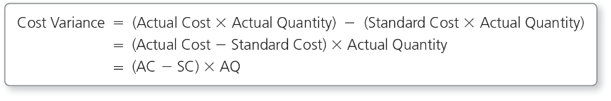
Variance Analysis for Product Costs
A cost variance measures how well the business keeps unit cost of material and labor inputs within standards.
The cost variance is the difference in costs of an input multiplied by the actual quantity used of the input.
Notes:
A cost variance measures how well the business keeps unit costs of material and labor inputs within standards. As the name suggests, the cost variance is the difference in costs, or actual cost per unit less the standard cost per unit, of an input, multiplied by the actual quantity used of the input. For example, if the actual cost are higher than the standard, the variance is unfavorable.

Slide 25
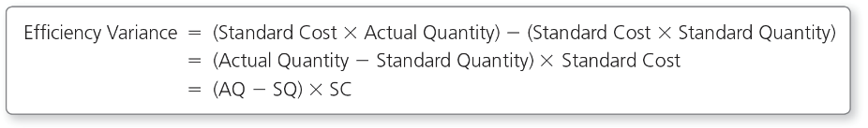
Variance Analysis for Product Costs
An efficiency variance measures how well the business uses its materials or human resources.
The efficiency variance is the difference in the quantities multiplied by the standard cost per unit of the input.
Notes:
An efficiency variance measures how well the business uses its materials or human resources. The efficiency variance measures the difference in quantities, or actual quantity of input used less the standard quantity of input allowed for the actual number of units produced, multiplied by the standard cost per unit of the input. For example, if the actual quantity exceeds the standard quantity, the variance is unfavorable.

Slide 26
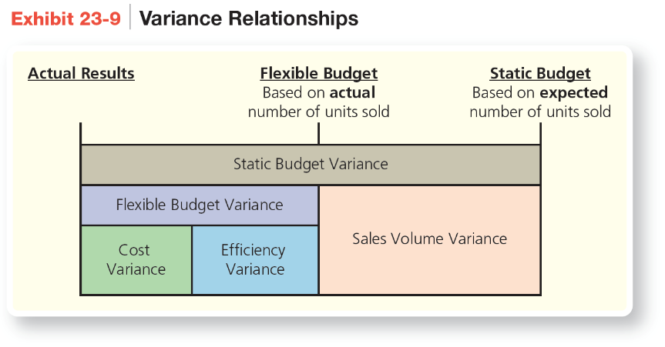
Variance Analysis for Product Costs
Notes:
Exhibit 23-9 shows the relationship among variances and how to separate total flexible budget variances for materials and labor into cost and efficiency variances. Exhibit 23-9 emphasizes two points. First, the cost and efficiency variances add up to the flexible budget variance. Second, static budgets play no role in the cost and efficiency variances. The static budget is used only to compute the sales volume variance, the variance caused because the company sold a different quantity than it thought it would sell when it created the budget. It is never used to compute the flexible budget variance or the cost and efficiency variances for materials and labor.

Slide 27
Learning Objective 3
Compute the standard cost variances for direct materials and direct labor

Slide 28
HOW ARE STANDARD COSTS USED TO DETERMINE DIRECT MATERIALS AND DIRECT LABOR VARIANCES?
Notes:
Now we’ll return to our Cheerful Colors example. Exhibit 23-5, the flexible budget performance report, shows several substantial flexible budget variances, including a $13,000 unfavorable variance for direct materials and a $10,400 favorable variance for direct labor. Exhibit 23-10 summarizes the flexible budget variances for the production costs.
Both favorable and unfavorable variances should be investigated, if substantial, to determine their causes. As an example, suppose a company avoided routine maintenance on machinery in order to have a favorable cost variance in the current period. In a later period, the company could have a major breakdown that could have been avoided if the machinery had been properly maintained. The breakdown could require not only a substantial repair bill but also a halt in production that could lead to lost sales. Therefore, managers should look at any variance that is significant.

Slide 29
Direct Materials Variances
The flexible budget variance for direct materials is $13,000 unfavorable.
Additional data concerning direct materials follow, including standards discussed in the previous section:
Notes:
The flexible budget variance for direct materials is $13,000 unfavorable. This slide presents additional data concerning direct materials, including standards discussed in the previous section.

Slide 30
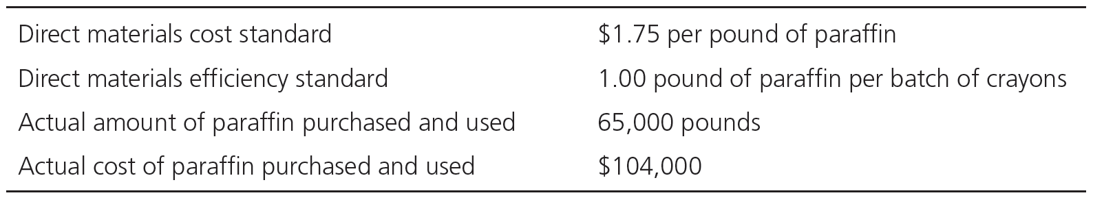
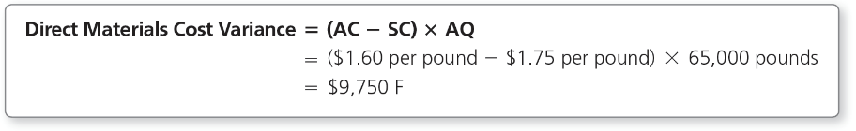
Direct Materials Cost Variance
The direct materials cost variance is $9,750 favorable.
Notes:
The flexible budget variance for direct materials is $13,000 unfavorable. Using the additional information, we can determine that Cheerful Colors paid less than expected for the paraffin. The actual cost per pound of paraffin is $1.60 ($104,000 / 65,000 pounds = $1.60 per pound). Using the formula, the direct materials variance is $9,750 favorable. The direct materials cost variance is favorable because the purchasing department paid less than the standard cost for paraffin.

Slide 31
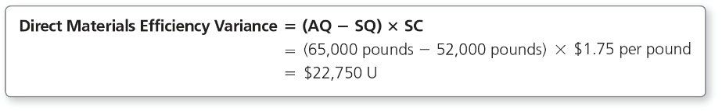
Direct Materials Efficiency Variance
The direct materials efficiency variance is $22,750 unfavorable.
The variance is unfavorable because workers used more paraffin than planned for 52,000 batches of crayons.
Notes:
To calculate the direct materials efficiency variance, the standard quantity of inputs has to be determined. The standard quantity of inputs is the quantity that should have been used for the actual units produced. For Cheerful Colors, the standard quantity of inputs (paraffin) that workers should have used for the actual number of crayon batches produced is 52,000 pounds (1.00 pound per batch × 52,000 batches). The direct materials efficiency variance is unfavorable because workers used more paraffin that they planned (budget) to use for 52,000 batches of crayons.

Slide 32
Summary of Direct Materials Variance
Notes:
Exhibit 23-11 summarizes how Cheerful Colors divides the $13,000 unfavorable direct materials flexible budget variance into its cost and efficiency components.
Note that favorable and unfavorable variances are netted together in the same way debits and credits are netted together. Favorable variances are added together to create a total favorable variance. Unfavorable variances are added together to create a total unfavorable variance. But if a favorable variance and an unfavorable variance exist, the variances are subtracted from each other. The variance is determined to be favorable or unfavorable based on which one is the larger amount.
In summary, Cheerful Colors spent $13,000 more than it should have for paraffin for two reasons. First, workers used 13,000 pounds of paraffin more than expected. The inefficient use of the paraffin reduced profits by $22,750, as shown by the unfavorable efficiency variance. Second, Cheerful Colors paid $1.60 per pound of paraffin instead of the standard rate of $1.75 per pound, for a favorable cost variance.
Let’s consider why each variance may have occurred and who may be responsible. The purchasing manager is in the best position to explain the favorable cost variance. Cheerful Colors’s purchasing manager may have negotiated a lower cost for paraffin. The production manager in charge of making crayons can explain why workers used so much paraffin to make the 52,000 batches of crayons. Was the paraffin of lower quality that caused crayons to be rejected? Did workers waste materials? Did the production equipment malfunction? Cheerful Colors’s top management needs this type of information to decide what corrective action to take.

Slide 33
Direct Labor Variances
Cheerful Colors uses a similar approach to analyze the direct labor flexible budget variance. The flexible budget variance for direct labor is $10,400 favorable, as shown in Exhibit 23-10.
Additional data concerning direct labor follow, including standards discussed in the previous section:
Notes:
Cheerful Colors uses a similar approach to analyze the direct labor flexible budget variance. The flexible budget variance for direct labor is $10,400 favorable, as shown in Exhibit 23-10.
This slide shows additional data concerning direct labor, including standards discussed in the previous section.

Slide 34
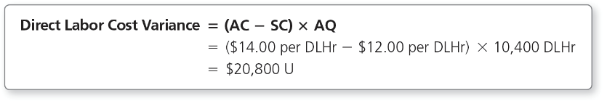
Direct Labor Cost Variance
The direct labor cost variance is $20,800 unfavorable.
The $20,800 direct labor cost variance is unfavorable because Cheerful Colors paid worker $2.00 more per hour than budgeted ($14.00 actual cost – $12.00 standard cost).
Notes:
The flexible budget variance for direct labor is $10,400 favorable. Using the additional information, we can determine that Cheerful Colors paid more than expected for direct labor. The actual cost per hour of direct labor is $14.00 ($145,600 / 10,400 DLHr = $14.00 per DLHr). The $20,800 direct labor cost variance is unfavorable because Cheerful Colors paid worker $2.00 more per hour than budgeted ($14.00 actual cost – $12.00 standard cost).

Slide 35
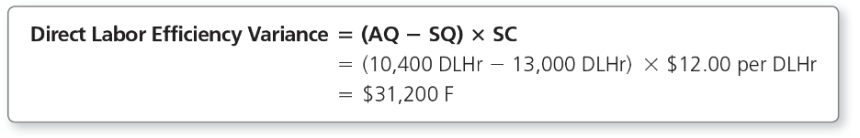
Direct Labor Efficiency Variance
The direct labor efficiency variance is $31,200 favorable.
The direct labor efficiency variance is favorable because laborers worked fewer hours than budgeted to produce 52,000 batches of crayons.
Notes:
The standard quantity of direct labor hours that workers should have used to make 52,000 batches of crayons is 0.25 direct labor hours each, or 13,000 total direct labor hours (52,000 batches × 0.25 DLHr per batch). The $31,200 direct labor efficiency variance is favorable because laborers worked fewer hours than budgeted to produce 52,000 batches of crayons.

Slide 36
Summary of Direct Labor Variances
Notes:
Exhibit 23-12 summarizes how Cheerful Colors divides the $10,400 favorable direct labor flexible budget variance into its cost and efficiency components. The $10,400 favorable direct labor variance suggests that total labor costs were significantly less than expectations. To manage Cheerful Colors’s labor costs, we need to gain more insight.
Workers made 52,000 batches of crayons in 10,400 hours instead of the budgeted 13,000 hours, for a favorable efficiency variance. Cheerful Colors paid its employees an average of $14.00 per hour in 2019 instead of the standard rate of $12.00, for an unfavorable cost variance. This situation reveals a trade-off. Perhaps Cheerful Colors hired more experienced, and thus more expensive, workers and had an unfavorable cost variance. However, due to more advanced skills, experience, and/or motivation, the workers turned out more work than expected, and the strategy was successful. The overall effect on profits was favorable.
This possibility reminds us that managers should take care in using variances to evaluate performance. Managers should always carefully analyze the data before taking action.

Slide 37
Learning Objective 4
Compute the standard cost variances for manufacturing overhead

Slide 38
HOW ARE STANDARD COSTS USED TO DETERMINE MANUFACTURING OVERHEAD VARIANCES?
The terms manufacturing overhead and overhead are often used interchangeably.
The total overhead variance is the difference between:
Notes:
In this section, we use the terms manufacturing overhead and overhead interchangeably. The total overhead variance is the difference between actual overhead cost and standard overhead allocated to production. Exhibit 23-10 shows that Cheerful Colors has incurred $30,160 in variable overhead costs and $23,920 in fixed overhead costs. Therefore, total overhead costs incurred are $54,080 ($30,160 + 23,920).

Slide 39
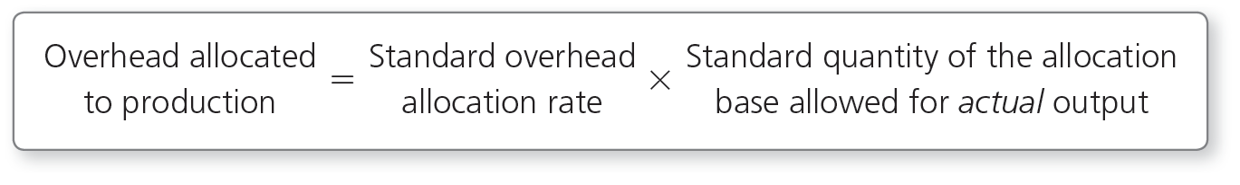
Allocating Overhead in a Standard Cost System
In a standard cost system, the manufacturing overhead allocated to production is as follows:
Notes:
In a standard cost system, the manufacturing overhead is allocated to production by multiplying the standard overhead allocation rate by the standard quantity of the allocation base allowed for actual output. In a standard cost system, the standard overhead allocation rate replaces the predetermined overhead allocation rate illustrated in previous chapters, but the concept is the same. It is a rate calculated during the budgeting process when other standards are determined.

Slide 40
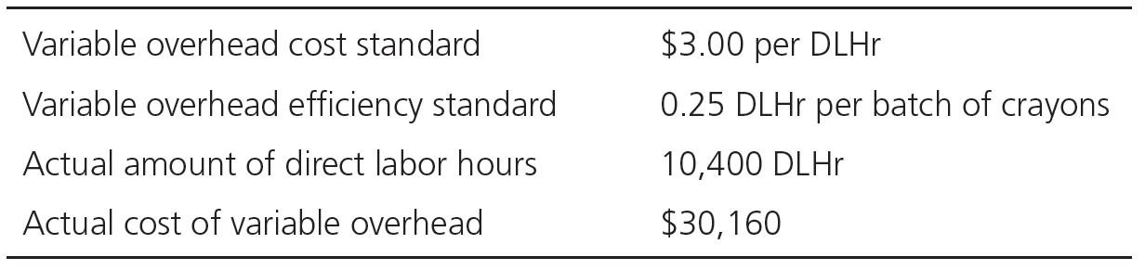
Variable Overhead Variances
The approach to analyze the variable overhead flexible budget variance is similar to the approaches for the other variances.
The information to calculate the overhead variances is as follows:
Notes:
Cheerful Colors uses a similar approach to analyze the variable overhead flexible budget variance as it did to analyze the direct materials and direct labor variances. Remember that direct materials and direct labor are also variable costs, so the approach is similar.

Slide 41
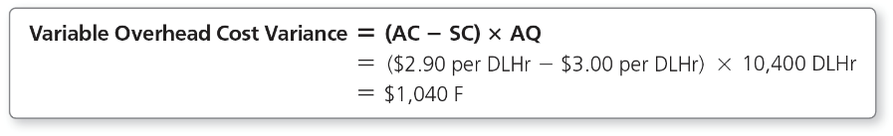
Variable Overhead Cost Variance
The variable overhead cost variance is $1,040 favorable.
Cheerful Colors paid less than expected for variable overhead.
Notes:
Cheerful Colors paid less than expected for variable overhead. The actual cost of variable overhead per hour of direct labor is $2.90 ($30,160 / 10,400 DLHr = $2.90 per DLHr). Using the formula, the variable overhead cost variance is $1,040 favorable. The $1,040 variable overhead cost variance is favorable because Cheerful Colors spent $0.10 less per hour than budgeted ($2.90 actual cost ‒ $3.00 standard cost).

Slide 42
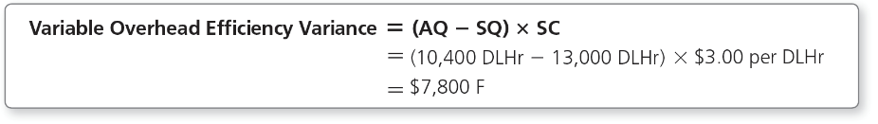
Variable Overhead Efficiency Variance
The variable overhead efficiency variance is $7,800 favorable.
The variance is favorable because the laborers worked less than expected.
Notes:
Because variable overhead is allocated based on direct labor hours used, this variance is also favorable, as the direct labor efficiency variable is favorable. The standard quantity of direct labor hours that workers should have used to make 52,000 batches of crayons is 13,000 total direct labor hours (52,000 batches × 0.25 DLHr per batch). The $7,800 variable overhead efficiency variance is favorable because laborers actually worked 2,600 fewer hours than the flexible budget called for to produce 52,000 batches of crayons, and variable overhead is allocated based on direct labor hours.

Slide 43
Summary of Variable
Overhead Variances
Notes:
Exhibit 23-13 summarizes how Cheerful Colors divides the $8,840 favorable variable overhead flexible budget variance into its cost and efficiency components. The $8,840 favorable variable overhead variance indicates that variable overhead costs were less than expected. To manage Cheerful Colors’s variable overhead costs, we need to get more insight. Cheerful Colors incurred $1,040 less than anticipated in actual variable overhead costs, for a favorable cost variance. Workers made 52,000 batches of crayons in 10,400 hours instead of the budgeted 13,000 hours, for a favorable efficiency variance. Management may decide that the variable overhead cost variance is sufficiently small that it does not warrant investigation. However, management may want to investigate the variance further to determine whether the reduction in costs was controllable or whether the cost standard needs to be updated.

Slide 44
Fixed Overhead Variances
The approach to analyze fixed overhead variances differs from the process used for the variable cost variances.
To analyze fixed overhead costs, we need:
  Actual fixed overhead costs incurred
  Budgeted fixed overhead costs
  Allocated fixed overhead costs
Notes:
The three production costs analyzed so far are variable costs, so the analysis is similar for direct materials, direct labor, and variable overhead. However, Cheerful Colors uses a slightly different approach to analyze the fixed overhead variances. Remember that fixed costs are not expected to change in total within the relevant range, but they do change per unit when there is a change in volume. To analyze fixed costs, we need three amounts: actual fixed overhead costs incurred, budgeted fixed overhead costs, and allocated fixed overhead costs.
Keep in mind that the budgeted amount for fixed overhead is the same in both the static budget and the flexible budget because fixed costs are not expected to change in total when there is a change in volume.

Slide 45
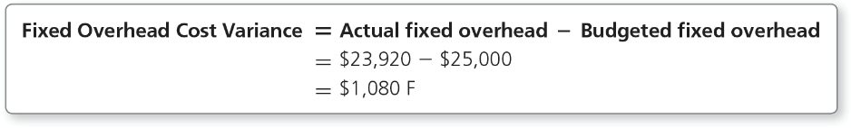
Fixed Overhead Cost Variance
The fixed overhead cost variance measures the difference between actual fixed overhead and budgeted fixed overhead.
Notes:
The fixed overhead cost variance measures the difference between actual fixed overhead and budgeted fixed overhead to determine the controllable portion of total fixed overhead variance. The $1,080 fixed overhead cost variance is favorable because Cheerful Colors actually spent less than budgeted for fixed overhead. Changes in volume do not affect fixed costs; therefore, there is only a cost effect and not an efficiency effect in the fixed overhead flexible budget variance.

Slide 46
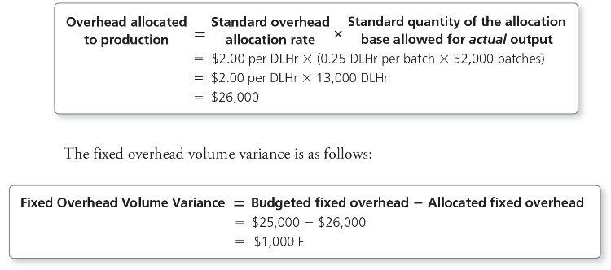
Fixed Overhead Volume Variance
The fixed overhead volume variance is the difference between the budgeted fixed overhead and the amount of fixed overhead allocated.
Notes:
The fixed overhead volume variance measures the difference between the budgeted fixed overhead and the amount of fixed overhead allocated to batches of crayons. Using the standard overhead allocation rate for fixed overhead previously calculated, fixed overhead is allocated at $2.00 per direct labor hour, and each batch of crayons has an efficiency standard of 0.25 direct labor hour per batch.
The $1,000 fixed overhead volume variance is favorable because Cheerful Colors produced more batches than budgeted and, therefore, allocated more overhead to crayon batches than the $25,000 budgeted fixed overhead amount. In other words, based on the standard for fixed overhead, Cheerful Colors has overallocated fixed overhead by $1,000.
The fixed overhead volume variance is not a cost variance—it is a volume variance—and explains why fixed overhead is overallocated or underallocated.

Slide 47
Fixed Overhead Volume Variance
Notes:
Exhibit 23-14 graphs the fixed overhead volume variance. The small blue triangle bordered by the lines representing budgeted fixed overhead, standard fixed overhead allocated, and standard direct labor hours represents the fixed overhead volume variance for this example.

Slide 48
Summary of Fixed Overhead Variances
Notes:
Exhibit 23-15 summarizes the fixed overhead variances. To manage Cheerful Colors’s fixed overhead costs, we need to get more insight. Cheerful Colors incurred $1,080 less than anticipated in fixed overhead costs, for a favorable cost variance. Workers made 52,000 batches of crayons, which was 2,000 batches more than budgeted and resulted in a $1,000 favorable volume variance.
Management may decide that the fixed overhead cost variance is sufficiently small and does not warrant investigation. However, management may want to investigate the variance further to determine whether the reduction in costs was controllable or whether the cost standard needs to be updated.

Slide 49
Learning Objective 5
Describe the relationship among and responsibility for the product cost variances

Slide 50
WHAT IS THE RELATIONSHIP AMONG THE PRODUCT COST VARIANCES, AND WHO IS RESPONSIBLE FOR THEM?
Notes:
Now that we have looked at the individual product cost variances, let’s look at the big picture. Exhibit 23-10 showed the flexible budget variances for the product costs: direct materials, direct labor, and manufacturing overhead. They are duplicated here for easier reference.

Slide 51
Variance Relationships
Notes:
Exhibit 23-16 illustrates the relationships among the various product cost variances. Take time to carefully study the diagram.
Notice that the fixed overhead volume variance is not included in the diagram. As previously stated, this variance is not a flexible budget variance but a volume variance. It shows how allocating fixed costs on a per unit basis causes a difference between budgeted fixed overhead and allocated fixed overhead. The allocation causes the overallocation or underallocation of fixed manufacturing overhead.

Slide 52
Variance Responsibilities
Cheerful Colors should investigate the variances it feels are significant.
A situation called management by exception occurs when managers concentrate on results that are outside the accepted parameters.
  Managers focus on the exceptions.
  Exceptions are either a percentage or dollar amount.
Notes:
Now that all the variances are summarized, Cheerful Colors can investigate the variances it feels are significant. This is called management by exception because managers concentrate on results that are outside the accepted parameters. In other words, managers focus on the exceptions. Exceptions can be expressed as a percentage of a budgeted amount or a dollar amount. Many companies use a combination of percentages and dollar amounts. For example, a company may investigate any variances greater than 10% of the budgeted amount and/or $10,000 or more. Cheerful Colors investigates any variances greater than $5,000 that are the direct materials variances, direct labor variances, and the variable overhead efficiency variance.

Slide 53
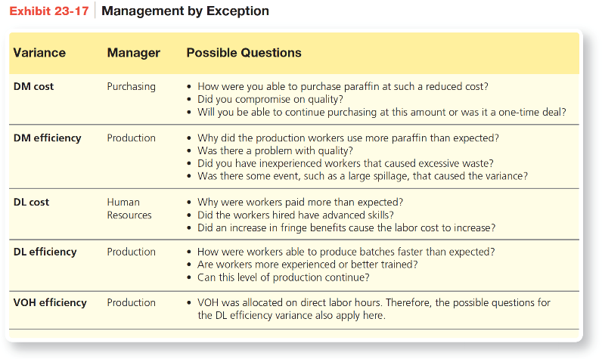
Variance Responsibilities
Notes:
Exhibit 23-17 provides some possible questions Cheerful Colors’s upper management may want to have answered.

Slide 54
Learning Objective 6
Record transactions in a standard cost system and prepare a standard cost income statement

Slide 55
HOW DO JOURNAL ENTRIES DIFFER IN A STANDARD COST SYSTEM?
Using a standard cost system simplifies the recording process because entries are made at standard costs.
Variances are recorded as soon as possible.
Notes:
Using a standard cost system simplifies the recording process because entries are made at standard costs. Management needs to know about variances to address each problem. Therefore, Cheerful Colors records variances from standards as soon as possible. This means that Cheerful Colors records direct materials cost variances when materials are purchased. It also means that Work-in-Process Inventory is debited at standard input quantities and standard costs as crayons are manufactured.

Slide 56
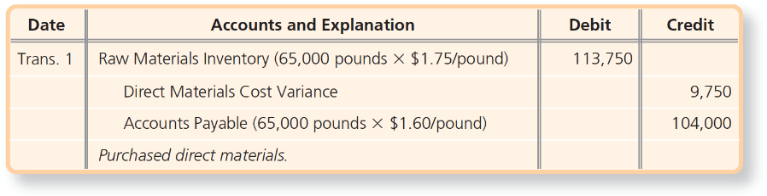
Transaction 1—Direct Materials Purchased
Cheerful Colors records a debit to Raw Materials Inventory for the standard price for the paraffin (65,000 pounds × $1.75).
The favorable variance of $9,750 is also recorded.
Notes:
The journal entry to record direct materials purchased has an emphasis on the cost of the materials. Transaction 1 records the debit to Raw Materials Inventory, which is recorded at the actual quantity of paraffin purchases (65,000 pounds) at the standard cost ($1.75 per pound). In contrast, the credit to Accounts Payable is for the actual quantity of paraffin purchased (65,000 pounds) at the actual cost ($1.60 per pound). This is the actual amount owed to the vendor. Maintaining Raw Materials Inventory at the $1.75 standard cost allows Cheerful Colors to record the direct materials cost variance at the time of purchase. Recall that Cheerful Colors’ direct materials cost variance was $9,750 favorable. A favorable variance has a credit balance and is a contra expense. An unfavorable variance means more expense has been incurred than planned and would have a debit balance.
When recording variances, favorable variances are credited, and unfavorable variances are debited. Remember that variances are considered favorable if they increase operating income—and operating income is increased with credits (such as revenues). Variances are considered unfavorable if they decrease operating income—and operating income is decreased with debits (such as expenses).

Slide 57
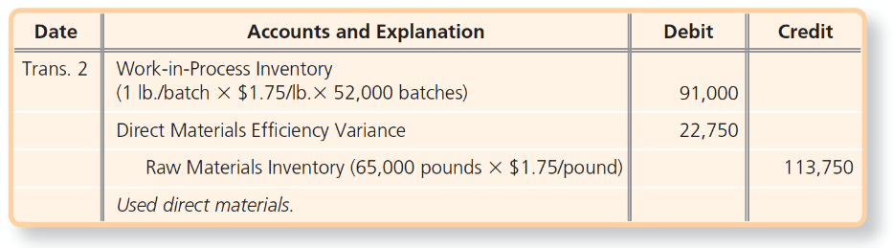
Transaction 2—Direct Materials Usage
When material is transferred to the Work-in-Process Inventory account, the amount at standard cost is the debit, and the unfavorable efficiency variance is recorded.
Notes:
Cheerful Colors debits Work-in-Process Inventory for the standard cost of the 52,000 pounds of direct materials that should have been used to make 52,000 batches of crayons. This maintains Work-in-Process Inventory at standard cost. Raw Materials Inventory is credited for the actual quantity of materials put into production (65,000 pounds) at the standard cost ($1.75 per pound). Cheerful Colors’s direct materials efficiency variance was $22,750 unfavorable. An unfavorable variance has a debit balance, which increases expense and decreases profits.

Slide 58
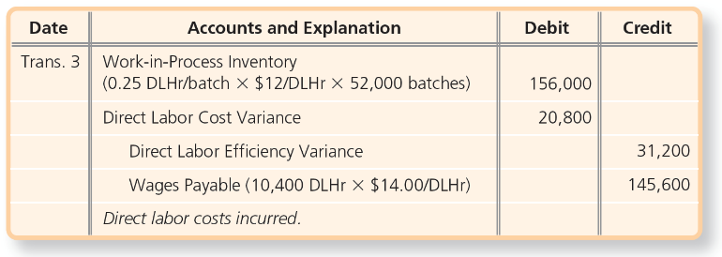
Transaction 3—Direct Labor
Work-in-Process Inventory is debited for the standard costs of the 13,000 direct labor hours.
Wages Payable is credited for the actual cost paid to employees, and the unfavorable direct labor cost variance is recorded, along with a favorable efficiency variance.
Notes:
In Transaction 3, Work-in-Process Inventory is debited for the $12.00 per hour standard cost of 13,000 direct labor hours that should have been used for 52,000 batches, the standard quantity. Wages Payable is credited for the actual cost (the actual hours worked at the actual wage rate) because this is the amount Cheerful Colors must pay the workers. The direct labor cost variance is $20,800 unfavorable, a debit amount. The direct labor efficiency variance is credited for the $31,200 favorable variance. This maintains Work-in-Process Inventory at standard cost.

Slide 59
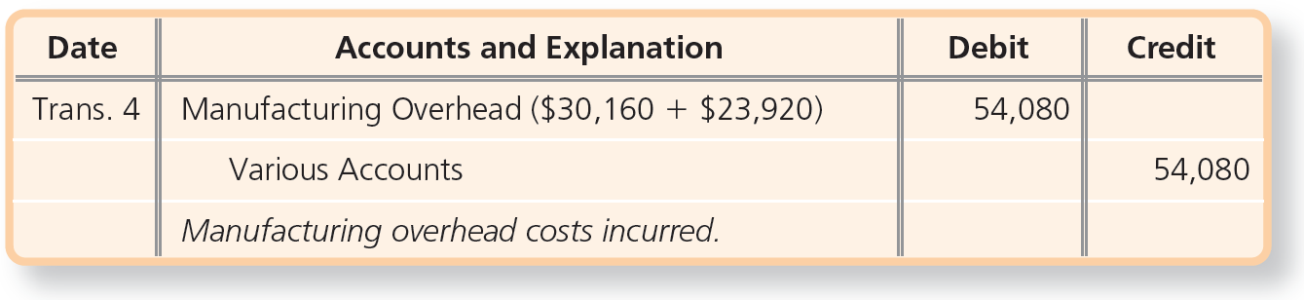
Transaction 4—Overhead Incurred
Manufacturing Overhead is debited for the actual fixed and variable costs of $54,080.
Notes:
Transaction 4 records Cheerful Colors’s actual overhead cost for 2019. Manufacturing Overhead is debited for the actual overhead costs of $54,080, which is the sum of $30,160 actual variable overhead and $23,920 actual fixed overhead. Various accounts may include Cash, Accounts Payable, Accumulated Depreciation, Prepaid Insurance, and other related overhead accounts.

Slide 60
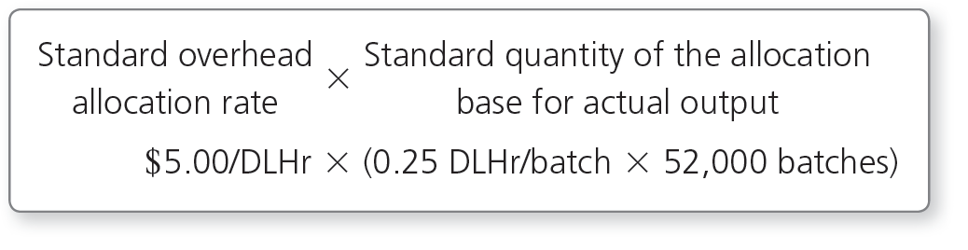
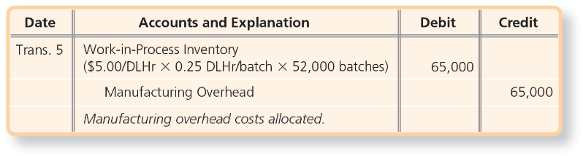
Transaction 5—Overhead Allocated
The amount of overhead allocated and recorded to Work-in-Process Inventory is:
Notes:
Transaction 5 shows the overhead allocated to Work-in-Process Inventory computed as the standard overhead rate of $5.00 per direct labor hour multiplied by the standard quantity of the allocation base for actual output, which is the standard rate of 0.25 direct labor hours per batch multiplied by the actual 52,000 batches sold.

Slide 61
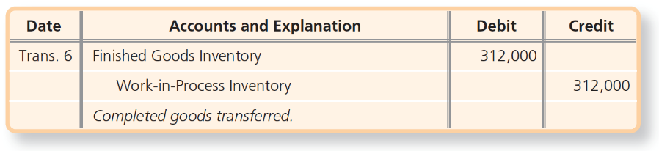
Transaction 6—Completed Goods
The standard cost of the 52,000 batches of crayons completed is transferred from Work-in-Process Inventory to Finished Goods Inventory.
Notes:
Transaction 6 transfers the standard cost of the 52,000 batches of crayons completed during 2019 from Work-in-Process Inventory to Finished Goods Inventory. The amount transferred is the total standard costs for the 52,000 batches: direct materials of $91,000, direct labor of $156,000, and manufacturing overhead of $65,000.

Slide 62
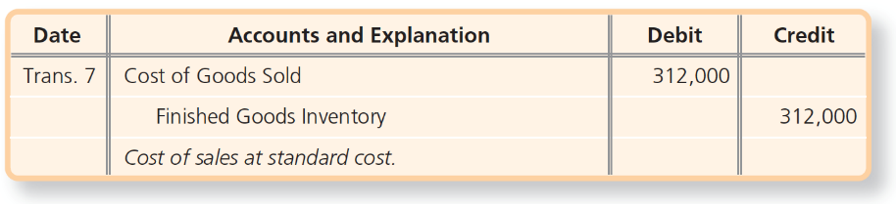
Transaction 7—Cost of Goods Sold
The crayons were sold during 2019, so
the standard costs are transferred from Finished Goods Inventory to Cost of Goods Sold.
Notes:
Transaction 7 transfers the cost of sales of the 52,000 batches completed at standard cost of $6.00 per batch, or $312,000 from Transaction 6 divided by 52,000 batches. This transaction assumes that all batches produced in 2019 were sold in 2019.

Slide 63
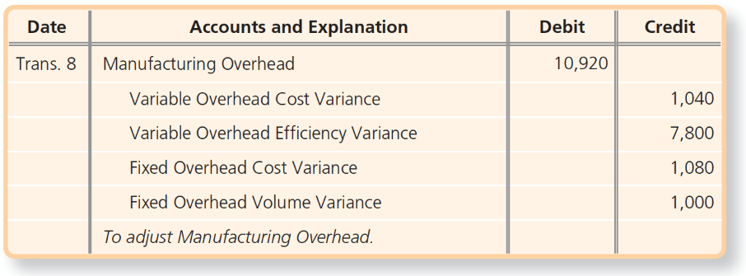
Transaction 8—Adjust Manufacturing Overhead
The Manufacturing Overhead account is adjusted, and the overhead variances are recorded.
Notes:
Transaction 8 adjusts the Manufacturing Overhead account and records the overhead variances. All the manufacturing overhead variances are favorable, so they are all credited. The debit to Manufacturing Overhead indicates that the actual overhead costs debited to the account were less than the allocated amounts credited to the account, and overhead was overallocated. The account, therefore, had a credit balance and has to be debited to bring it to a zero balance. When overhead is underallocated, the adjustment to Manufacturing Overhead is a credit, and the net amount of the overhead variances is unfavorable.

Slide 64
Notes:
Exhibit 23-18 shows the relevant Cheerful Colors accounts after posting these entries.
Notice that the inventory accounts have a zero balance at the end of 2019. That is because we assumed that our fictitious company, Cheerful Colors, used all materials purchased, completed all products started, and sold all products completed.

Slide 65
Standard Cost Income Statement
Notes:
Cheerful Colors’s top management needs to know about the company’s cost variances. Exhibit 23-19 shows a standard cost income statement that highlights the variances for management. The variances with credit balances are shown in parentheses because they are contra expenses and therefore decrease the expense Cost of Goods Sold.
Notice that the operating income shown in Exhibit 23-19 is the same as that shown in Exhibit 23-5, Flexible Budget Performance Report. The standard cost income statement doesn’t alter the actual operating income; it simply emphasizes the variances from standard.
The statement starts with sales revenue at standard and subtracts the unfavorable sales revenue variance of $5,200 from Exhibit 23-5 to yield actual sales revenue. A favorable sales revenue variance would be added.
Next, the statement shows cost of goods sold at standard cost. Then the statement separately lists each manufacturing cost variance, followed by cost of goods sold at actual cost. At the end of the period, all the variance accounts, which are temporary accounts, are closed to zero out their balances.
The income statement shows that the net effect of all the manufacturing cost variances is $8,320 favorable. Therefore, 2019’s operating income is $8,320 more than it would have been if all the actual manufacturing costs had been equal to their standard costs.

Slide 66


