Slide 1
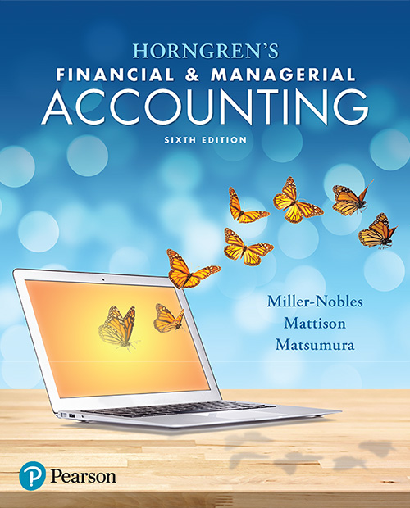
Chapter 7
Internal Control and Cash

Slide 2

Chapter 7 Learning Objectives
Define internal control and describe the components of internal control and control procedures
Apply internal controls to cash receipts
Apply internal controls to cash payments

Slide 3
Chapter 7 Learning Objectives
Explain and journalize petty cash transactions
Explain and journalize credit card sales
Demonstrate the use of a bank account as a control device and prepare a bank reconciliation and related journal entries

Slide 4
Chapter 7 Learning Objectives
Use the cash ratio to evaluate business performance

Slide 5
Learning Objective 1
Define internal control and describe the components of internal control and control procedures

Slide 6
WHAT IS INTERNAL CONTROL, AND HOW CAN IT BE USED TO PROTECT A COMPANY’S ASSETS?
A key responsibility of a business manager is to control operations.
Internal control is the organizational plan and all the related measures adopted by an entity to safeguard assets, encourage employees to follow company policies, promote operational efficiency, and ensure accurate and reliable accounting records.
Notes:
Owners set goals, hire managers to lead the way, and hire employees to carry out the business plan. Internal control is an organizational plan and all the related measures adopted by an entity to safeguard assets, encourage employees to follow company policies, promote operational efficiency, and ensure accurate and reliable accounting records.

Slide 7
WHAT IS INTERNAL CONTROL, AND HOW CAN IT BE USED TO PROTECT A COMPANY’S ASSETS?
Internal control is the plan and measures designed to:
  Safeguard assets
  Encourage employees to follow company policies
  Promote operational efficiency
  Ensure accurate, reliable accounting records
Notes:
A company must protect its assets; otherwise, it is throwing away resources. If you fail to safeguard cash, the most liquid of assets, it will quickly slip away.
Everyone in an organization needs to work toward the same goals. It is important for a business to identify policies to help meet the company’s goals. These policies are also important for the company to ensure that all customers are treated similarly and that results can be measured effectively.
Businesses cannot afford to waste resources. Businesses work hard to make sales and do not want to waste any of the benefits. Promoting operational efficiency reduces expenses and increases profits.
Accurate, reliable accounting records are essential. Without reliable records, managers cannot tell which part of the business is profitable and which part needs improvement.

Slide 8
Internal Control and the
Sarbanes-Oxley Act
The Committee of Sponsoring Organizations (COSO) provides thought leadership related to enterprise risk management, internal control, and fraud deterrence.
  COSO’s mission is to develop frameworks and guidance to help companies improve their internal controls and reduce fraud in organizations.
Public companies - companies that sell stock to the general public - are required by the U.S. Congress to maintain a system of internal controls.
Notes:
Internal controls are critical for public companies.

Slide 9
Internal Control and the
Sarbanes-Oxley Act
Congress passed the Sarbanes-Oxley Act (SOX) to address public concern about various accounting scandals.
The Sarbanes-Oxley Act (SOX) requires companies to review internal control and take responsibility for the accuracy and completeness of their financial reports.
Notes:
Congress passed the Sarbanes-Oxley Act (SOX) to address public concern about various accounting scandals. Sarbanes-Oxley requires companies to review internal control and take responsibility for the accuracy and completeness of their financial reports.

Slide 10
Internal Control and the
Sarbanes-Oxley Act
SOX Provisions
Public companies must issue an internal control report, which is a report by management describing its responsibility for and the adequacy of internal controls over financial reporting.
  An auditor must evaluate internal controls.
The Public Company Accounting Oversight Board (PCAOB), oversees the work of auditors of public companies.
Notes:
SOX Provisions:
1. Public companies must issue an internal control report, which is a report by management describing its responsibility for and the adequacy of internal controls over financial reporting. An auditor must evaluate internal controls.
2. The Public Company Accounting Oversight Board (PCAOB), oversees the work of auditors of public companies.

Slide 11
Internal Control and the
Sarbanes-Oxley Act
SOX Provisions (continued)
Accounting firms are not allowed to audit a public company and also provide certain consulting services for the same client.
Stiff penalties await violators—25 years in prison for securities fraud and 20 years for an executive making false sworn statements.
Notes:
SOX Provisions
3. Accounting firms are not allowed to audit a public company and also provide certain consulting services for the same client.
4. Stiff penalties await violators—25 years in prison for securities fraud and 20 years for an executive making false sworn statements.

Slide 12
The Components of Internal Control
Control procedures
Risk assessment
Information system
Monitoring of controls
Environment
Internal controls are monitored by internal auditors and external auditors.
Notes:
A business can achieve its internal control objectives by addressing the following five components: control procedures, risk assessment, information systems, monitoring of controls, and environment. Control procedures are designed to ensure that the business’s goals are achieved. As part of the internal control system, the company’s business risk, as well as the risk concerning individual accounts, must be assessed. The higher the risk, the more controls a company must put in place to safeguard its assets and accounting records. Controls must be in place within the information system to ensure that only authorized users have access to various parts of the accounting information system. Companies hire auditors to monitor their controls. An internal auditor is an employee of the business who ensures that the company’s employees are following company policies, that the company meets all legal requirements, and that operations are running efficiently. An external auditor is an outside accountant, completely independent of the business, who evaluates the controls to ensure that the financial statements are presented fairly, in accordance with GAAP.

Slide 13
Internal Control Procedures
Competent, reliable, and ethical personnel
Assignment of responsibilities
Separation of duties divides responsibilities between two or more people to limit fraud and promote accuracy of accounting records.
  Separating operations from accounting.
  Separating the custody of assets from accounting
Notes:
Competent, Reliable, and Ethical Personnel
Employees should be competent, reliable, and ethical. Paying good salaries will attract high-quality employees. Employees should also be trained to do the job, and their work should be adequately supervised.
Assignment of Responsibilities
In a business with good internal controls, no duty is overlooked. Each employee has certain, carefully defined responsibilities. For example, in a large company, the person in charge of signing checks is called the treasurer. The chief accounting officer is called the controller. Even an entry-level bookkeeper, whose job includes recording accounting transactions accurately, has clear responsibilities. This assignment of responsibilities creates job accountability, thus ensuring all important tasks get done.
Separation of Duties
Smart management policies divide responsibilities between two or more people. Separation of duties limits fraud and promotes the accuracy of the accounting records. Separation of duties can be divided into two parts:
1. Separating operations from accounting. Accounting should be completely separate from the operating departments, such as production and sales. What would happen if sales personnel recorded the company’s revenue? Sales figures could be inflated, and then top managers would not know how much the company actually sold.
2. Separating the custody of assets from accounting. Accountants must not handle cash, and cashiers must not have access to the accounting records. If one employee has both duties, that employee could steal cash and conceal the theft in the accounting records. The treasurer of a company handles cash, and the controller accounts for the cash. Neither person has both responsibilities. This control applies to all assets, not just cash.

Slide 14
Internal Control Procedures
Audits
  Internal audits are performed by employees of the company.
  External audits are performed by independent auditors (not employees).
Documents
Electronic Devices
  For example, sensors attached to inventory can reduce theft
Notes:
Audits
To assess the adequacy and accuracy of their accounting records, most companies perform both internal and external audits. Remember that an audit is an examination of a company’s financial statements and accounting system by a trained accounting professional called an auditor. Internal audits are performed by employees of the company. External audits are performed by independent auditors who are not employees of the company.
To evaluate the accounting system, auditors must examine the internal controls and test them to ensure the controls are working properly.
Documents
Documents provide the details of business transactions and include invoices and orders, which may be paper or electronic. Documents should be prenumbered to prevent theft and inefficiency. A gap in the numbered sequence draws attention.
Electronic Devices
Accounting systems are relying less on paper documents and more on electronic documents and digital storage devices. For example, retailers control inventory by attaching an electronic sensor to merchandise. The cashier removes the sensor after a sale is made. If a customer tries to leave the store with the sensor attached, an alarm sounds. Devices such as these can significantly reduce theft.

Slide 15
Internal Control Procedures
E-Commerce
  Encryption rearranges plain-text messages by a mathematical process.
  Firewalls limit access into a local network.
  Passwords, PINs, and signatures
Other Controls
  Examples: Fireproof vaults, alarms, loss-prevention specialists, fidelity bonds, mandatory vacations and job rotation.
Notes:
E-Commerce
E-commerce creates its own unique types of risks. Hackers may gain access to confidential information, such as account numbers and passwords, or introduce computer viruses, Trojans, or phishing expeditions. To address the risks posed by e-commerce, companies have devised a number of security measures. One technique for protecting customer data is encryption. Encryption rearranges plain-text messages by a mathematical process. The encrypted message cannot be read by those who do not know the code. Another technique for protecting data is firewalls. Firewalls limit access into a local network. Members can access the network, but nonmembers cannot. Usually several firewalls are built into the system. At the point of entry, additional security measures, such as passwords, PINs (personal identification numbers), and signatures are used. For additional
security, more sophisticated firewalls are used deeper in the network to protect more sensitive data.
Other Controls
The types of other controls are as endless as the types of businesses that employ them. Some examples of other common controls include the following:
• Fireproof vaults to store important documents
• Burglar alarms, fire alarms, and security cameras
• Loss-prevention specialists who train company employees to spot suspicious activity
• Fidelity bonds to reimburse the company for any losses due to employee theft
• Mandatory vacations and job rotation

Slide 16
The Limitations of Internal Control—Costs and Benefits
Internal controls cannot completely prevent fraud.
Collusion is when two or more people work together to circumvent internal controls and defraud a company.
The stricter the internal controls, the higher the costs.
  Internal controls are judged based upon their cost versus benefit.
Notes:
Unfortunately, most internal controls can be overcome. Collusion is when two or more people work together to circumvent internal controls and defraud a company. It is difficult and costly to plan controls that can prevent collusion. The stricter the internal control system, the more it costs. How tight should the controls be? Internal controls must always be judged in light of their costs versus their benefits.

Slide 17
Learning Objective 2
Apply internal controls to cash receipts

Slide 18
WHAT ARE THE INTERNAL CONTROL PROCEDURES WITH RESPECT TO CASH RECEIPTS?
Cash receipts occur primarily when a business sells merchandise or services.
Each source of cash has unique security measures.
  A receipt of cash over the counter in a store involves a point-of-sale terminal (cash register).
  Many companies receive checks by mail for payments of service or merchandise – several controls are needed for cash receipts by mail.
Notes:
All cash receipts should be deposited in the bank for safekeeping shortly after the cash is received. Companies receive cash either over the counter, through the mail, or by electronic funds transfer. Each source of cash has its own security measures.
Consider a retail store. For each transaction, the retail store issues a receipt to ensure that each sale is recorded. At the end of the day, a manager proves the cash by comparing the cash in the drawer against the machine’s record of cash sales. This step helps prevent theft by the clerk.

Slide 19
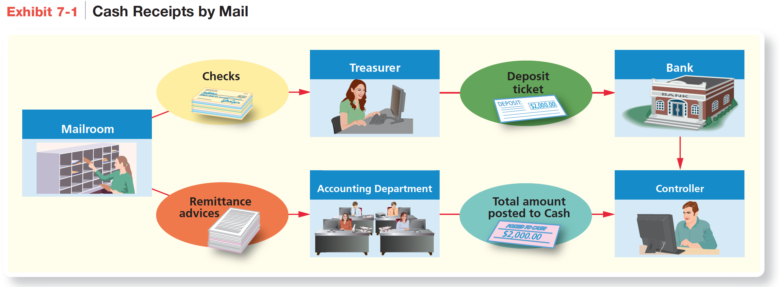
Cash Receipts by Mail
Notes:
Exhibit 7-1 shows how companies control cash received by mail.

Slide 20
Cash Receipts by Mail
Step 1: All incoming mail is opened by a mailroom employee. The mailroom then sends all customer checks to the treasurer and all remittance advices to the accounting department.
  A remittance advice is an optional attachment to a check that tells the business the reason for the payment.
Step 2: The treasurer has the cashier deposit the checks in the bank. The cashier receives a deposit receipt.
Notes:
Step 1: All incoming mail is opened by a mailroom employee. The mailroom then sends all customer checks to the treasurer and all remittance advices to the accounting department. A remittance advice is an optional attachment to a check that tells the business the reason for the payment.
Step 2: The treasurer has the cashier deposit the checks in the bank. The cashier receives a deposit receipt.

Slide 21
Cash Receipts by Mail
Step 3: The accounting department uses the remittance advices to record the journal entries to Cash and customer accounts.
Step 4: As a final control, the controller compares the following records for the day:
  Bank deposit amount from the treasurer
  Debit to Cash from the accounting department
Notes:
Step 3: The accounting department uses the remittance advices to record the journal entries to Cash and customer accounts.
Step 4: As a final control, the controller compares the following records for the day:
- Bank deposit amount from the treasurer
- Debit to Cash from the accounting department

Slide 22
Cash Receipts by Mail
A lock-box system is a system in which customers send their checks to a post office box that belongs to a bank. A bank employee empties the box daily and records the deposits into the company’s bank account.
Notes:
Many companies use a lock-box system as an alternative to accepting cash or checks via the mail or over the counter. A lock-box system is a system in which customers send their checks to a post office box that belongs to a bank. A bank employee empties the box daily and records the deposits into the company’s bank account.

Slide 23
Learning Objective 3
Apply internal controls to cash payments

Slide 24
WHAT ARE THE INTERNAL CONTROL PROCEDURES WITH RESPECT TO CASH PAYMENTS?
Companies make many payments by check.
Payments by check provide internal controls:
  A check provides a record of the payment.
  A check requires a signature by an authorized official.
  Supporting evidence is reviewed prior to signing the check.
Notes:
Companies make many payments by check. Companies need a good separation of duties between the operations of the business and writing checks for cash payments. Payment by check is an important internal control because a check provides a record of the payment, it must be assigned by an authorized official, and the official reviews supporting evidence prior to signing the check for payment.

Slide 25
Controls Over Payment by Check
Notes:
Exhibit 7-2 shows the purchasing and payment process.
First, a purchase order is prepared and sent to the vendor. Second, the inventory is sent by the vendor to the company. At the same time, a copy of the invoice is sent to the company. When the inventory is received, it is counted and compared to the original purchase order to ensure that what was received matches what was originally ordered. A copy of the receiving report is then sent to the accounting department, where it is matched against the invoice. If the amounts match, the invoice is authorized for payment, and a check is sent to the vendor.

Slide 26
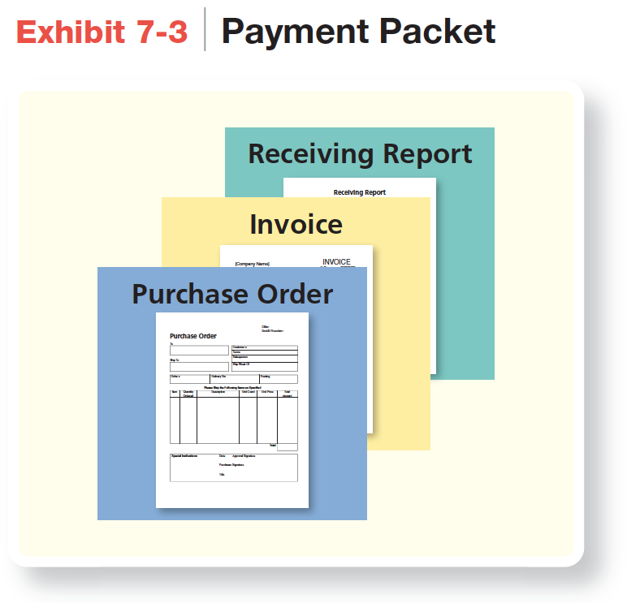
Controls Over Payment by Check
The controller or the treasurer should examine the payment packet to prove:
It received the goods ordered.
It is paying only for the goods received and authorized.
It is paying the correct amount.
Notes:
Exhibit 7-3 shows Smart Touch Learning’s payment packet of documents, which may be in either electronic or paper format. Each of the documents in the process is prepared in multiple copies. For example, the purchase order has at least three copies. One stays in the originating department. One copy goes to the vendor. The third copy is sent to the receiving department to be matched against the packing list that comes with the delivered inventory. Only when the system is able to match all three documents (purchase order, receiving report, and invoice) is the invoice authorized for payment.
After payment, the payment packet is marked as paid to prevent the bill from being paid twice. Electronically paid invoices are automatically marked “paid” by most accounting systems.

Slide 27
Streamlined Procedures
Evaluated Receipts Settlement (ERS) is a procedure that compresses the payment approval process into a single step by comparing the receiving report to the purchase order.
Electronic Data Interchange (EDI) is a streamlined process that bypasses paper documents altogether. Computers of customers communicate directly with the computers of suppliers to automate routine business transactions.
Notes:
Evaluated Receipts Settlement (ERS) is a procedure that compresses the payment approval process into a single step by comparing the receiving report to the purchase order.
Electronic Data Interchange (EDI) is streamlined process that bypasses paper documents altogether. Computers of customers communicate directly with the computers of suppliers to automate routine business transactions.

Slide 28
Learning Objective 4
Explain and journalize petty cash transactions

Slide 29
HOW CAN A PETTY CASH FUND BE USED FOR INTERNAL CONTROL PURPOSES?
Petty cash is used as an in-office source of cash for small immediate purchases.
It is often the responsibility of a designated employee.
A petty cash ticket serves as authorization for payment.
Uses for Petty Cash
Office donuts
Cleaning supplies
Sympathy flowers
Entertaining clients
Public transportation
Tips for service providers
Notes:
It is not cost-effective for a business to write a check for taxi fare or the delivery of a package across town. To meet these needs and to streamline recordkeeping for small cash transactions, companies keep cash on hand to pay small amounts. This fund is called Petty Cash.
Petty cash controls require the following:
Designate a custodian of the petty cash fund.
Designate a small amount of cash to be kept in the petty cash fund.
Support all petty cash payments with a petty cash ticket. These tickets are sequentially numbered.

Slide 30
Setting Up the Petty Cash Fund
On August 1, Smart Touch Learning creates a petty cash fund of $200. The custodian cashes the $200 check and places the currency in the fund box.
Notes:
To set up the petty cash fund, a journal entry is prepared that shows a credit to Cash and a debit to Petty Cash. A check is written and cashed at the bank. The cash is then placed in the custody of a responsible employee who must administer the fund.

Slide 31
Setting Up the Petty Cash Fund
For each petty cash payment, the custodian prepares a petty cash ticket.
An imprest system is a way to account for petty cash by maintaining a constant balance in the petty cash account. At any time, cash plus petty cash tickets must total the amount allocated to the petty cash fund.
Notes:
For each petty cash payment, the custodian prepares a petty cash ticket like the one in Exhibit 7-4.
Using an imprest system is a way to account for petty cash by maintaining a constant balance in the Petty Cash account. At any time, cash plus petty cash tickets must total the amount allocated to the petty cash fund.

Slide 32
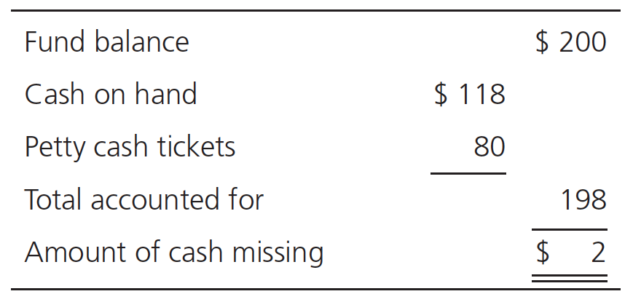
Replenishing the Petty Cash Fund
On August 31, the petty cash fund holds $118 in cash and $80 in petty cash tickets. You can see that $2 is missing:
Notes:
On August 31, the petty cash fund holds $118 in cash and $80 in petty cash tickets. $2 is missing.

Slide 33
Replenishing the Petty Cash Fund
To replenish the petty cash fund, the company writes a check, payable to Petty Cash, for $82 to bring the cash on hand up to $200.
Notes:
To replenish the petty cash fund, you need to bring the cash on hand up to $200. The company writes a check, payable to Petty Cash, for $82 ($200 imprest balance ‒ $118 cash on hand). The fund custodian cashes this check and puts $82 back in the fund box. Now the fund box holds $200 cash, as it should.

Slide 34
Replenishing the Petty Cash Fund
When cash is missing, the Cash Short & Over account is used to record the unaccounted for amount.
The Petty Cash account is used in a journal entry only when the fund is started or when its amount is increased or decreased.
When replenishing the fund, the company debits either the associated expense incurred or the asset purchased with the funds.
Notes:
When cash is missing, the Cash Short & Over account is used to record the unaccounted for amount. The Petty Cash account is used in a journal entry only when the fund is started or when its amount is increased or decreased. When replenishing the fund, the company debits either the associated expense incurred or the asset purchased with the funds.

Slide 35
Replenishing the Petty Cash Fund
At times the sum of cash in the petty cash fund plus the tickets may exceed the fund balance. Consider the previous example. Assume the petty cash ticket no. 102 for delivery was for $30 instead of $20.
Notes:
At times the sum of cash in the petty cash fund plus the tickets may exceed the fund balance. Consider the previous example. Assume the petty cash ticket no. 102 for delivery was for $30 instead of $20.

Slide 36
Replenishing the Petty Cash Fund
In this case, the cash on hand plus petty cash tickets ($208) is more than the fund balance ($200). A cash overage exists. The journal entry to replenish the fund would be:
Notes:
We know the total debits are $90 ($60 + $30). We know the check to replenish the fund was still $82 (credit to Cash) because the fund balance should total $200 and there was $118 in the petty cash box. For this situation, we need an $8 credit to make the journal entry balance, a gain, which is credited to Cash Short & Over.

Slide 37
Changing the Amount of the Petty Cash Fund
On September 1, Smart Touch Learning decides to increase the amount of the petty cash fund from $200 to $300.
In order to increase the fund, Smart Touch Learning must write a check for the additional $100, cash the check, and place the additional currency in the petty cash box.
Notes:
On September 1, Smart Touch Learning decides to increase the amount of the petty cash fund from $200 to $300. In order to increase the fund, Smart Touch Learning must write a check for the additional $100, cash the check, and place the additional currency in the petty cash box. Petty Cash is debited and Cash is credited.

Slide 38
Learning Objective 5
Explain and journalize credit card sales

Slide 39
HOW ARE CREDIT CARD SALES RECORDED?
Net Method
Smart Touch Learning sells merchandise inventory (ignore Cost of Goods Sold) to a customer for $3,000 on August 15. The customer pays with a third-party credit card. The card processor assesses a 4% fee and deposits the net amount. Entry on the sale date:
Notes:
In addition to receiving cash receipts from customers over the counter, most companies also accept credit cards and debit cards. By accepting credit cards and debit cards, such as Visa, MasterCard, and American Express, businesses are able to attract more customers. Credit cards offer the customer the convenience of buying something without having to pay cash immediately. Debit cards, on the other hand, reduce the customer’s bank account immediately but allow the customer to pay electronically instead of with currency or by writing a check.
Companies hire a third-party processor to process credit and debit card transactions. Transactions are usually entered into an electronic terminal (card scanner) that the company either purchases or rents from the processor. The fees the card processor charges the company for its processing services vary depending on the type of card and the specific agreement the company has with the card processor. The processor agreement specifies how fees are paid to the processor. The following are two common methods of handling credit card proceeds and processing fees:
Net: The total sale less the processing fee assessed equals the net amount of cash deposited by the processor, usually within a few days of the sale date.
Gross: The total sale is deposited daily within a few days of the actual sale date. The processing fees for all transactions processed for the month are deducted from the company’s bank account by the processor, often on the last day of the month.

Slide 40
HOW ARE CREDIT CARD SALES RECORDED?
Gross Method
Smart Touch Learning sells merchandise inventory (ignore Cost of Goods Sold) to a customer for $3,000 on August 15. The customer pays with a third-party credit card. The processor uses the gross method. Entry on the sale date:
Notes:
Smart Touch Learning sells merchandise inventory (ignore Cost of Goods Sold) to a customer for $3,000 on August 15. The customer pays with a third-party credit card. The processor uses the gross method. Cash is debited and Sales Revenue is credited.

Slide 41
HOW ARE CREDIT CARD SALES RECORDED?
Gross Method
At the end of August, the processor would collect the 4% fee assessed for the month.
Notes:
At the end of August, the processor would collect the 4% fee assessed for the month. Credit Card Expense is debited and Cash is credited for $120 (4%*$3,000).

Slide 42
Learning Objective 6
Demonstrate the use of a bank account as a control device and prepare a bank reconciliation and related journal entries

Slide 43
HOW CAN THE BANK ACCOUNT BE USED AS A CONTROL DEVICE?
Common bank account controls:
A signature card is a card that shows each authorized person’s signature for a bank account.
A deposit ticket is a bank form that is completed by the customer and shows the amount of each deposit.
Notes:
Cash is the most liquid asset reported on the balance sheet because it is the medium of exchange. Because cash is easy to conceal and relatively easy to steal, businesses keep their cash in a bank account. The common controls are signature cards, deposit tickets, and checks.
A signature card is a card that shows each authorized person’s signature for a bank account. A deposit ticket is a bank form that is completed by the customer and shows the amount of each deposit.

Slide 44
HOW CAN THE BANK ACCOUNT BE USED AS A CONTROL DEVICE?
Common bank account controls:
A check is a document that instructs a bank to pay the designated person or business a specified amount of money.
  The maker is the party who issues the check.
  The payee is the individual or business to whom the check is paid.
  The routing number identifies the bank upon which the payment is drawn.
  The account number identifies the account upon which the payment is drawn.
Notes:
A check is a document that instructs a bank to pay the designated person or business a specified amount of money. The maker of the check is the party who issues the check. The payee is the individual or business to whom the check is paid. Each check has two parts: the routing number and account number. The routing number is the 9-digit number that identifies the bank on which the payment is drawn. The account number on a check is the number that identifies the account on which the payment is drawn.

Slide 45
Notes:
Exhibit 7-5 shows a check with remittance advice.

Slide 46
Bank Statement
A bank statement reports the activity in a customer’s account.
  It shows the account’s beginning and ending balances.
  It lists the month’s cash transactions conducted through the bank account.
Canceled checks are the physical or scanned copies of the maker’s cashed (paid) checks.
Notes:
A bank statement is a document from the bank that reports the activity in the customer’s account. It shows the bank account’s beginning and ending balances and lists the month’s cash transactions conducted through the bank account. Often the bank balance on a given date is different from the balance on the books. There are often very good explanations for the difference, such as checks that the company has written (and deducted from its books) but that have not cleared the bank. To explain the difference between the two unequal balances, a bank reconciliation is prepared. Some activities have been conducted by the business, but there is a time delay between the transaction and when the bank learns the information. These activities include deposits in transit and outstanding checks. There are also activities that happen at the bank that the business does not learn about until the business receives the periodic bank statement. These activities include amounts collected by the bank, electronic funds transfers, bank service charges, interest that is earned by the company or that is owed by the company, and nonsufficient funds checks.
A cancelled check is a physical or scanned copy of the maker’s cash (paid) checks.

Slide 47
Notes:
Exhibit 7-6 shows the April 30, 2017, bank statement of Smart Touch Learning.

Slide 48
Electronic Funds Transfers
Electronic funds transfer (EFT) is a system that transfers cash by electronic communication rather than by paper documents.
  Many bills are paid with EFT
  EFT is less expensive than mailing a check
  Debit card transactions and direct deposits are EFTs
Notes:
Electronic funds transfer (EFT) is a system that transfers cash by electronic communication rather than by paper documents. Many bills are paid with EFT. EFT is less expensive than mailing a check. Debit card transactions and direct deposits are EFTs.

Slide 49
Bank Reconciliation
The bank reconciliation compares and explains the differences between cash on the company’s books and the bank’s records.
Differences arise because of a time lag in recording transactions, called timing differences.
Notes:
A bank reconciliation is a document that explains the reasons for the differences between a depositor’s cash records and the depositor’s cash balance in its bank account. Timing differences are the differences that arise between the balance on the bank statement and the balance on the company’s books because of a time lag in recording transactions.

Slide 50
Preparing the Bank Side of the Bank Reconciliation
The bank side of the reconciliation includes:
Deposits in transit that are recorded by the company but not yet by its bank.
Outstanding checks that are issued by a company and recorded on its books but not yet paid by its bank.
Bank errors that either incorrectly increase or decrease the bank balance.
Notes:
The bank side of the reconciliation includes:
Deposits in transit that are recorded by the company but not yet by its bank.
Outstanding checks that are issued by a company and recorded on its books but not yet paid by its bank.
Bank errors that either incorrectly increase or decrease the bank balance.

Slide 51
Preparing the Book Side of the Bank Reconciliation
The book side of the reconciliation includes:
Credit memorandums (bank collections) are cash receipts the bank has received and recorded but the company has not recorded on its books.
Electronic Funds Transfers
Service charge, often referred to as a debit memorandum
Interest Revenue on a Checking Account
Nonsufficient funds (NSF) checks are received from customers for payment of services rendered or merchandise sold that have turned out to be worthless.
Book errors that either incorrectly increase or decrease the cash balance in the company’s general ledger.
Notes:
The book side contains items not yet recorded by the company on its books but that have been recorded by the bank or errors made by the company. A credit memorandum increases a bank account, while a debit memorandum is a decrease in a bank account. Nonsufficient funds (NSF) checks are checks for which the maker’s bank account has insufficient money to pay the check.

Slide 52
Exhibit 7-7 Bank Reconciliation
Reconciliation Items:
Exhibit is continued on the next slide.
Notes:
Panel A of Exhibit 7-7 lists the reconciling items.

Slide 53
Exhibit 7-7 Bank Reconciliation (continued)
Bank Reconciliation:
Exhibit is continued on the next slide.
Notes:
Panel B of Exhibit 7-7 shows the completed reconciliation.

Slide 54
Exhibit 7-7 Bank Reconciliation (continued)
Bank Reconciliation:
Notes:
Exhibit 7-7 lists the reconciling items. The bank balance must always add deposits in transit, subtract outstanding checks, and add or subtract corrections of bank errors. Book balances must always add bank collections, interest revenue, and EFT receipts. The book balance always subtracts service charges, NSF checks, and EFT payments and adds or subtracts corrections of book errors.

Slide 55
Bank Side of the Reconciliation
The beginning balance taken from the bank statement is $12,720.
Additions and subtractions:
Deposit in transit. The deposit made on April 30 for $9,000 has not yet been recorded by the bank (must add to the bank balance).
Outstanding check. Check number 204 for $2,000 is outstanding (must subtract from the bank balance).
After all items affecting the bank side have been identified, the adjusted bank balance is determined.
Notes:
The beginning balance taken from the bank statement is $12,720.
Additions and subtractions:
Deposit in transit. The deposit made on April 30 for $9,000 has not recorded by the bank (added to the bank balance).
Outstanding check. Check number 204 for $2,000 is outstanding (subtracted from the bank balance).
After all items affecting the bank side have been identified, the adjusted bank balance is determined.

Slide 56
Book Side of the Reconciliation
The beginning cash balance taken from the general ledger is $20,850.
Additions and subtractions:
Electronic funds transfer (EFT). An EFT receipt from a customer in the amount of $100 not recorded in the Cash account (must add to the book balance).
Interest revenue. A $30 deposit on the bank statement for interest earned not recorded in the Cash account (must add to the book balance).
Service charge. A $20 service charge on the bank statement not recorded in the company’s Cash account (must subtract from the book balance).
Notes:
The beginning cash balance taken from the general ledger is $20,850.
Additions and subtractions:
Electronic funds transfer (EFT). An EFT receipt from a customer in the amount of $100 not recorded in the Cash account (added to the book balance).
Interest revenue. A $30 deposit on the bank statement for interest earned not recorded in the Cash account (added to the book balance).
Service charge. A $20 service charge on the bank statement not recorded in the company’s Cash account (subtracted from the book balance).

Slide 57
Book Side of the Reconciliation
Additions and subtractions (continued):
Electronic funds transfer (EFT). An EFT payment to Water Works for $40 not recorded in the company’s Cash account (must subtract from the book balance).
Nonsufficient funds (NSF) check. An NSF check from a customer on the bank statement (must subtract from the book balance).
After recording all of the items that affect the book balance, Smart Touch Learning determines the adjusted book balance and verifies that it equals the adjusted bank balance.
Notes:
Additions and subtractions (continued):
Electronic funds transfer (EFT). An EFT payment to Water Works for $40 not recorded in the company’s Cash account (subtracted from the book balance).
Nonsufficient funds (NSF) check. An NSF check from a customer on the bank statement (subtracted from the book balance).
After recording all of the items that affect the book balance, Smart Touch Learning determines the adjusted book balance and verifies that it equals the adjusted bank balance.

Slide 58
Journalizing Transactions from the Bank Reconciliation
Notes:
The bank reconciliation is an accountant’s tool separate from the journals and ledgers. It does not account for transactions in the journal. To get the transactions into the accounts, we must make journal entries and post to the ledger. All items on the book side of the bank reconciliation require journal entries. We make no journal entries from the items on the bank side because we have already recorded these items in the business’s Cash account.
The bank reconciliation in Exhibit 7-7 requires Smart Touch Learning to make journal entries to bring the Cash account up to date. Numbers in the journal entries correspond to the reconciling items listed in Exhibit 7-7, Panel A, and to the book side of the reconciliation in Panel B. Note that one compound entry could be made instead of the five separate entries illustrated.

Slide 59
Journalizing Transactions from the Bank Reconciliation
The journal entries are posted to the Cash T-account:
The ending balance in the Cash T-account equals the adjusted book balance and the adjusted bank balance on the bank reconciliation.
Notes:
The ending balance in the Cash T-account equals the adjusted book balance and the adjusted bank balance on the bank reconciliation.

Slide 60
Learning Objective 7
Use the cash ratio to evaluate business performance

Slide 61

HOW CAN THE CASH RATIO BE USED TO EVALUATE BUSINESS PERFORMANCE?
The cash ratio helps determine a company’s ability to meet its short-term obligations.
Cash equivalents are highly liquid investments that can converted into cash in three months or less.
Notes:
The cash ratio is a measure of a company’s ability to pay current liabilities from cash and cash equivalents. Cash ratio = (Cash + Cash equivalents) / Total current liabilities. A cash equivalent is a highly liquid investment that can be converted into cash in three months or less.

Slide 62
HOW CAN THE CASH RATIO BE USED TO EVALUATE BUSINESS PERFORMANCE?
Kohl’s cash and cash equivalents and total current liabilities from its balance sheet:
Cash ratio as of January 30, 2015:
Cash ratio as of January 30, 2016:
Notes:
Kohl’s cash and cash equivalents and total current liabilities can be found on the balance sheet (visit http://www.pearsonhighered.com/Horngren to view a link to Kohl’s Corporation’s annual report).
The cash ratio has dropped significantly from 2015 to 2016 due to a decrease in available cash and cash equivalents. This ratio is the most conservative valuation of liquidity because it looks at only cash and cash equivalents, leaving out other current assets such as merchandise inventory and accounts receivable. Notice that for both years the cash ratio was below 1.0. Having a cash ratio below 1.0 is a good thing. A cash ratio above 1.0 might signify that the company has an unnecessarily large amount of cash supply. This cash could be used to generate higher profits or be paid out for dividends. However, a very low ratio doesn’t send a strong message to investors and creditors that the company has the ability to
repay its short-term debt.

Slide 63


