Slide 1
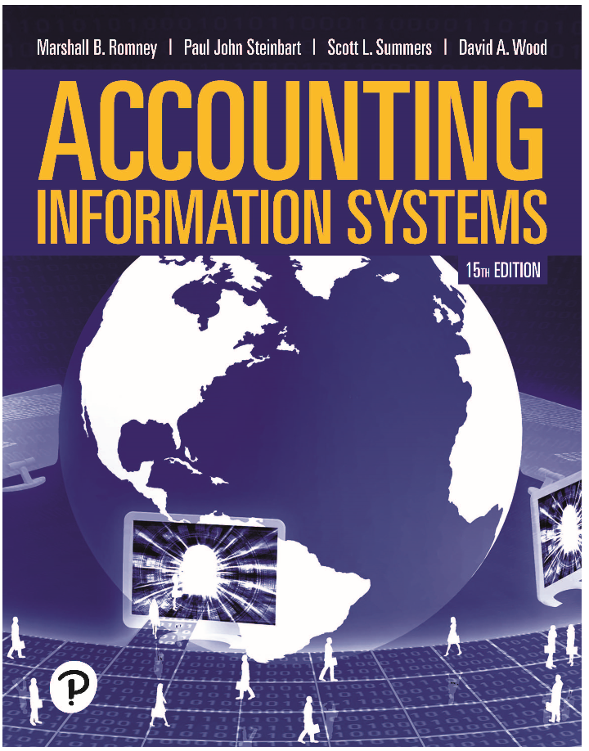
Accounting Information Systems
Fifteenth Edition
Chapter 10
Control and Accounting Information Systems
Copyright © 2021, 2018, 2015 Pearson Education, Inc. All Rights Reserved
Notes:
If this PowerPoint presentation contains mathematical equations, you may need to check that your computer has the following installed:
1) Math Type Plugin
2) Math Player (free versions available)
3) NVDA Reader (free versions available)

Slide 2
Learning Objectives (1 of 2)
Explain basic control concepts and why computer control and security are important.
Compare and contrast the C O B I T, C O S O, and E R M control frameworks.
Describe the major elements in the control environment of a company.

Slide 3
Learning Objectives (2 of 2)
Explain how to assess and respond to risk using the Enterprise Risk Management (E R M) model.
Describe control activities commonly used in companies.
Describe how to communicate information and monitor control processes in organizations.

Slide 4
Why Is Control Needed?
Any potential adverse occurrence or unwanted event that could be injurious to either the accounting information system or the organization is referred to as a threat or an event.
The potential dollar loss should a particular threat become a reality is referred to as the exposure or impact of the threat.
The probability that the threat will happen is the likelihood associated with the threat.
Notes:
Many organizations have real risks by not adequately protecting their data. Although they may see the threat of the risk, many organizations underestimate the impact and the likelihood that a threat will occur.

Slide 5
A Primary Objective of an A I S
Is to control the organization so the organization can achieve its objectives
Management expects accountants to:
  Take a proactive approach to eliminating system threats.
  Detect, correct, and recover from threats when they occur.

Slide 6
Internal Controls
Processes implemented to provide assurance that the following objectives are achieved:
  Safeguard assets
  Maintain sufficient records
  Provide accurate and reliable information
  Prepare financial reports according to established criteria
  Promote and improve operational efficiency
  Encourage adherence with management policies
  Comply with laws and regulations
Notes:
Good internal controls are necessary for an organization to achieve its goals.

Slide 7
Functions of Internal Controls
Preventive controls
  Deter problems from occurring
Detective controls
  Discover problems that are not prevented
Corrective controls
  Identify and correct problems; correct and recover from the problems
Notes:
In addition to the functions of internal controls, controls are segregated into two categories:
General controls which ensure that organization’s control environment is stable and well managed.
Application controls that prevent, detect, and correct transaction errors and fraud in application programs. These controls are concerned with the accuracy, completeness, validity, and authorization of the data captured, entered, processed, stored, transmitted to other systems, and reported.

Slide 8
Foreign Corrupt Practices (F C P A) and Sarbanes–Oxley Acts (S O X)
F C P A is legislation passed (1977)
  To prevent companies from bribing foreign officials to obtain business
  Requires all publicly owned corporations to maintain a system of internal accounting controls
S O X is legislation passed (2002) that applies to publicly held companies and their auditors to
  Prevent financial statement fraud
  Make financial reports transparent
  Protect investors
  Strengthen internal controls
  Punish executives who perpetrate fraud
Notes:
Both these legislative acts rely on good internal control systems; without good internal controls, the entire capital markets would be questionable of its value. It’s important to point out to students their role in society as an accountant and why internal controls are so important as investors from Wall Street to Main Street place reliance on the financial statements.
The passage of SOX changed the way accountants operate; specifically:
PCAOB, which enforces auditing, quality control, ethics, independence, and other auditing standards.
New rules for auditors: must report specific information to the company’s audit committee; prohibits auditors from performing nonaudit services; audit firms cannot provide services if top management was employed by the auditing firm and worked on the company’s audit in the preceding 12 months.
New rules for audit committees.
New rules for management.
New internal control requirements.

Slide 9
Control Frameworks
C O B I T
  Framework for IT control
C O S O
  Framework for enterprise internal controls (control-based approach)
C O S O-E R M
  Expands C O S O framework taking a risk-based approach

Slide 10
C O B I T Framework
Current framework version is C O B I T 2019
Based on the following principles:
  Meeting stakeholder needs
  Covering the enterprise end-to-end
  Applying a single, integrated framework
  Enabling a holistic approach
  Separating governance from management
Notes:
The COBIT framework has evolved over the years and each time there are major changes to the framework; the framework is numbered to its current version. The current version of COBIT for IT controls is COBIT 2019.
The benefit of a standard framework for IT controls is that it allows:
Management to benchmark their environments and compare it to other organizations
Because the framework is comprehensive, it provides assurances that IT security and controls exist
Auditors to substantiate their internal control opinions
The framework is based on the five principles:
Meeting stakeholders’ needs means that enterprises exist to create value to their shareholders. Thus, the governance objective is value creation.
Covering the enterprise from end-to-end means that COBIT 2019 addresses governance and management of information and information-related technologies throughout the enterprise. This means that it is not focused solely on the IT function as information technology runs throughout the enterprise.
Applying a single, integrated framework means that COBIT 2019 can align with other governance frameworks such as COSO and COSO-ERM.
Enabling a holistic approach includes the following enablers:
Processes—a set of activities to achieve an overall IT-related goal
Organizational structures—key decision-making entity
Culture, ethics, and behavior of individuals and the organization
Principles and policies guide the day-to-day management
Information
Infrastructure, technology, and applications
People, skills, and competencies
5. Separating governance from management

Slide 11
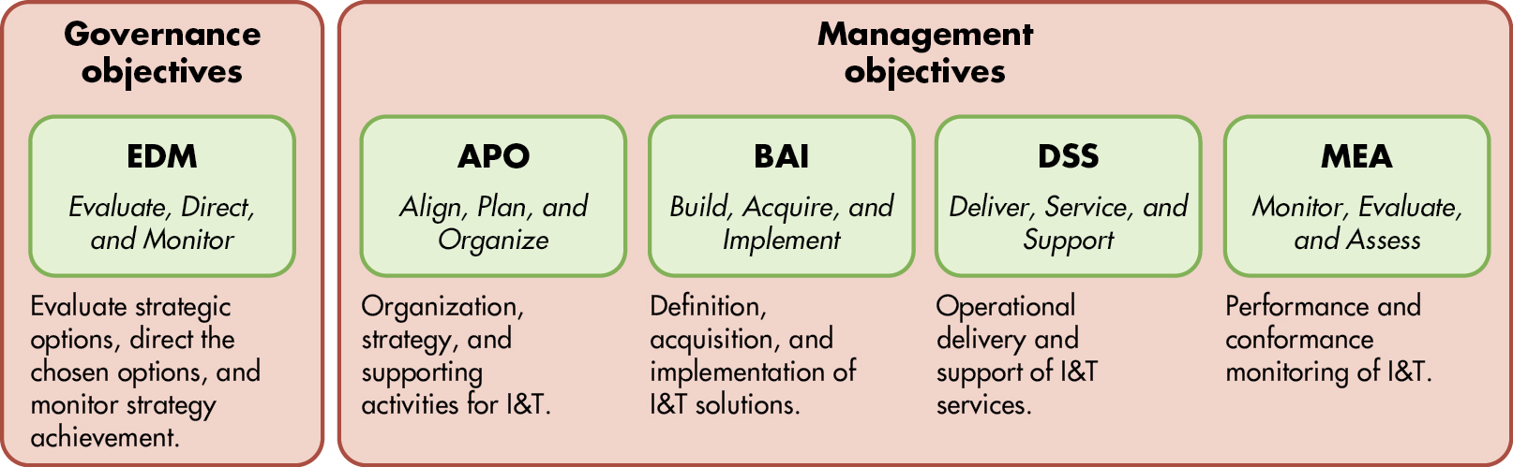
Figure 10.1 C O B I T 2019 Governance and Management Objectives
COBIT® 2019. © 2019 ISACA® All rights reserved. Used by permission of ISACA.
Notes:
COBIT 2019 is a framework that identifies five governance processes using the Evaluate Direct Monitor (EDM), which are:
1. Ensured governance framework setting and maintenance
2. Ensured benefits delivery
3. Ensured risk optimization
4. Ensured resource optimization
5. Ensured stakeholder transparency
There are 35 management processes that are organized under the following four domains:
Align, plan, and organize
Build, acquire, and implement
Deliver, service, and support
Monitor, evaluate, and assess
Long Description:
The “Governance objectives” are listed as follows”
• E D M: Evaluate, Direct, and Monitor
• Evaluate strategic options, direct the chosen options, and monitor strategy achievement.
The “Management objectives” are listed as follows”
• A P O: Align, Plan, and Organize
• Organization, strategy, and supporting activities for I and T.
• B A I: Build, Acquire, and Implement
• Definition, acquisition, and implementation of I and T solutions
• D S S: Deliver, Service, and Support
• Operational delivery and support of I and T services
• M E A: Monitor, Evaluate, and Assess
• Performance and conformance monitoring of I and T.

Slide 12
Components of the C O S O Internal Control – Integrated Framework
There are five components of the C O S O Internal Control – Integrated Framework
  Control environment
  Risk assessment
  Control activities
  Information and communication
  Monitoring

Slide 13
The Control Environment
Management’s philosophy, operating style, and risk appetite
Commitment to integrity, ethical values, and competence
Internal control oversight by Board of Directors
Organizing structure
Methods of assigning authority and responsibility
Human resource standards
Notes:
The internal environment establishes the foundation for all other components of the internal control model.
Assessing the internal environment involves observance of the organizational behavior of management actions and evaluation of policies and procedures. For example, is there a written code of conduct that explicitly describes honest and dishonest behaviors? Does the company exhibit good hiring practices to by evaluating qualified applicants and conducting thorough background checks?

Slide 14
Risk Assessment
Risk is assessed from two perspectives:
Likelihood
  Probability that the event will occur
Impact
  Estimate potential loss if event occurs
Types of risk
Inherent
  Risk that exists before plans are made to control it
Residual
  Risk that is left over after you control it
Notes:
Risk assessment is perhaps the most difficult step for organizations because once they identify what can go wrong, organizations need to think about the probability that it actually will happen and estimate costs. This truly can be a daunting task with a lot of uncertainty!
Many organizations will look at this task from a qualitative and quantitative perspective, provided that they have enough data. From a qualitative perspective, management can simply assign high, medium, or low risk based upon their collective discussion. After assessing all the risks identified in this manner, a heat map can be generated to determine which risks have high (usually a red color), medium (orange color), or low (yellow color).
Quantitative analysis can examine probabilistic techniques to model the cashflow or earnings based upon the risk identified.

Slide 15
Risk Response
Reduce
  Implement effective internal control
Accept
  Do nothing, accept likelihood, and impact of risk
Share
  Buy insurance, outsource, or hedge
Avoid
  Do not engage in the activity
Notes:
Management can respond to risk in four ways:
Reduce the amount of risk by implementing internal controls
Do nothing and accept the likelihood and impact of the risk
Share the risk by buying insurance, doing a joint venture, or hedging transactions
Avoid the risk entirely and sell off a division or not manufacture that product line

Slide 16
Control Activities
Proper authorization of transactions and activities
Segregation of duties
Project development and acquisition controls
Change management controls
Design and use of documents and records
Safeguarding assets, records, and data
Independent checks on performance

Slide 17
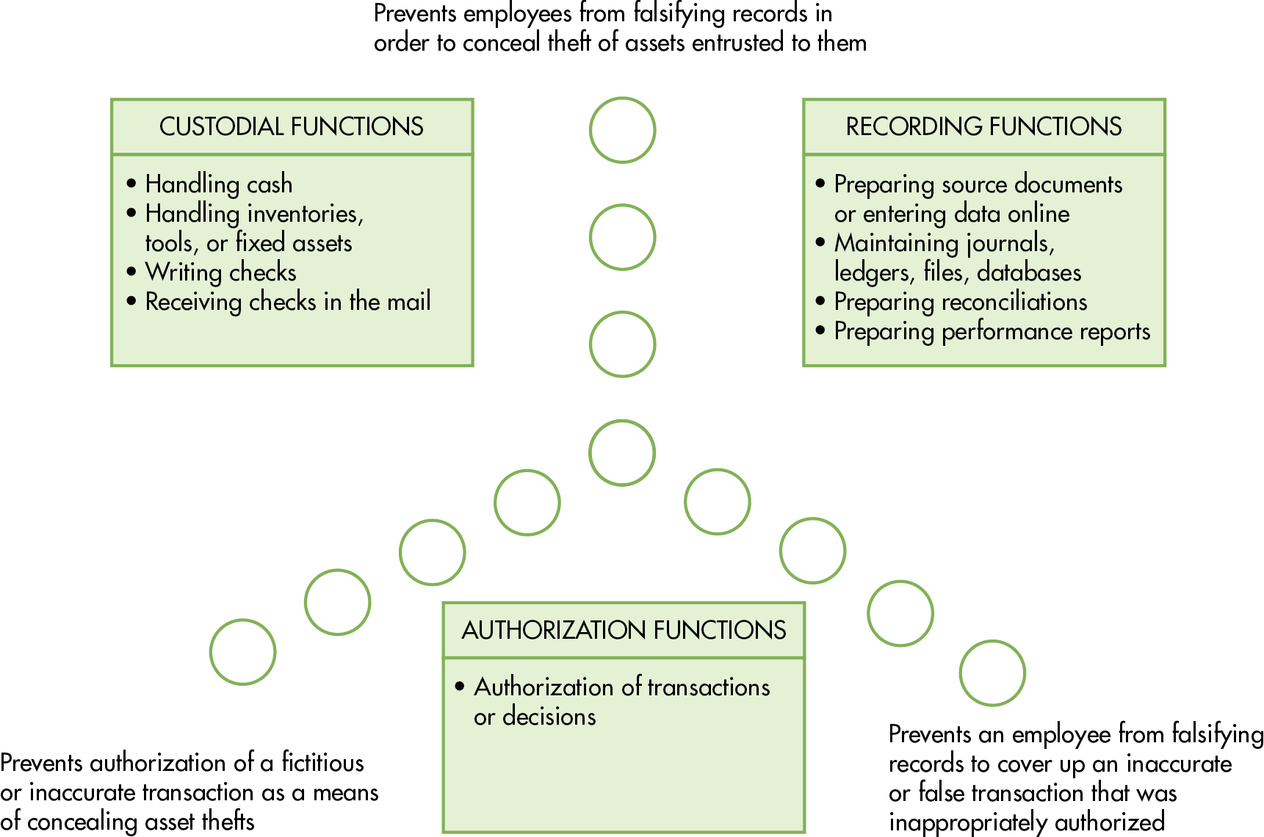
Figure 10.4 Separation of Duties
Notes:
Good internal control requires that no single employee of a company have too much responsibility over transactions and business processes. Segregation of duties prevents an employee from committing and concealing fraud. The three functions that need to be segregated are:
Custodial function which handles cash and assets (inventory, fixed assets)
Recording function which involves preparing source documents, entering data into the system, maintaining journals or data files, and performing reconciliations of accounts
Authorizing function which involves approving transactions and decisions
Long Description:
The diagram shows the process of segregation of duties involving the following:
• Prevents employees from falsifying records in order to conceal theft of assets entrusted to them
• Prevents authorization of a fictitious or inaccurate transaction as a means of concealing asset thefts
• Prevents an employee from falsifying records to cover up an inaccurate or false transaction that was inappropriately authorized
The segregation of duties appears is as follows:
• CUSTODIAL FUNCTIONS
• Handling cash
• Handling inventories, tools, or fixed assets
• Writing checks
• Receiving checks in the mail
• RECORDING FUNCTIONS
• Preparing source documents or entering data online
• Maintaining journals, ledgers, files, databases
• Preparing reconciliations
• Preparing performance reports
• AUTHORIZATION FUNCTIONS
• Authorization of transactions or decisions

Slide 18
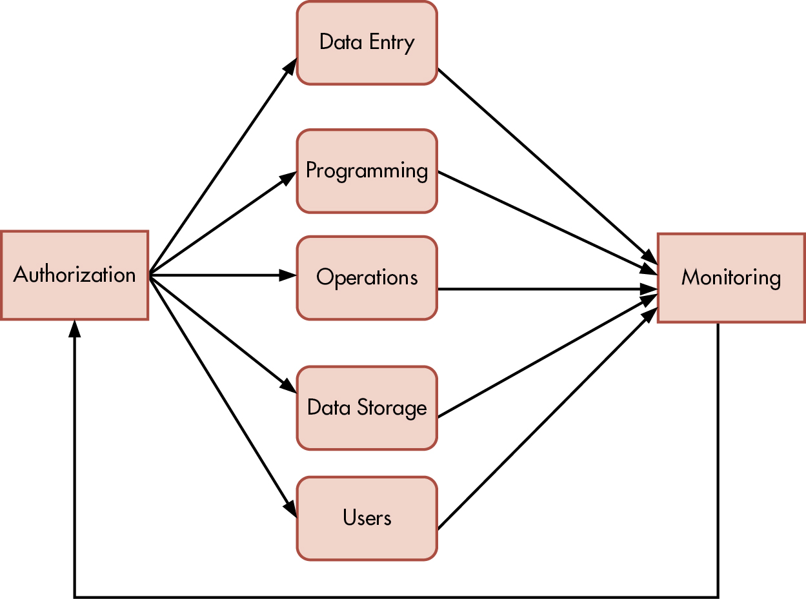
Figure 10.5 Segregation of System Duties
Notes:
Long Description:
The diagram shows “Authorization” connected to six elements “Data Entry,” “Programming,” “Operations,” “Data Storage,” and “Users” by arrows. These elements are together connected to “Monitoring” which further connects itself to “Authorization.”

Slide 19
Information and Communication
There are three principles that apply to the information and communication process:
  Obtain or generate relevant, high-quality information to support internal control.
  Internally communicate the information, including objectives and responsibilities, necessary to support the other components of internal control.
  Communicate relevant internal control matters to external parties.

Slide 20
Monitoring
Perform internal control evaluations (e.g., internal audit)
Implement effective supervision
Use responsibility accounting systems (e.g., budgets)
Monitor system activities
Track purchased software and mobile devices
Conduct periodic audits (e.g., external, internal, network security)
Employ computer security officer
Engage forensic specialists
Install fraud detection software
Implement fraud hotline

Slide 21
Key Terms (1 of 3)
Threat
Exposure/impact
Likelihood/risk
Internal controls
Preventive controls
Detective controls
Corrective controls
General controls
Application controls
Belief system
Boundary system
Diagnostic control system
Interactive control system
Foreign Corrupt Practices Act (F C P A)
Sarbanes-Oxley Act (S O X)
Public Company Accounting Oversight Board (P C A O B)
Control Objectives for Information and Related Technology (C O B I T)
Committee of Sponsoring Organizations (C O S O)
Internal Control–Integrated Framework (I C)
Control environment
Risk appetite
Audit committee
Policy and procedures manual
Background check

Slide 22
Key Terms (2 of 3)
Inherent risk
Residual risk
Expected loss
Control activities
Authorization
Digital signature
Specific authorization
General authorization
Segregation of accounting duties
Collusion
Segregation of systems duties
Systems analysts
Programmers
Computer operators
Users
Systems administrators
Network managers
Security management
Change management
Data control
Steering committee
Strategic master plan
Project development plan
Project milestones
Data processing schedule
System performance measurements
Throughput
Utilization

Slide 23
Key Terms (3 of 3)
Response time
Postimplementation review
Systems integrator
Analytical review
Audit trail
Computer security officer (C S O)
Chief compliance officer (C C O)
Forensic investigators
Computer forensics specialists
Neural networks
Fraud hotline

Slide 24

Copyright
This work is protected by United States copyright laws and is provided solely for the use of instructors in teaching their courses and assessing student learning. Dissemination or sale of any part of this work (including on the World Wide Web) will destroy the integrity of the work and is not permitted. The work and materials from it should never be made available to students except by instructors using the accompanying text in their classes. All recipients of this work are expected to abide by these restrictions and to honor the intended pedagogical purposes and the needs of other instructors who rely on these materials.

