Slide 1
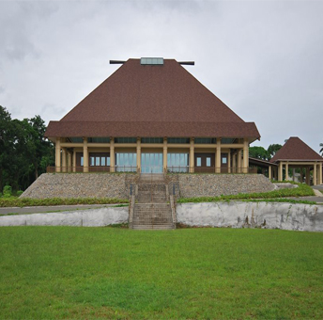
Week 3 Lecture 2 HIS 701
THE GREAT COUNCIL OF CHIEFS DURING COLONIAL RULE

Slide 2
Origins
According to Lal,B.1992. p14.
British Colonial Sir Arthur Gordon- ‘indirect rule’ system- created a permanent Bose Levu Vakaturaga- Great Chiefly Council (or Council of Chiefs - GCC)- to meet annually to advise the governor on native Fijian affairs and assist him in formulating native regulations. The Council was established in 1876 under the governorship of Sir Arthur Gordon. The decision was taken following consultations with chiefs, who advised Sir Arthur on how best to govern the colony's indigenous population.
The Great Council of Chiefs (Bose Levu Vakaturaga in Fijian), was a constitutional body in the Republic of the Fiji Islands from c.1897 to March 2012

Slide 3
Origin of GCC
The Great Council of Chiefs was a brainchild of William Pritchard, the British Consulate who initiated the first ever, general meeting of chiefs in Levuka on December 14, 1859 to pave the way for the cessation process of Fiji to the British Crown.

Slide 4
It became the major symbol of Fijian identity and strength in the colonial political structure and continued to have this significance after independence, ritually affirming an ethnic political unity transcending geographical and cultural differences among Fijians in opposition to the other sections of Fiji’s population.

Slide 5
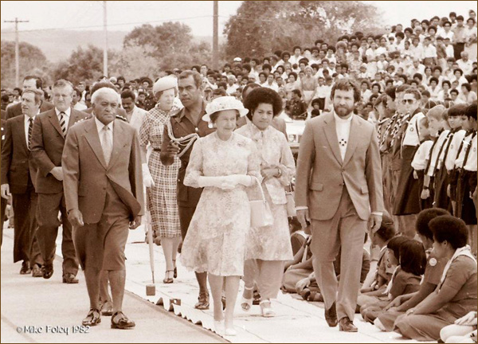

Slide 6
According to Halapua,W. 2003.p7:
There was already in place a loose communal network of some chiefs at time of Cession, which Sir Arthur Gordon then institutionalized
These key group of chiefs were the mouthpiece or representatives that negotiated with Sir Hercules Robinson for Fiji to be ceded to Great Britain in 1874.

Slide 7
Became the major symbol of Fijian identity & strength in the colonial political structure
It embodied a privileged relationship of trust and protection established between the Fijians and the British when the leading chiefs voluntarily ceded Fiji to the British Crown in 1874
Colonial Governors chaired meetings of the GCC
Held every year or two with rich ceremonial protocol and chaired by the British Governor in Colonial era.

Slide 8
usually in villages of pre-eminent chiefs
Discussions center on policies and legislations related to Fijian affairs
Up until 1963- selected Fijian representatives to the colonial parliament
Councils of chiefs had long been important in Fijian political life, and the chiefs who assembled to discuss ceding their islands to the British Crown formed, perhaps, the greatest of such assemblies. Although in pre-colonial times there had been no enduring council of representatives from all chiefdoms, the GCC can be said to have roots in Fijian tradition – as well as in the ideas of British colonial officials.
It is the classic ‘neo-traditional’ institution, established through a blending of traditional forms of rank and political procedure with colonial law and its administrative and consultative requirements.

Slide 9
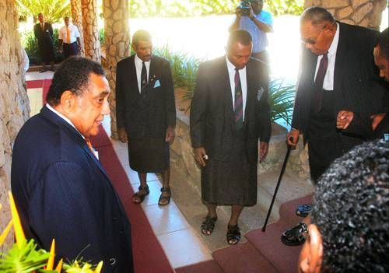
Members…

Slide 10
Throughout colonial period, was an exclusive forum of high-ranking hereditary chiefs, including many senior officials in the Fijian Administration, the body charged with supervising village life

Slide 11
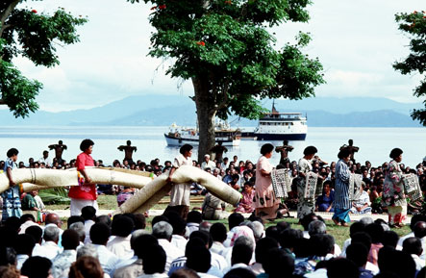
Stemmed in tradition and protocol…

Slide 12
Most influential members-paramount chiefs of southeastern Viti Levu and eastern islands
for example in last 20 years of British rule- Ratu Sir Lala Sukuna, Ratu Kamisese Mara, Ratu Sir George Cakobau, Ratu Edward Cakobau, and Ratu Penaia Ganilau.
All these chiefs began their political career as GCC nominees to the colonial parliament

Slide 13
According to Norton,R.2006.p4.
These chiefs, in the context of ethnic tensions, preserved their leadership after Fijians were given the franchise in 1963
The last four of these chiefs, dominated the political arena in the transition to independence
Ratu Mara and Ratu Penaia Ganilau continued to exercise powerful influence until recent times, passing away respectively in 1993 and 2004.

Slide 14
From 1950’s- membership extended to include representation of trade unions and other urban organizations
Ratu Mara once explained to critics: more a ‘chiefly’ council than a council of chiefs, characterized by a ‘certain standard of behavior which can be performed by all sections of Fijians….a standard of behavior for which all Fijians aim’.

Slide 15
Trend strengthened after independence
all Fijians elected to the lower house of parliament became ex-officio members of GCC
Late 1970s, sometimes half the GCC members were commoners or people of modest chiefly rank
According to Lasaqa,I.1984.p164:
It had become ‘an assembly of Fijian leaders from all walks of life, with divergent interests

Slide 16
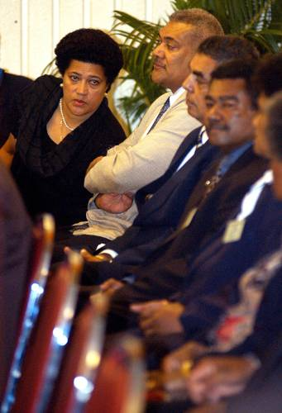
After 1987….
After Rabuka’s coups- GCC reverted to being exclusively a council of hereditary chiefs, with military encouragement

Slide 17
Then the Minister for Fijian Affairs, an army colonel, explained:
‘while we appreciate the contributions made by commoners…it is becoming increasingly evident that the chiefs can be outvoted…
…what we want is for the commoners to act as advisers while the decision making is left entirely to chiefs’. Fiji Times, 16 Feb,1988.

Slide 18
Rabuka himself lamented that:
‘there are so many non-chiefs there who will try to dictate resolutions…the chiefs are so humble, their personalities and their character do not make them forceful enough when they discuss matters. They will agree, they will compromise…whereas those who are not chiefs in the GCC tend to be very, very selfish……

Slide 19
This view received no vindication from the turmoil stirred up by aggressive chiefly rivalries in the GCC in recent years, especially during the coup crisis of 2000
Prior to 2006- GCC had 54 members
Each of the provincial councils chooses three.
There were 4 ex-officio – the president and Vice-President, the PM, and the Minister for Fijian Affairs

Slide 20
The latter nominates an additional six chiefs,
And the Council of Rotuma- two delegates
Members form a wide spectrum of experience and outlook
A few have tertiary education, careers as bureaucrats, professionals or politicians, and are widely travelled.
Most have relatively little formal education and many live mainly in their home villages

Slide 21
Some have progressive views on sharing of power and resources,
majority have very ethnocentric outlooks
Since 1987- GCC undergone regressive change
But powers have been enhanced
1990 Constitution –increased delegates to Senate from 8(of 22) members- as it was under 1970 constitution, to 24(of 34) members

Slide 22
Empowered to decide the appointments of the President and Vice-President of Fiji
Authority retained until 1997 constitution
Strength in Senate had been reduced to 14(of 32) seats
While commoners and people of modest chiefly rank have been largely excluded from the GCC, they have for many years predominated among the elected Fijian members of the House of Representatives.

Slide 23
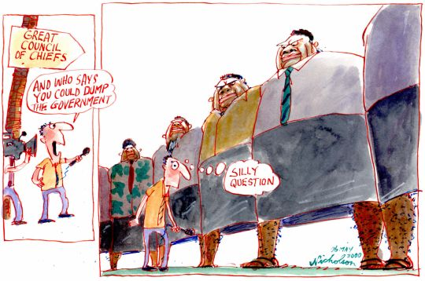

Slide 24
GCC role
Since that first shot was fired on May 14, 1987 in Fiji’s unknowing parliament, the fluidity of Fijian politics has never recovered from the so called coup culture.
It has become the main catalyst to legitimize the overthrow of any tyranny of democracy in Fijian politics.
Caught in this vice-like grip is the Great Council of Chiefs, the last bastion of the Fijian race. For many years Fiji has looked up to the Great Council of Chiefs for answers to a wide range of its problems in its darkest hours.
And many times they have bailed out a nation on the brink of collapse with their wisdom and aura.
That is why it has been revered and tagged with the label, august institution. However, the 2006 coup and the leadership problems that continue to plague Fiji, have given fuel to the growing number of critics who are losing confidence in this institution.

Slide 25
GCC condition
The continuous silence on the part of the chiefs has also fuelled rumors that the GCC may have been too politicized, and, that what the public now hears is only the voice of the institution called the GCC making decisions but without the full mandate of all chiefs.
This school of thought is also bold enough to claim that the GCC aura and manna have been lost.

Slide 26
Interim Prime Minister Frank Bainimarama’s public swipe at the GCC, though considered harsh by many, has also given fuel to that same school of thought.
The erosion of chiefly rule, stemming from the 1987 coup, was sensed and opposed strongly by the late Josevata Kamikamica.
He said the chiefly body should be a political, with reference to the Soqosoqo ni Vakavulewa ni Taukei Party the first political party to receive the backing of the chiefly body

Slide 27
2006, Bainimarama Vs GCC
A dramatic highlight of the aftermath of the army coup of December 2006, however, has been military commander Bainimarama’s acrimonious conflict with the GCC. Whereas Rabuka had readily secured the chiefs’ approval of his quest to re-instate a Fijian-dominated government, Bainimarama had, purportedly in the national interest, deposed such a government – indeed, one only recently returned to office by the vast majority of Fijian voters.
The GCC refused to accept Bainimarama’s claim to have taken authority from the President of Fiji, asked the army to return to barracks, and proposed that the President appoint a council to set up an interim regime. The commander’s angry response was to direct the GCC not to meet again without his approval. Continuing resistance from the GCC provoked Bainimarama to declare he was dissolving its current membership in preparation for a review and reform.

Slide 28
Army Vs GCC
The commander’s ascendancy in Fiji’s political life was driven especially by his determination to expunge the nationalist influence that, since the crisis of 2000, he had viewed as a threat to the integrity of the army under his control. His rhetoric about the army’s responsibility to safeguard the nation has been compelled by this preoccupation no less than by a concern for order, justice, and well-being in Fiji’s multi-ethnic society.
The army has become the pre-eminent institutional vehicle of ethnic Fijian power – paradoxically set against Fijian nationalism, and harshly dismissive of the GCC as being mainly aligned with that force.

Slide 29
Despite Fiji's membership of the Commonwealth of Nations at that time as a republic, the Great Council recognized Queen Elizabeth II as its traditional Queen or paramount chief.
On 20 April 2005, the Fijian government announced plans to grant greater formal powers to the Great Council. This proposal was immediately opposed by Fiji Labour Party leader Mahendra Chaudhry, who said it would lead to "dual government" in Fiji, and also drew criticism from Ratu Epeli Ganilau. The former Chairman of the Great Council, now the interim president of the National Alliance Party, said that he believed that the powers of the Council were already sufficient.
In a controversial move, the Great Council decided on 28 July 2005 to endorse the government's Reconciliation, Tolerance, and Unity Bill, which aimed to establish a commission empowered to compensate victims and pardon perpetrators of the 2000 coup. Opponents, including former Great Council Chairman Ganilau, said that it was just a legal device to free government supporters who had been convicted and imprisoned on coup-related charges.

Slide 30
Suspension & projected Revival
The Council was suspended in April 2007 by Commodore Frank Bainimarama, author of the December 2006 military coup. It was not, however, abolished. In February 2008, the interim government announced that Bainimarama, as Minister for Indigenous Affairs, was appointing himself chairman of the Council. As chairman, he would appoint all other members, acting on the recommendation of the provincial councils, and would have the authority to discipline, suspend, or dismiss any member.
The interim government asked provinces to submit nominees for the Great Council of Chiefs by July 15, 2008. If certain provinces did not provide nominees, Bainimarama would name GCC members to represent those provinces himself.
On August 5, 2008, it was announced that the Great Council of Chiefs was ready to reconvene. It would be composed of three chiefs from each of the fourteen provinces, and would be chaired by the Minister for Fijian Affairs, who at that time was Commodore Bainimarama.

Slide 31
Disestablishment
On 14 March 2012, Bainimarama announced that President Ratu Epeli Nailatikau had "approved decrees that formally de-establish the Great Council of the Chiefs". He accused the Council of having "become politicized to the detriment of Fiji’s pursuit of a common and equal citizenry"

Slide 32
GCC role in Constitution & Power
According to the Constitution, the Great Council of Chiefs had two major powers:
It functioned as an electoral college to elect the President and Vice-President of Fiji, for a five-year term. In certain circumstances prescribed by the Constitution, it might remove the President or Vice-President from office, in the case of felony, incompetence, negligence, or being unable to carry out their constitutional duties.
It chose 14 of the 32 members of the Senate. (Although Senators were ceremonially appointed by the President, his role was a mere formality: the Constitution obligated him to accept and appoint the 14 nominees chosen by the Council, as well as 18 Senators nominated by other institutions (Prime Minister 9, Leader of the Opposition 8, Council of Rotuma .
Filling nearly half of the seats in the Senate, the nominees of the Great Council of Chiefs had an effective veto if they voted as a block, as they were almost certain to be joined by enough of the other Senators to muster a majority. They did not always vote as a block, however: Fiji's chiefs are a very diverse body. In practice, the Great Council of Chiefs delegated its prerogative of choosing Senators to Fiji's fourteen provincial councils, with each province choosing one Senator.
In addition to these constitutionally mandated functions, the Great Council of Chiefs had other roles that might from time to time be prescribed by law. In addition, it was considered almost compulsory for the government to consult and secure the approval of the Council before making major changes to the Constitution, although nothing in the Constitution required it to do so.

Slide 33
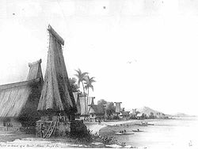
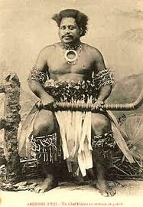
The End

Slide 34
References:
Halapua,Winston.2003. Tradition, Lotu and Militarism in Fiji. Fiji Institute of Applied Studies,Lautoka,Fiji.
Lal, Brij. 1992. Broken Waves. University of Hawaii Press,Honolulu.
http://epress.anu.edu.au/coup_coup/mobile_devices/ch05.html

Slide 35
