Slide 1
LAND POLICIES –CSR, ALTA AND EXPIRING LAND LEASES: Introduction
Land problem in Fiji-complex in nature
Why? Most land under communal ownership
Of Total Land-7.5% held by Government
10% freehold
82.5-native land held by Fijian landowning units
State and freehold land was not sufficient for demands for agricultural leaseholds
Native land, which is inalienable, was opened up for agricultural expansion
It was leased out to tenants under the provision of 1880 Native Land Ordinance, then
Through 1940 NLTB and Native Land Trust Act, and later
Under 1966 Agricultural Land Ordinance
And 1976 Agricultural Landlord and Tenant Act

Slide 2
Colonial Sugar Refining Company (CSR)
Since early 1880s- a major player in the utilization of land for commercial agriculture
Sydney, Australia based company
Colonial governors facilitated to CSR both outright purchase of large tracts of freehold land and lease (99yrs & 999 years) of sizeable portions of native land
Its demand for a plentiful and cheap supply of labor led to Indian indentured labor system (1879-1916)- 60,000+ Indian laborers brought to Fiji to establish and labor in CSR plantations
They followed and worked alongside Melanesian laborers (1860s black birding era)-a disguised form of slavery.
CSR goal was to make maximum profit so
1920-1930 – CSR subdivided its large estates and leased out on average, 10 acre allotments to Indian contract and tenant farmers
Indian labourers at end of contract (Girmit) either left Fiji (20,000) or stayed to work as farmers, laborers and small business people.
Besides CSR, European settlers and more established Indian settlers also leased land from indigenous landowners.
In the period up to 1940s- there were more than 4,000 tenant farmers and 4,500 sub-contract growers supplying CSR
Native land lease was critical to the continued expansion and profitability of the sugar industry
However native leaseholds became entangled in numerous malpractice suits
Corruption became widespread, eg
Indian leaseholders either selling or subleasing at overpriced rates, and
Landowners, as a group or individually, seeking premiums and other payments as a precondition to leasing land.

Slide 3
NLTB and ALTA
Ratu Sukuna’s vision and initiative led to the passage of the Native Land Trust Board Act and Native Land Trust Act in 1940, which established the Native Land Trust Board (NLTB) for reserving native land for the use of landowners, and the leasing of land for non-indigenous citizens.
In the 1998 Parliamentary Paper No. 4- NLTB was entrusted to ensure good farming practices and satisfactory returns to mataqalis.
Since mid 1960s-agricultural land managed by NLTB under ALTO and successor ALTA.
ALTA –introduced to ‘rationalize the leasing of all crown, native and freehold land for agricultural purposes.’
Under ALTA, prime role of NLTB as trustee of Fijian land was recognized, while also protecting landowners’ and tenants’ interests
ALTA covers all agricultural land in Fiji, except where landholding is less than one acre, or where tenancies are held by members of a registered co-operative society, where society is the landlord (often indigenous Fijians), or where land is situated within a native reserve.

Slide 4
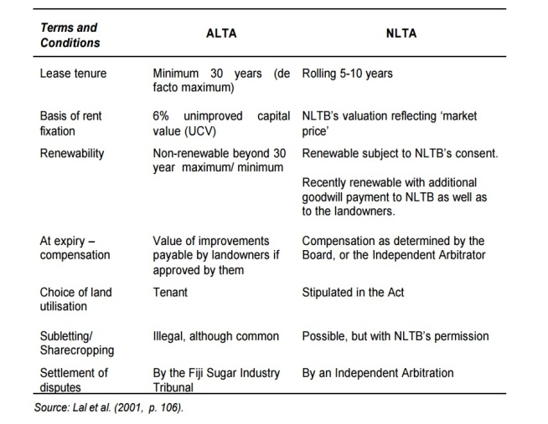
Reserved native land is not available for non-indigenous Fijian use.
Leasing of reserve land to indigenous Fijians, called ‘J’ class, may only be allowed under the provision of ALTA, and only under exceptional circumstances as determined by Minister for Fijian Affairs
Although leasing of land classified as reserved for indigenous Fijian use is subject to provisions of Native Land Trust Act (NLTA), in practice, much of the reserve land is leased outside the NLTA or ALTA.
Under ALTA, all leases are granted for a minimum of 30 years with no automatic right for renewal.
The Act also states however, that once the lease expires, the tenant must be compensated with a sum equivalent to the value of the improvements carried out.
The rent charged under ALTA is based on the unimproved capital value (UCV), the rent would be equivalent to 6% of UCV.
1940-Native Land Act enacted and NLTB established
NLTB is a statutory body with complete control over all native land and is expected to manage the land for the benefit of the Fijian owners under a land ownership and user rights system instituted by the colonial government that supposedly reflects the land tenure system that existed in pre-colonial times (Lal et al. 2001)
Lal, 2001 lists seven key differences between ALTA and NLTA.
Refer to handout on table on Differences in institutional arrangements under ALTA and NLTA.

Slide 5
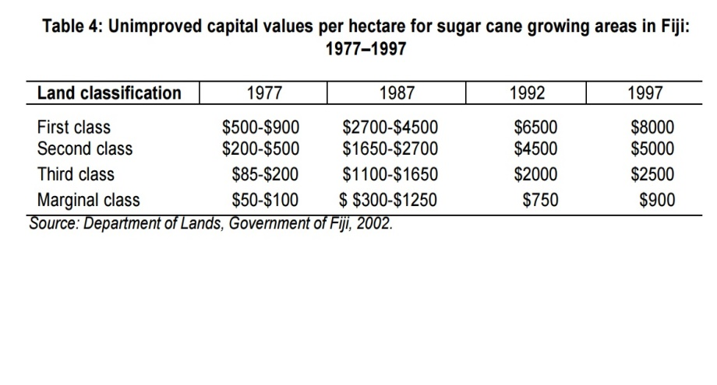
ALTA and expiring land leases
ALTA-seen as the most important legislation affecting agricultural land because it applies to all agricultural land held in parcels exceeding 1.0 ha (2.5 acres) except land in reserves.
ALTA sets out the terms and conditions that must be contained, or will be implied in the absence of formal documentation by courts, in all leases.
Of all the clauses in ALTA, two are the most contentious :
The clause that stipulates no automatic right of renewal and
The clause that requires landlords to provide evidence that their needs are greater than the tenants’ when seeking the return of the leasehold land during the period of lease .
For farmers, there is no security of tenure following the expiry of leases.
The provision relating to rent assessment restricts the rental that can be levied by the landlord to 6% of the unimproved capital value (UCV) of the land, which must be reviewed every 5 years.
The UCV is determined for every class of agricultural land by a government appointed committee of valuers.
Since 1977, the UCV has been revised three times: 1987, 1992 and 1997. Refer to table 4.

Slide 6
One of the effects of ALTA has been that the landowners could legitimately claim that, since ALTA prevents the operation of free market , they are not receiving a genuine return on their asset.
A significant part of the value of land becomes vested in the original tenant, either in the form of an annual profit rent or in the form of a premium when that tenant sells his interest.
This has led to a large proportion of landowners refusing to renew their native land leases.
Table 4 shows:
The UCV has been increasing over time due to changes in market conditions
There has also been a long standing practice of NLTB and landowners to demand periodic goodwill payments, especially when considering renewing of leases.
Other payments extracted from tenant farmers include payments in cash and kind to NLTB officials and representatives of landlords to expedite the resolution of any difficulties that the landlord may encounter in their relationship with the tenant.
In sugar industry:
Approximately 73% of Indo-Fijian sugar cane farmers have been cultivating land leased from the indigenous community
These leases began expiring in 1997. Refer to Table 5.
Between 1997 and 2001-4,222 leases on native land expired: 95 in 1997, 204 in 1998, 1,541 in 1999, 1,940 in 2000 and 442 in 2001.
NLTB returned 2,031 leaseholds to landowners and in 2002- processed a further 2,039 to give back to the mataqalis ( is a Fijian clan or landowning unit)
825 were allowed to take residential leases of around an acre on their former leaseholds (Fiji Times, 19Feb, 2002,p4) see Table 5.

Slide 7
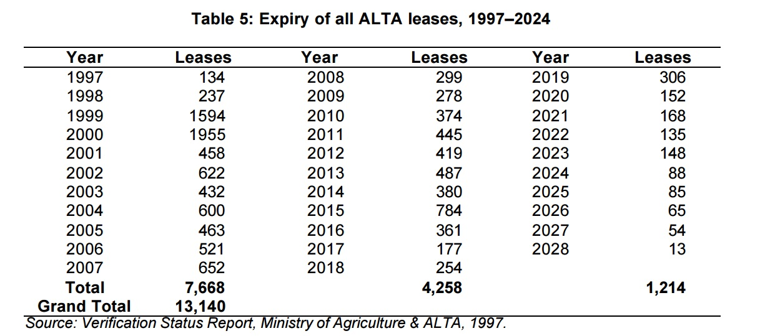

Slide 8
The government, NLTB, the landowners and the tenant community found themselves in a dilemma on how best to deal with the consequences of expiring land leases.
NLTB had stated that a majority of the landowners want their land back, and those few leases that are to be renewed, ought to be renewed under a different act than ALTA, which is seen as tenant-friendly.
Landowners took over properties on native land whose leases have expired and their former tenants sought shelter with relatives and friends
2000 political turmoil, mob violence, looting and burning and attacks on people led to unprecedented emergence of displaced people.
More than 50 farmers and their families, who were relatively secure farmers on government crown land in Muaniweni, moved to Lautoka as refugees
Some tenants whose leases had expired had different responses from on renewal of leases from two or more mataqalis
Other instances, landowners have agreed to renewal but NLTB said no and in other cases the opposite

Slide 9
These different responses and delay led to some landowners forcefully occupying some tenants’ homes
Some astute/shrewd farmers dismantled their wood and iron homes long before the leases expired
All these brought an air of resentment between the two groups
Non-renewal of leases brought their share of problems
As most leases were associated with sugar cane farming, the economy can be directly affected
Sugar industry-contribute a lot to economy and Fiji society
During 1994-accounted for 40% of agricultural GDP, which comprised 22% of total GDP
Approx. 25% economically active population, including 22,000 sugar cane farmers derive their income from the sugar industry
According to Benefield et al. 1984- The linkages from this industry have major implications on entire economy- the multiplier effect of sugar earnings has been very significant.

Slide 10
Fiji’s three governments since 1992 have been looking at a number of options to deal with the land crisis:
1) reverting the land to the landowners and leaving tenants to search for alternate livelihoods
2) reverting the land to the landowners while resettling the tenant farmers on state, freehold or native land (which is not required by landowners);
3) renewing land leases for another term under the Agricultural Landlord and Tenants Act (ALTA); and
4) Renewing land leases for another term under the Native Land and Trust Act (NLTA).
These governments have not made any significant progress on the matter.
There are five parties involved in this issue:
Landowners
Tenants
Industry
Government
NLTB
Notes:
Lal,B. 1992. Broken Waves. University of Hawaii Press
Lal,B and Fortune, K. 2000. A South Pacific-an Encyclopedia. University of Hawaii Press.
Naidu, V and Reddy, M. 2002. ALTA and Expiring Land Leases. Ford Foundation Project. UNESCO.

Slide 11
LAND ISSUES - PARTIES WITH VESTED INTEREST-VIEWS AND CONCERNS
There are basically five parties involved in this issue: the government, the NLTB, the landowners, the sugar industry and the tenants. These five parties have the following views and concerns:
Landowners:
To take back some land for their own use;
Need higher income from land leased land;
Land leased for agricultural purpose is used solely for that purpose and not for residential and commercial development; and
4) They want to have greater active participation in the sugar industry

Slide 12
Tenants:
Need longer term leases with reasonable rentals
Require reasonable advance notice periods before expiry of their tenancy
Require protection by legislation against unreasonable rental increase and other charges; and
Require fair compensation for improvements upon expiry of a lease.

Slide 13
Industry:
Prefer to retain ALTA, albeit amended, to incorporate new initiatives and structures.
Minimum tenancy period to remain at 30 years
Given that a large number of leases (4,837) will expire between 1997 and 2005, some new leases be issued for varying periods in excess of current terms in order to spread the expiry dates in the future
4) ALTA should be amended to include a ten year minimum notification period of termination for all leases;
5)recommends the establishment of a Lands Utilization, Planning and Control Board comprising representatives from Ministry of Lands, Agriculture, NLTB, Town and Country Planning and the sugar industry;
6) Residential leases should be issued to houses other than that occupied by the tenant;

Slide 14
7)Current system of fixed UCV to determine land rent is fair and should be maintained;
8)For those farmers whose leases are not renewed, an appropriate system of resettlement on state and freehold land be established;
9)All displaced tenants should be compensated for all improvement and developments made on land irrespective of whether prior consent was obtained or not from the landlord;
10) Industry welcomes the desire of landowners to participate more actively. The industry states its willingness to help all new incoming farmers to take up cane farming; and
11)Share farming, if considered, will be extremely difficult to ensure compliance and fair and equitable sharing of returns.

Slide 15
Labour Government’s Proposals-1999:
1)That ALTA should remain as the governing law covering all agricultural leases;
2)That ALTA should, however, be amended to make it more equitable;
3)That such amendments be made to accommodate the following:
That a minimum term of 30years to be retained; however, an amendment to be made such that on the 25th year, and on renewal, the lease is to be extended for a further 30years
b) That land used for intensive commercial agriculture, such as piggery, poultry, egg production, bee keeping and hydroponics etc be excluded from the ambit of ALTA;
C)That the rental system be based on up to 10% UCV;
d) That the charging of premiums on the granting of new leases and any renewal thereafter be allowed under ALTA, and the amount to be determined by the Committee of Valuers;
e) Full compensation for improvements at market value be paid in accordance with agreed Schedule of;
f) An other amendments proposed by Cyril Farrows in his submission to previous government.
4) That the NLTB should be solely and directly responsible for consulting the landowning units on the issue of new leases, or extension of existing leases.
(Source: Fiji Government’s submission to NLTB on ALTA and Land,1999)

Slide 16
NLTB rejected proposal outright stating that any attempt to implement it would result in more evictions. The report stated:
Any attempt by the government to implement this proposition will demonstrate the government’s insensitivity towards the realities of the landowners and tenants particularly within the sugar cane belt, the effects this will have on the sugar industry and Fiji’s economy. We say this because many more tenants will be subjected to eviction from the sugar cane belt as is the current practice.
(Source: NLTB’s reply to Government Submission,1999).
In rejecting it, NLTB reiterated that NLTA is legislation that should be adopted and rental rates should be determined by NLTB based on market conditions.
The 1999 People’s Coalition Government had provided two options to those farmers whose leases had expired.
A lump sum payment of $28,000 or
Resettlement on a five acre plot

Slide 17
Some farmers were resettled, many are still hoping for state help to earn a living
Some farmers stayed at refugee camps
Some farmers sought refuge with relatives
A refugee camp was established in Valelawa in Vanua Levu by National Farmers’ Union to accommodate farmers who had no place to go when their lease expired
The union ceased assistance after a year when funding ran out so farmers had to find other means of survival
An ALTA settlement unit was established by the then government to look into case of displaced farmers.
Government identified three areas for resettlement of farmers. Refer table 6

Slide 18
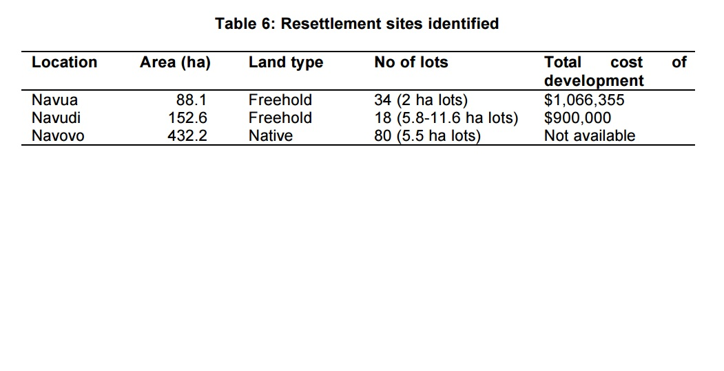

Slide 19
Navua and Navudi are freehold sites while Navovo is native land.
The government resettlement fell short of catering for the large number of farmers whose leases had expired, nearly 3,000 former farming families had been displaced.
These had serious consequences with several reported cases of depression, some deaths, suicides and attempted suicides attributed to non-renewal of leases and lack of support.
(source: Fiji Times, 10 October, 2001.)
A study done on sugar can farmers affected by expiry land leases found that a significant number wished to continue as sugar can farmers meaning a deep commitment to the industry

Slide 20
Farmers who opted for resettlement prefer to be resettled on freehold land due to security of tenure
Given the scarcity of freehold this is unrealistic and the only other option is native land lease
Farmers preferred ALTA to regulate leases and to have a minimum period of 20years
There is no quick solution to the impasse between NLTB and tenant farmers
Some displaced farmers have moved to urban and peri-urban areas and looked for alternative livelihoods.
Some are barely making ends meet
The future of the agricultural sector as a whole is uncertain.
The issue of land needs a serious review with all stakeholders seeking a more realistic and fair long term resolution agreeable for all parties concerned.
Notes:
References:
Lal,B. 1992. Broken Waves. University of Hawaii Press
Lal,B and Fortune, K. 2000. A South Pacific-an Encyclopedia. University of Hawaii Press.
Naidu, V and Reddy, M. 2002. ALTA and Expiring Land Leases. Ford Foundation Project. UNESCO.

