Slide 1
ENS803 Climate Change Impact and Adaptation in the South Pacific
Climate Science and Climate Change

Slide 2
THE CLIMATE SYSTEM
“The atmosphere is the central component of the complex, connected, and interactive global environmental system upon which all life depends. Climate may be broadly defined as the long-term behavior of this environmental system. To understand fully and to predict changes in the atmospheric component of the climate system, one must understand the sun, oceans, ice sheets, solid earth, and all forms of life”
The American Meteorological Society and the University Corporation for Atmospheric Research, “Weather and the Nation’s Well-Being,” Bulletin of the American Meteorological Society, 73, no. 12 (December 1991), 2038.

Slide 3
Is climate the same as weather?
Climate vs. Weather
Weather: Atmospheric state at a
particular time
Climate: Weather averaged over
many times (30 or more)

Slide 4
Climate System
The climate system consists of the five components
Atmosphere
Ocean
Cryosphere (ice)
Biosphere
Geosphere

Slide 5
Schematic view showing several components of Earth’s climate system. Many interactions occur among the various components on a wide range of space and time scales, making the system extremely complex.

Slide 6
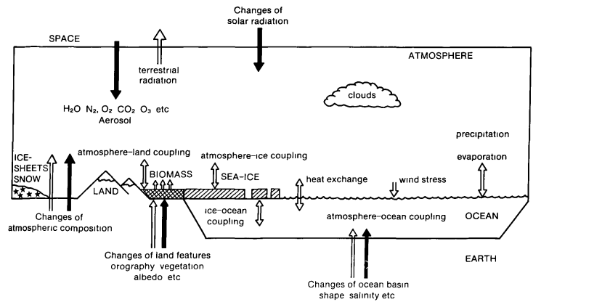
Schematic illustration of the components of the coupled atmosphere-ocean ice-land climatic system The full arrows are examples of external processes, and the open arrows are examples internal processes in climatic change (from Houghton, 1984).

Slide 7
Climate Change
• Climate has always been changing
during Earth’s history
• In past, change was usually slow
==> 10,000 years or more to see change
• Now, might be in period where climate
is changing much faster
==> 50-100 years
==> probably due to human activities

Slide 9
Climate change refers to a significant and sustained (over decades or longer) change from one climatic condition to another.
The term “global warming” refers to a specific kind of climate change in which Earth’s average temperature is increasing.
Abrupt climate change refers to a sudden, rapid change from one climate state to another (over a period of years rather than centuries or millennia).

Slide 10
What Is Abrupt Climate Change?
The United States Climate Change Science Program defines abrupt climate change as “a change in the climate (for example, in temperature or precipitation) that takes place over a few decades or less, persists for at least a few decades, and causes substantial disruptions in human and natural systems.” Abrupt climate change may affect the entire globe or just a region.

Slide 11
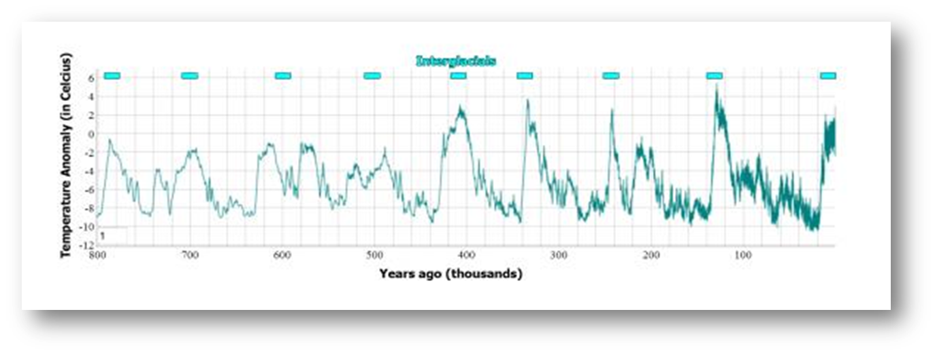
The planet’s climate has changed many times over Earth’s long geologic history. Over the past million years, Earth has experienced several glacial periods interspersed with interglacial (warmer) periods.
The relatively constant and favorable interglacial period of climate experienced over the past 8,000 years has made human civilization’s advancement possible.

Slide 12
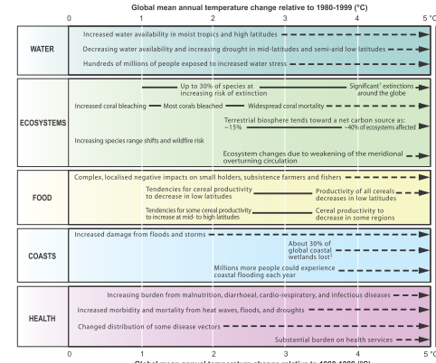
Key impacts as a function of increasing global average temperature change(Impacts will vary by extent of adaptation, rate of temperature change, and socio-economic pathway). Ref. IPCC Report

Slide 13
Projected impacts of climate change on various sectors (Source: Stern, 2006) Funafuti Atoll, Tuvalu (Source: Karen McNamara)

Slide 14
Global Mean Sea Level

Slide 16
Questions in Debate
What factors determine global climate?
What are the greenhouse gases and why are they increasing?
Which gases are the most important?
How much do we expect climate to change?
How much confidence do we have in our predictions?
Will the climate of the future be very different?
Has man already begun to change the global climate?
What will be the effect of climate change on ecosystems?

Slide 18
Why is the present rapid warming happening?
Scientists believe the rapid warming in the last several decades is due mostly to human-induced changes to the atmosphere, on top of some natural variations.
Causes of the climate Change
Natural
Anthropogenic

Slide 19
Natural Causes of Climate Change
Plate tectonics (rearranging Earth’s continents, moving them closer or farther from the equator and the poles)
Volcanic activity (changing the reflectivity and composition of the atmosphere)
Variations in Earth’s orbit (the natural, cyclic change in our planet’s orbit, axial tilt, and wobble)
Solar variability (whether the Sun varies in its radiation output and whether sunspots affect the output).

Slide 20
Anthropogenic Addition
Nitrogen
Oxygen
Carbon Dioxide
Why potential Green House gas is only CO2?
Climate change induced by human activity may occur due to changes in the composition of the Earth’s atmosphere from waste gases due to industry, farm animals and land clearing, or changes in the land surface reflectivity caused by land clearing, cropping and irrigation. These gases include several, such as carbon dioxide, methane and oxides of nitrogen, that can absorb heat radiation (long-wave or infra-red radiation) from the Sun or the Earth.

