Slide 1
Climate Change policy
Lecture 7 (a)

Slide 2
Kyoto protocol
The Kyoto Protocol is an international treaty which extends the 1992 United Nations Framework Convention on Climate Change (UNFCCC) that commits state parties to reduce greenhouse gas emissions, based on the scientific consensus that (part one) global warming is occurring and (part two) that human-made CO₂ emissions are driving it. The Kyoto Protocol was adopted in Kyoto, Japan, on 11 December 1997 and entered into force on 16 February 2005. There are currently 192 parties (Canada withdrew from the protocol, effective December 2012) to the Protocol.

Slide 3
The Kyoto Protocol implemented the objective of the UNFCCC to reduce the onset of global warming by reducing greenhouse gas concentrations in the atmosphere to "a level that would prevent dangerous anthropogenic interference with the climate system" (Article 2). The Kyoto Protocol applies to the six greenhouse gases listed in Annex A:
carbon dioxide (CO₂),
Methane (CH₄),
nitrous oxide (N₂O),
hydrofluorocarbons (HFCs),
perfluorocarbons (PFCs), and
sulfur hexafluoride (SF₆)

Slide 4
The Protocol is based on the principle of common but differentiated responsibilities: it acknowledges that individual countries have different capabilities in combating climate change, owing to economic development, and therefore puts the obligation to reduce current emissions on developed countries on the basis that they are historically responsible for the current levels of greenhouse gases in the atmosphere.

Slide 5
Flexibility mechanism
The Protocol defines three "flexibility mechanisms" that can be used by Annex I Parties in meeting their emission limitation commitments. The flexibility mechanisms are:
International Emissions Trading (IET),
the Clean Development Mechanism (CDM),
and Joint Implementation (JI).

Slide 6
Clean Development Mechanism (CDM
Suppose Annex B country Australia is given emission quota of 200 units, but it emits 210 units of green house gas.
But Australia can finance a solar power project in some village of India (Non-Annex or developing Country) and get certificate that the solar plant led to reduction of 10 units of green house gas. In this way, Australia will remain in its quota/limit.
Similarly, suppose Australian Government has passed a law that a steel production company with output of 200 tons of steel per a day, must not emit more than 10 units of green house gas in a year.
But this company wants to produce more steel, then its green house gas emission has increased to 11 units. (1 more unit above the quota)
So this company can also do some solar-projects in India, Brazil etc. and get a certificate that it has led to reduction of 1 unit of GHG emission. = problem solved.

Slide 7
Joint Implementation (JI)
This is identical to CDM.
In CDM, Australia can do good project in a non-Annex country (developing country) e.g. India.
In Joint Implementation, Australia can do the good project in another Annex B country e.g. Japan to meet the quota.

Slide 8
Why USA did not ratify Kyoto Protocol
US President George W Bush refused to ratify Kyoto protocol saying that it would gravely damage the US economy.
for example a US steel company would need to either buy Carbon Credits from another company or invest in some projects in a developing country), while an Indian or Chinese Steel company has no such obligation so their cost of production = low, hence they can sell their products @lower MRP = US steel company will loose customers.
So US Government feels is that the treaty is fatally flawed, because it does not require developing countries (especially India and China) to commit to emissions reductions.
After President Bush, President Obama too, didn’t ratify Kyoto protocol for the same reason. (plus we should also understand that the powerful US industrialist lobby may stop election funds to a candidate, if he is in favor of Kyoto protocol, so USA is unlikely to ratify Kyoto or any such future protocols that are legally binding!)

Slide 9
Canada Quits Kyoto protocol
In 2011, Canada, become the first country to quit the Kyoto Protocol on climate change, saying the 1997 accord was handicapped because top green house emitters like the United States and China not covered by it. (Because USA has refused to ratify the treaty and China being an Annex II country –has no compulsory responsibility to cut down emission.)

Slide 10
COP, Convention of Parties
The Conference of Parties (COP) is the apex decision-making body of the United Nations Climate Change Framework Convention (UNFCCC). The UNFCCC was formed in 1994 to stabilize the greenhouse gas emissions and to protect the earth from the threat of climate change.
All States that are Parties to the Convention are represented at the COP, at which they review the implementation of the Convention and any other legal instruments that the COP adopts and take decisions necessary to promote the effective implementation of the Convention, including institutional and administrative arrangements.

Slide 11
What is Paris agreement
The Paris Agreement is a legally binding international treaty on climate change. It was adopted by 196 Parties at COP 21 in Paris, on 12 December 2015 and entered into force on 4 November 2016.
Its goal is to limit global warming to well below 2, preferably to 1.5 degrees Celsius, compared to pre-industrial levels.
To achieve this long-term temperature goal, countries aim to reach global peaking of greenhouse gas emissions as soon as possible to achieve a climate neutral world by mid-century.
The Paris Agreement is a landmark in the multilateral climate change process because, for the first time, a binding agreement brings all nations into a common cause to undertake ambitious efforts to combat climate change and adapt to its effects.

Slide 12
How does the Paris Agreement work?
Implementation of the Paris Agreement requires economic and social transformation, based on the best available science. The Paris Agreement works on a 5- year cycle of increasingly ambitious climate action carried out by countries. By 2020, countries submit their plans for climate action known as nationally determined contributions (NDCs).
In their NDCs, countries communicate actions they will take to reduce their Greenhouse Gas emissions in order to reach the goals of the Paris Agreement. Countries also communicate in the NDCs actions they will take to build resilience to adapt to the impacts of rising temperatures.

Slide 13
How are countries supporting one another?
The Paris Agreement provides a framework for financial, technical and capacity building support to those countries who need it.
Finance
The Paris Agreement reaffirms that developed countries should take the lead in providing financial assistance to countries that are less endowed and more vulnerable, while for the first time also encouraging voluntary contributions by other Parties. Climate finance is needed for mitigation, because large-scale investments are required to significantly reduce emissions. Climate finance is equally important for adaptation, as significant financial resources are needed to adapt to the adverse effects and reduce the impacts of a changing climate.

Slide 14
Technology
The Paris Agreement speaks of the vision of fully realizing technology development and transfer for both improving resilience to climate change and reducing GHG emissions. It establishes a technology framework to provide overarching guidance to the well-functioning Technology Mechanism. The mechanism is accelerating technology development and transfer through it’s policy and implementation arms.
Capacity-Building
Not all developing countries have sufficient capacities to deal with many of the challenges brought by climate change. As a result, the Paris Agreement places great emphasis on climate-related capacity-building for developing countries and requests all developed countries to enhance support for capacity-building actions in developing countries.

Slide 15
COP21
At COP 21 in Paris, on 12 December 2015, Parties to the UNFCCC reached a landmark agreement to combat climate change and to accelerate and intensify the actions and investments needed for a sustainable low carbon future. The Paris Agreement builds upon the Convention and – for the first time – brings all nations into a common cause to undertake ambitious efforts to combat climate change and adapt to its effects, with enhanced support to assist developing countries to do so. As such, it charts a new course in the global climate effort.
The Paris Agreement’s central aim is to strengthen the global response to the threat of climate change by keeping a global temperature rise this century well below 2 degrees Celsius above pre-industrial levels and to pursue efforts to limit the temperature increase even further to 1.5 degrees Celsius. Additionally, the agreement aims to increase the ability of countries to deal with the impacts of climate change, and at making finance flows consistent with a low GHG emissions and climate-resilient pathway. To reach these ambitious goals, appropriate mobilization and provision of financial resources, a new technology framework and enhanced capacity-building is to be put in place, thus supporting action by developing countries and the most vulnerable countries, in line with their own national objectives. The Agreement also provides for an enhanced transparency framework for action and support.

Slide 16
The Paris Agreement, Adopted Through Decision, Addresses Crucial Areas Necessary To Combat Climate Change. Some Of The Key Aspects Of The Agreement Are Set Out Below:
Long-term temperature goal – The Paris Agreement, in seeking to strengthen the global response to climate change, reaffirms the goal of limiting global temperature increase to well below 2 degrees Celsius, while pursuing efforts to limit the increase to 1.5 degrees.
Global peaking and 'climate neutrality-To achieve this temperature goal, Parties aim to reach global peaking of greenhouse gas emissions (GHGs) as soon as possible, recognizing peaking will take longer for developing country Parties, so as to achieve a balance between anthropogenic emissions by sources and removals by sinks of GHGs in the second half of the century

Slide 17
Mitigation (Art. 4) – The Paris Agreement establishes binding commitments by all Parties to prepare, communicate and maintain a nationally determined contribution (NDC) and to pursue domestic measures to achieve them.
Sinks and reservoirs (Art.5) –The Paris Agreement also encourages Parties to conserve and enhance, as appropriate, sinks and reservoirs of GHGs as referred to in Article 4, paragraph 1(d) of the Convention, including forests.
Voluntary cooperation/Market- and non-market-based approaches (Art. 6) – The Paris Agreement recognizes the possibility of voluntary cooperation among Parties to allow for higher ambition and sets out principles – including environmental integrity, transparency and robust accounting – for any cooperation that involves internationally transferal of mitigation outcomes. It establishes a mechanism to contribute to the mitigation of GHG emissions and support sustainable development, and defines a framework for non-market approaches to sustainable development.

Slide 18
Adaptation (Art. 7) – The Paris Agreement establishes a global goal on adaptation – of enhancing adaptive capacity, strengthening resilience and reducing vulnerability to climate change in the context of the temperature goal of the Agreement. It aims to significantly strengthen national adaptation efforts, including through support and international cooperation. It recognizes that adaptation is a global challenge faced by all. All Parties should engage in adaptation, including by formulating and implementing National Adaptation Plans, and should submit and periodically update an adaptation communication describing their priorities, needs, plans and actions. The adaptation efforts of developing countries should be recognized

Slide 19
Loss and damage (Art. 8) – The Paris Agreement recognizes the importance of averting, minimizing and addressing loss and damage associated with the adverse effects of climate change, including extreme weather events and slow onset events, and the role of sustainable development in reducing the risk of loss and damage. Parties are to enhance understanding, action and support, including through the Warsaw International Mechanism, on a cooperative and facilitative basis with respect to loss and damage associated with the adverse effects of climate change.
Finance, technology and capacity-building support (Art. 9, 10 and 11) – The Paris Agreement reaffirms the obligations of developed countries to support the efforts of developing country Parties to build clean, climate-resilient futures, while for the first time encouraging voluntary contributions by other Parties

Slide 20
Climate change education, training, public awareness, public participation and public access to information (Art 12) is also to be enhanced under the Agreement.
Transparency (Art. 13), implementation and compliance (Art. 15) – The Paris Agreement relies on a robust transparency and accounting system to provide clarity on action and support by Parties, with flexibility for their differing capabilities of Parties. In addition to reporting information on mitigation, adaptation and support, the Agreement requires that the information submitted by each Party undergoes international technical expert review.

Slide 21
Global Stocktake (Art. 14) – A “global stocktake”, to take place in 2023 and every 5 years thereafter, will assess collective progress toward achieving the purpose of the Agreement in a comprehensive and facilitative manner. It will be based on the best available science and its long-term global goal. Its outcome will inform Parties in updating and enhancing their actions and support and enhancing international cooperation on climate action.
Decision 1/CP.21 also sets out a number of measures to enhance action prior to 2020, including strengthening the technical examination process, enhancement of provision of urgent finance, technology and support and measures to strengthen high-level engagement. Decision 1/CP.21 also sets out a number of measures to enhance action prior to 2020, including strengthening the technical examination process, enhancement of provision of urgent finance, technology and support and measures to strengthen high-level engagement.

Slide 22
What is carbon neutrality?
What is carbon neutrality?
Carbon neutrality means having a balance between emitting carbon and absorbing carbon from the atmosphere in carbon sinks. Removing carbon oxide from the atmosphere and then storing it is known as carbon sequestration. In order to achieve net zero emissions, all worldwide greenhouse gas emissions will have to be counterbalanced by carbon sequestration.
Carbon sink is any system that absorbs more carbon than it emits. The main natural carbon sinks are soil, forests and oceans. To date, no artificial carbon sinks are able to remove carbon from the atmosphere on the necessary scale to fight global warming.

Slide 23
COP 23
COP23 is the informal name for the 23rd Conference of the Parties to the United Nations Framework Convention on Climate Change (UNFCCC). The UNFCCC was adopted in 1992 at the Rio Earth Summit, which marked the beginning of the international community’s first concerted effort to confront the problem of climate change. Known also as the Rio Convention, the UNFCCC established a framework for action to stabilise concentrations of greenhouse gases in the earth’s atmosphere. The UNFCCC entered into force in 1994, and nearly all of the world’s nations—a total of 195—have now signed on.
Specifically, meetings of the Conference of the Parties serve to:
• 1. Review the implementation of the Convention (COP), the Kyoto Protocol (CMP) and the Paris Agreement (CMA), respectively; and
• 2. Adopt decisions to further develop and implement these three instruments.

Slide 24
The purpose of the conference was to discuss and implement plans about combating climate change, including the details of how the Paris Agreement will work after it enters into force in 2020
Significant progress was made on the so-called implementation guidelines for the Paris Agreement – commonly known as the Paris Rulebook – which are the details that will determine how the Agreement will work in practice. COP23 resulted in the Fiji Momentum for Implementation, which reinforced the need for urgent action and increased ambition. Parties will need to finalise the Implementation Guidelines at COP24.

Slide 25
The Paris Agreement was an agreement within the United Nations Framework Convention on Climate Change (UNFCCC), dealing with greenhouse-gas-emissions mitigation.
The Kyoto Protocol is a treaty that commits state parties to reduce greenhouse gas emissions, based on the scientific consensus.

Slide 26
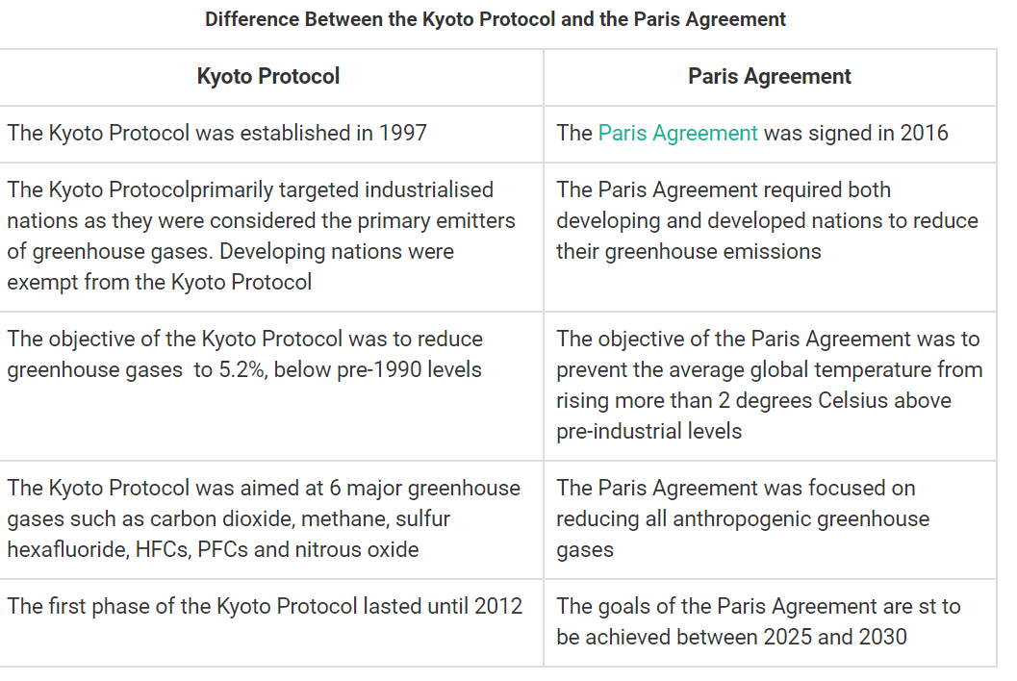

Slide 27
Climate change policy of Fiji
Policies have been developed in the areas of agriculture, land use, forestry, fisheries and water. They focus on the sustainable management of Fiji’s natural resources and the establishment of appropriate institutional arrangements for effective implementation and monitoring. A major component is the incorporation of environmental management in order to address issues that emanate from natural hazards and unsustainable resource management and utilisation. These policies play an important role in supporting efforts to reduce adverse impacts of climate change on Fiji’s economic and social development

Slide 28
Mission statement
To increase Fiji’s capacity to cope with the impacts of climate change by strengthening institutional and legal frameworks, providing sound scientific information, and implementing effective awareness and education initiatives
To maximise access to and secure globally available financing for climate change mitigation and adaptation efforts •
To strengthen Fiji’s support towards neighbouring Pacific Island countries that are highly vulnerable to the impacts of climate change
To strengthen engagement in international climate change policy processes and fulfil obligations on climate change mitigation and adaptation

Slide 29
Goal of Climate change policy
to support the implementation of Fiji’s Roadmap for democracy and sustainable socio-economic development 2009–2014 under the People’s charter for change, peace and progress;
to promote integration of climate change issues in national planning, budgeting and implementation processes;
to provide guidance on government’s responses to climate change issues;
to guide sectors to develop appropriate climate change adaptation and mitigation strategies;
to support requests to regional and international agencies to provide resources and assistance in addressing national climate change issues;
to contribute to Pacific regional actions and to meeting international commitments.

Slide 30
Policy objectives and strategies
The objectives cover the following areas:
1. mainstreaming
2. data collection, storage and sharing
3. awareness raising
4. education and training
5. adaptation
6. mitigation
7. financing
8. international and Pacific region participation.

Slide 31
Tutorial and discussion questions
What is the difference between Paris agreement and Kyoto Protocol?
Explain what is flexibility mechanism.
What is carbon neutrality and carbon sequestration?
What are the adaption and mitigation measures projects implemented in Fiji?

