Slide 1
ENS803 Climate Change Impacts
Lecture: Impacts of Climate Change on Public Health
August 2018

Slide 2
What is ‘public health’?
4 main definitions, we will select two:
Public health is the ‘health or physical well-being of a whole community’ (The National Resources Defense Council)
The New Zealand Ministry of Health defines it as ‘the science and art of promoting health, preventing disease and prolonging life through organized efforts of society’.

Slide 3
Impacts of climate change on public health (section 2.5.4, text)
There are several pathways by which climate change affects public health (Figure on next slide):
Natural and anthropogenic (human-caused) activities both affect climate change (left of the diagram) by causing changes in frequency, intensity and means of temperature, precipitation, humidity, wind patterns
Mitigation? – through mitigation (reduction in GHGs), we can reduce climate change (mostly developed countries).
Climate change affects the environment in 4 broad pathways (middle of the diagram):
Extreme weather events
Effects on ecosystems
Sea level rise
Environmental degradation
These 4 environmental effects affects public health (5 impacts on right of diagram)

Slide 4
The health impacts of climate change – 3 main categories:
A) heat induced morbidity and mortality,
B) infectious diseases, and
C) impacts due to the effect of extreme weather such as flooding and drought on the social welfare of the population
Note: Measurement of health effects from climate change can only be very approximate
Next slide shows overview of ‘Impacts of climate change on public health’

Slide 5
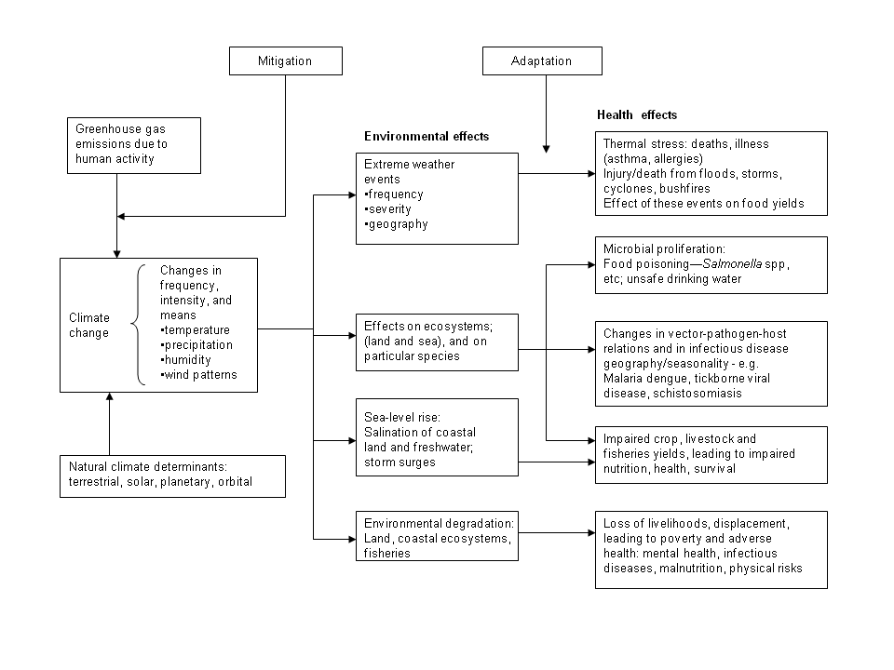

Slide 6
Some examples of health effects from environmental effects
Extreme weather-higher temperatures in summer increase mortality,
e.g. 2003 heat wave in Europe (global warming from human-generated greenhouse gas emissions accounted for half of the heat during the heat waves, therefore half of the deaths are due to human action!)
Urban cities are more likely to suffer heat waves due to ‘Urban Heat Island’ effect (see next slide). Lack of vegetation (and therefore lack of cooling effect of evaporation) in cities produce the ‘Urban Heat Island’ effect

Slide 7
Urban Heat-Island profile

Slide 8
How can deaths from heat waves be prevented?
Adaptation can help reduce mortality
through greater prevention awareness (people being warned through media)
And by providing more air-conditioning and cooling centers, fountains etc. throughout the cities
Deaths due to heat waves are expected to increase by 5.7 % (as a result of climate change)

Slide 9
Other effects of climate change on health:
Increased carbon dioxide in the air promotes plant growth and reproduction – which means more pollen in the air
More pollen can lead to more allergic reactions (asthma attacks, sinus diseases etc.)
Infectious diseases are influenced by climate, as pathogen survival rates are strongly affected by temperature change
Diseases carried by birds, animals, and insects (vector-born) such as malaria, dengue fever, and dengue hemorrhagic fever may be influenced by temperature as mosquitoes are sensitive to climate conditions such as temperature humidity, solar radiation, and rainfall.
Examples: El Nino and cholera in Bangladesh; malaria increase in eastern Africa
Extreme rainfall events lead to flooding, which may cause untreated sewage to pollute coastal waters and cause skin infections to bathers; mosquito breeding areas increase leading to more dengue cases etc.

Slide 10
Effects of climate change on food production?
Droughts and other extreme climate conditions have a direct influence on food crops and also by changing the ecology of plant pathogens
Indirect effects include changes in soil quality, incidence of plant diseases and weed and insect populations.
Food spoilage will increase with more heat and humidity.
Persistent drought has already reduced food production in Africa.
Malnutrition will be increased due to drought, particularly poorer countries
Frequency of diarrhea and other diseases like conjunctivitis that are associated with poor hygiene and a breakdown in sanitation may increase.

Slide 11
Climate change and ocean acidification?
Climate change is associated with decreased pH (acidification) of oceans due to higher CO₂ levels.

Slide 12
Another Result of Increasing CO₂:Ocean Acidification

Slide 13
CO₂ and Ocean Acidification
Ocean Acidification is the name given to ongoing decrease in pH of the earth’s Oceans.
Caused by the Ocean’s uptake of anthropogenic carbon dioxide from the atmosphere.
Between 1751 and 1994 the surface ocean pH is estimated to have decreased from 8.25 to 8.14.
It is believed the resulting continual decrease in pH will have a negative effect for oceanic calcifying organisms (Projected pH 2100 = 7.82).
Orr, James C.; Fabry, Victoria J.; Aumont, Olivier; Bopp, Laurent; Doney, Scott C.; Feely, Richard A. (2005). “Anthropogenic ocean acidification over the twenty-first century and its impact on calcifying organisms” Nature 437 (7059): 681-686.

Slide 14
Conclusions
The implications of climate change on public health are broad and vast.
The interconnectedness of all of earth's systems and human health is an area that is a challenge to study; the climate change scenarios are variable.
Public health is directly tied to the human ecosystem that we create through our unsustainable activities.
The deterioration of public health on this planet is perhaps the most important consequence of our own unsustainable choices.

