Slide 1
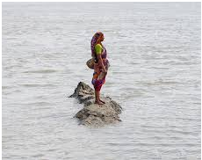
Lecture 11: Climate Change and Population Migration and displacement
ENS701: Climate Change and the South Pacific

Slide 2
Definition
Environmental Migrants:
Persons or group of persons who, for compelling reasons of sudden or progressive changes in the environment that adversely affect their lives or living conditions, are obliged to leave their habitual homes, or choose to do so, either temporarily or permanently, and who move either within their country or abroad.
Cross-border displacement in the context of disasters and the effects of climate change: refers to situations where people flee or are displaced across borders in the context of sudden- or slow-onset disasters, or in the context of the adverse effects of climate change

Slide 3
A growing crisis
As early as 1990 the Intergovernmental Panel on Climate Change (IPCC) noted that the greatest single impact of climate change might be on human migration—with millions of people displaced by shoreline erosion, coastal flooding and agricultural disruption. Since then, successive reports have argued that environmental degradation, and in particular climate change, is poised to become a major driver of population displacement—a crisis in the making.

Slide 4
In the mid-1990s, it was widely reported that up to 25 million people had been forced from their homes and off their land by a range of serious environmental pressures including pollution, land degradation, droughts and natural disasters. At the time it was declared that these “environmental refugees”, as they were called , exceeded all documented refugees from war and political persecution put together.

Slide 5
200 million climate migrants by 2050?
Professor Myers’ estimate of 200 million climate migrants by 2050 has become the accepted figure—cited in respected publications from the IPCC to the Stern Review on the Economics of Climate Change.
To put the number in perspective it would mean that by 2050 one in every 45 people in the world will have 12 been displaced by climate change. It would also exceed the current global migrant population. According to the International Organization for Migration (IOM) about 192 million people, or 3 per cent of the world’s population, now live outside their place of birth.

Slide 6
Drivers of climate change
The meteorological impact of climate change can be divided into two distinct drivers of migration; climate processes such as sea-level rise, salinization of agricultural land, desertification and growing water scarcity, and climate events such as flooding, storms and glacial lake outburst floods.
But non-climate drivers, such as government policy, population growth and community-level resilience to natural disaster, are also important. All contribute to the degree of vulnerability people experience.

Slide 7
Climate change and forced migration
Climate change will cause population movements by making certain parts of the world much less viable places to live; by causing food and water supplies to become more unreliable and increasing the frequency and severity of floods and storms.
Recent reports from the IPCC and elsewhere set out the parameters for what we can expect:
By 2099 the world is expected to be on average between 1.8ºC and 4ºC hotter than it is now. Large areas are expected to become drier—the proportion of land in constant drought expected to increase from 2 per cent to 10 per cent by 2050. Meanwhile, the proportion of land suffering extreme drought is predicted to increase from 1 per cent at present to 30 per cent by the end of the 21st century. Rainfall patterns will change as the hydrological cycle becomes more intense. In some places this means that rain will be more likely to fall in deluges (washing away top-soil and causing flooding).

Slide 8
Crop yields in central and south Asia could fall by 30 per cent by the middle of the 21st century. Some fish stocks will migrate towards the poles and colder waters and may deplete as surface water run-off and higher sea temperatures lead to more frequent hazardous algal blooms and coral bleaching.
Compounding this, climate change is predicted to worsen a variety of health problems leading to more widespread malnutrition and diarrhoeal diseases, and altered distribution of some vectors of disease transmission such as the malarial mosquito.
Global average sea level, after accounting for coastal land uplift and subsidence, is projected to rise between 8 cm and 13 cm by 2030, between 17 cm and 29 cm by 2050, and between 35 cm and 82 cm by 2100 (depending on the model and scenario used). Large delta systems are at particular risk of flooding. The area of coastal wetlands is projected to decrease as a result of sea level rise. For a high emissions scenario and high climate sensitivity wetland loss could be as high as 25 per cent and 42 per cent of the world’s existing coastal wetlands by the 2050s and 2100s respectively.

Slide 9
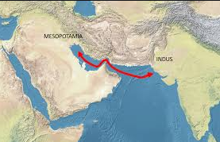
Climate migration is not new
Archaeological evidence suggests that human settlement patterns have responded repeatedly to changes in the climate. There is evidence that the emergence of the first large, urban societies was driven by a combination of climatic and environmental desiccation.
The complex societies of Egypt and Mesopotamia, for example, emerged as people migrated away from desiccating rangelands and into riverine areas. The resulting need to organize densely packed populations in order to manage scarce resources in restricted areas has been identified as one of the main driving forces behind the development of the first civilizations.

Slide 10
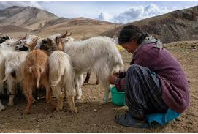
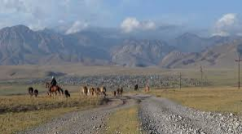
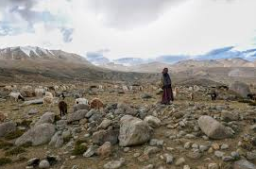
Existing patterns of climate migration
Migration is (and always has been) an important mechanism to deal with climate stress. Pastoralist societies have of course habitually migrated, with their animals, from water source to grazing lands in response to drought as well as part of their normal mode of life. But it is becoming apparent that migration as a response to environmental change is not limited to nomadic societies.

Slide 11
In western Sudan, for example, studies have shown that one adaptive response to drought is to send an older male family member to Khartoum to try and find paid labour to tide the family over until after the drought. Temporary migration in times of climate stress can help top-up a family’s income (through remittances from paid work elsewhere) and reduce the draw on local resources (fewer mouths to feed).
When climate stresses coincide with economic or social stresses, the potential for forced migration from rural areas increases significantly.

Slide 12
Migration, even forced migration, is not usually just a product of an environmental “push” from a climate process like sea level rise. Except in cases of climate events, where people flee for their lives, it does require some kind of “pull”: be it environmental, social or economic.

Slide 13
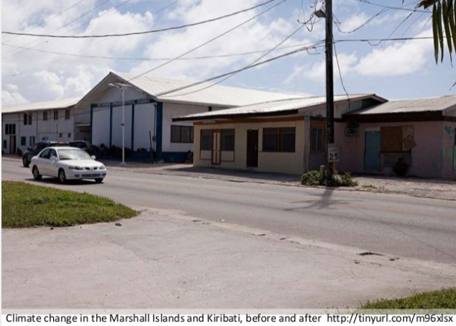
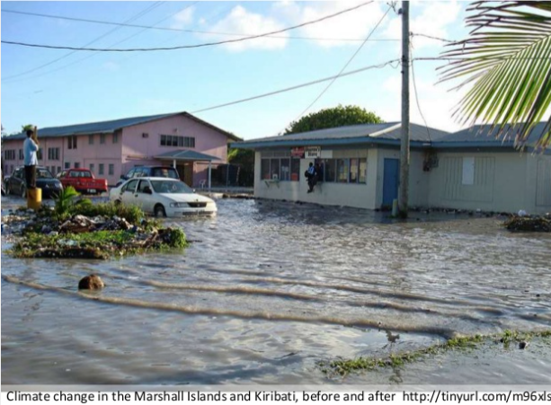

Slide 14
Example of south pacific Islands
The atoll of states of Kiribati and Tuvalu have the unenviable distinction of being among the countries in the world that are most vulnerable to climate change. Both atoll nations are situated just metres above water. Both are already feeling the effects of a changing climate, with recent years seeing king tides affect the urban atolls of South Tarawa and Funafuti, and cyclonic activity causing extensive damage in Tuvalu.

Slide 15
Together with Nauru, these countries also have another unenviable trait: their citizens are afforded few opportunities to migrate overseas to live and work.
Nauru (population approx. 11,000) is the only Pacific island state with a population of fewer than 100,000 people that has no special migration access to a larger country.
Kiribati and Tuvalu have very limited access to New Zealand, with 75 places available each year for applicants selected by ballot. This minimal level of migration access sets these countries apart from other similar small nations in the Pacific, whose citizens are able to freely migrate to wealthy larger countries with which they have a special relationship (New Zealand, in the case of Niue and Cook Islands; and the US, in the case of Palau, Marshall Islands and the Federated States of Micronesia).

Slide 16
Migration, both internal and overseas, has historically been a key adaptive strategy for some households in these countries (for example, Tuvalu and Kiribati for decades sent large numbers of seafarers overseas to work on container ships). But in today’s bordered world, opportunities for migration overseas are limited for those without the requisite qualifications. The migration opportunities that do exist are least available to those who live in the most vulnerable locations and circumstances.

