Slide 1
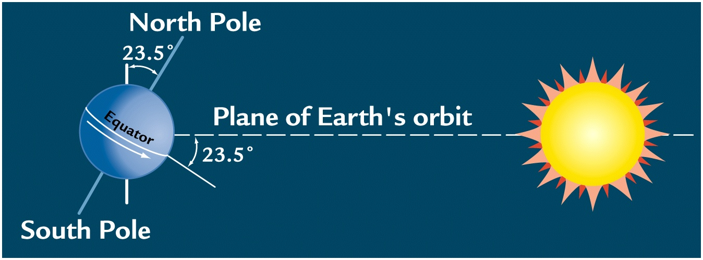
School of Applied Sciences Department of Environment Science Nabua/Natabua Campus
Week 4: Evidence of Climate change

Slide 2
1. Climate and Earth's Energy
The Earth's climate is a solar powered system. Globally, over the course of the year, the Earth system—land surfaces, oceans, and atmosphere—absorbs an average of about 240 watts of solar power per square meter (one watt is one joule of energy every second).

Slide 3
Earth’s Climate System Today
Heated by solar energy
Tropics heated more than poles
Imbalance in heating redistributed
Solar heating and movement of heat by oceans and atmosphere determines distribution of:
Temperature
Precipitation
Ice
Vegetation

Slide 4
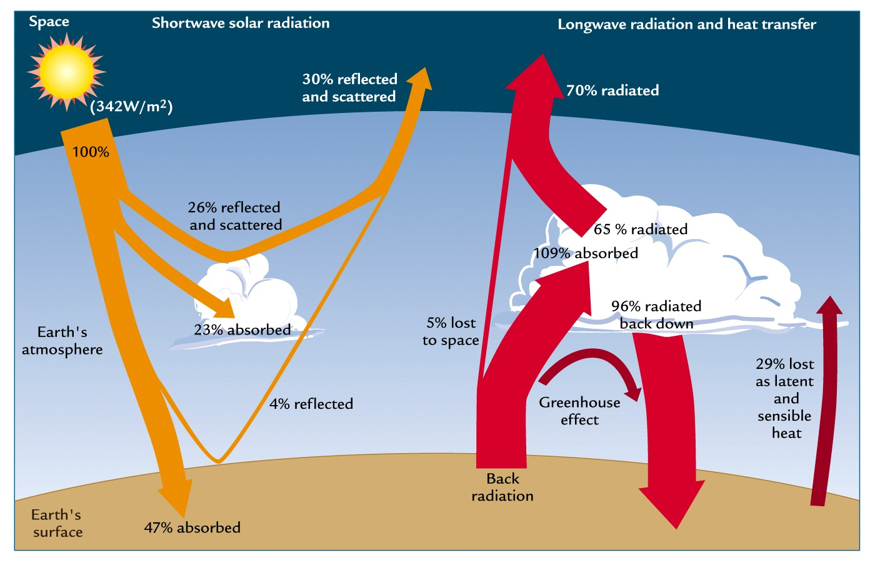
30% Solar Energy Reflected
Energy reflected by clouds, dust, surface
Ave. incoming radiation 0.7 x 342 = 240 W m⁻²

Slide 5
2. Discovery of Climate change
The history of the scientific discovery of climate change began in the early 19th century when ice ages and other natural changes in paleo-climate were first suspected and the natural greenhouse effect first identified. In the late 19th century, scientists first argued that human emissions of greenhouse gases could change the climate. Many other theories of climate change were advanced, involving forces from volcanism to solar variation

Slide 6
In the 1960s, the warming effect of carbon dioxide gas became increasingly convincing. Some scientists also pointed out that human activities that generated atmospheric aerosols(e.g., "pollution") could have cooling effects as well. During the 1970s, scientific opinion increasingly favored the warming viewpoint. By the 1990s, as a result of improving fidelity of computer models and observational work confirming the Milankovitch theory of the ice ages, a consensus position formed: greenhouse gases were deeply involved in most climate changes and human-caused emissions were bringing discernible global warming.

Slide 7
Since the 1990s, scientific research on climate change has included multiple disciplines and has expanded. Research has expanded our understanding of causal relations, links with historic data and ability to model climate change numerically. Research during this period has been summarized in the Assessment Reports by the Intergovernmental Panel on Climate Change.

Slide 8
The Intergovernmental Panel on Climate Change (IPCC) is an intergovernmental body of the United Nations, dedicated to providing the world with an objective, scientific view of climate change, its natural, political and economic impacts and risks, and possible response options.
It was established in 1988 by the World Meteorological Organization (WMO) and the United Nations Environment Programme (UNEP), and later endorsed by the United Nations General Assembly. Membership is open to all members of the WMO and UN. The IPCC produces reports that contribute to the work of the United Nations Framework Convention on Climate Change (UNFCCC), the main international treaty on climate change. The objective of the UNFCCC is to "stabilize greenhouse gas concentrations in the atmosphere at a level that would prevent dangerous anthropogenic (human-induced) interference with the climate system". The IPCC's Fifth Assessment Report was a critical scientific input into the UNFCCC's Paris Agreement in 2015.

Slide 9
IPCC reports cover the "scientific, technical and socio-economic information relevant to understanding the scientific basis of risk of human-induced climate change, its potential impacts and options for adaptation and mitigation." The IPCC does not carry out original research, nor does it monitor climate or related phenomena itself. Rather, it assesses published literature including peer-reviewed and non-peer-reviewed sources. However, the IPCC can be said to stimulate research in climate science. Chapters of IPCC reports often close with sections on limitations and knowledge or research gaps, and the announcement of an IPCC special report can catalyse research activity in that area.

Slide 10
3. Climate change and variability
The Milankovitch theory is used to explain the impacts of the Earth’s movements on its climate. It was developed by Serbian geophysicist and astronomer Milutin Milanković during the early 1900s. Using mathematical theory, he hypothesised that variations in the Earth’s orbit were the primary drivers of global climate patterns. These ‘orbital forcing’ mechanisms are centred on three parameters:
eccentricity,
obliquity, and
precession.
These parameters interact with one another, each with a different periodicity (or cycle). The Milankovitch theory addresses the impacts of these three factors on the Earth’s climate.

Slide 11
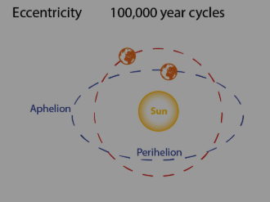
The eccentricity, a period of about 100,000 years in which the nearly circular orbit of the Earth changes into a more elliptical orbit.
The shape of the Earth’s orbit determines the amount of incoming solar radiation due to changes in the distance from the Earth to the sun.

Slide 12
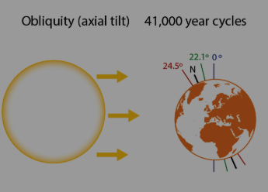
The next factor is called obliquity, a period of about 41,000 years where the Earth's axis tilt varies between 21.5 and 24.5 degrees.
When obliquity increases (i.e. the earth is tilted at a greater angle) there is a greater variation between Winter and Summer insolation – in Summer there is more solar radiation, and in Winter there is less. This solar radiation is not equally distributed, however, due to the shape of the Earth’s surface. With an increase in obliquity, high latitudes (towards the poles) receive an increase in insolation, while lower latitudes receive a decrease in insolation

Slide 13
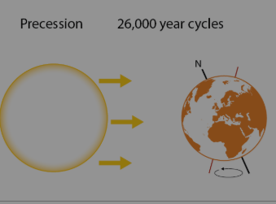
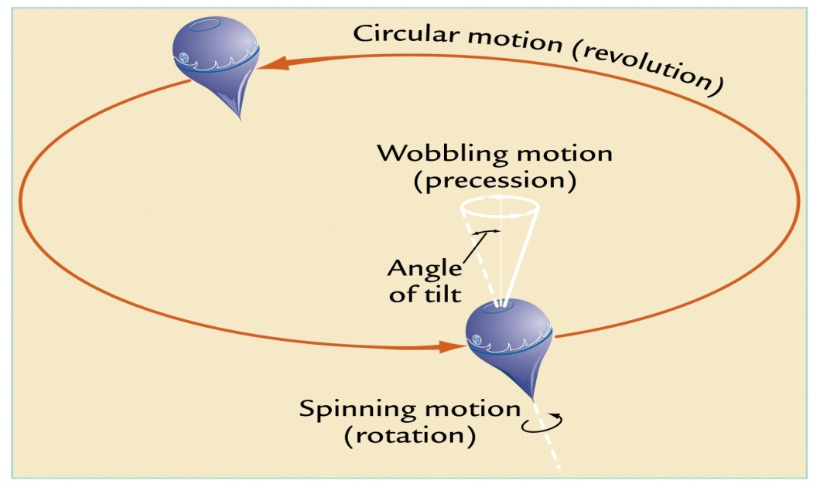
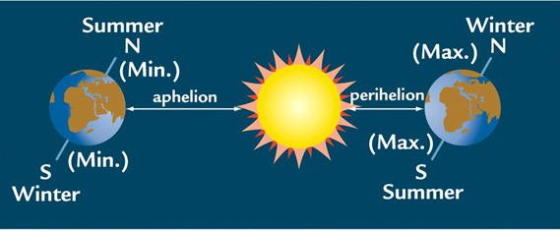
The final factor is called precession, a period of approximately 23,000 years where the Earth's axis wobbles like a spinning top
The impacts of precession are largely felt at perihelion (when the Earth is at its closest proximity to the Sun) due to increased solar radiation. For example, when the North Pole is directed towards the Sun, the northern hemisphere receives much more insolation in Summer, and experiences a colder Winter.

Slide 14
4. Science and understanding of climate change
1. What is climate change?
The term ‘climate’, in its broadest sense, refers to a statistical description of weather and of the related conditions of oceans, land surfaces and ice sheets. This includes consideration of averages, variability and extremes. Climate change is an alteration in the pattern of climate over a long period of time, and may be due to a combination of natural and human induced causes.
2. How has climate changed?
Global climate has varied greatly throughout Earth’s history. In the final decades of the 20th century, the world experienced a rate of warming that is unprecedented for thousands of years, as far as we can tell from the available evidence. Global average temperature rise has been accompanied by ongoing rises in ocean temperatures, ocean heat storage, sea levels and atmospheric water vapour. There has also been shrinkage in the size of ice sheets and most glaciers. The recent slowdown in the rate of surface warming is mainly due to climate variability that has redistributed heat in the ocean, causing warming at depth and cooling of surface waters. Australia’s climate has warmed along with the global average warming.

Slide 15
3. Are human activities causing climate change?
Human activities are increasing greenhouse gas concentrations in the atmosphere. This increase is extremely likely to have caused most of the recent observed global warming, with CO2 being the largest contributor. Some observed changes in Australia’s climate, including warming throughout the continent and drying trends in the southwest, have been linked to rising greenhouse gas concentrations.
4 How do we expect climate to evolve in the future?
If greenhouse gas emissions continue to grow rapidly, it is expected that, by 2100, the global average air temperature over the Earth’s surface will warm by around 4°C above mid-19th century temperatures. There are many likely ramifications of this warming. However, if emissions are reduced sufficiently rapidly, there is a chance that global average warming will not exceed 2°C and other impacts will be limited.

Slide 16
How are extreme events changing?
Since the mid-20th century, climate change has resulted in increases in the frequency and intensity of very hot days and decreases in very cold days. These trends will continue with further global warming. Heavy rainfall events have intensified over most land areas and will likely continue to do so, but changes are expected to vary by region.
6. How are sea levels changing?
Sea levels have risen during the 20th century. The two major contributing factors are the expansion of sea water as it warms, and the loss of ice from glaciers. Sea levels are very likely to rise more quickly during the 21st century than the 20th century, and will continue to rise for many centuries.
7. What are the impacts of climate change?
Climate change has impacts on ecosystems, coastal systems, fire regimes, food and water security, health, infrastructure and human security. Impacts on ecosystems and societies are already occurring around the world. The impacts will vary from one region to another and, in the short term, can be both positive and negative. In the future, the impacts of climate change will intensify and interact with other stresses. If greenhouse gas emissions continue to be high, it is likely that the human-induced component of climate change will exceed the capacity of some countries to adapt

Slide 17
8. What are the uncertainties and their implications?
There is near-unanimous agreement among climate scientists that human-caused global warming is real. However, future climate change and its effects are hard to predict accurately or in detail, especially at regional and local levels. Many factors prevent more accurate predictions, and some uncertainty is likely to remain for considerable time. Uncertainty in climate science is no greater than in other areas where policy decisions are routinely taken to minimise risk. Also, the uncertainty means that the magnitude of future climate change could be either greater or less than present-day best estimates.
9. What does science say about options to address climate change?
Societies,, face choices about how to respond to the consequences of future climate change. Available strategies include reducing emissions, capturing CO2, adaptation and ‘geoengineering’. These strategies, which can be combined to some extent, carry different levels of environmental risk and different societal consequences. The role of climate science is to inform decisions by providing the best possible knowledge of climate outcomes and the consequences of alternative courses of action.

