Slide 1
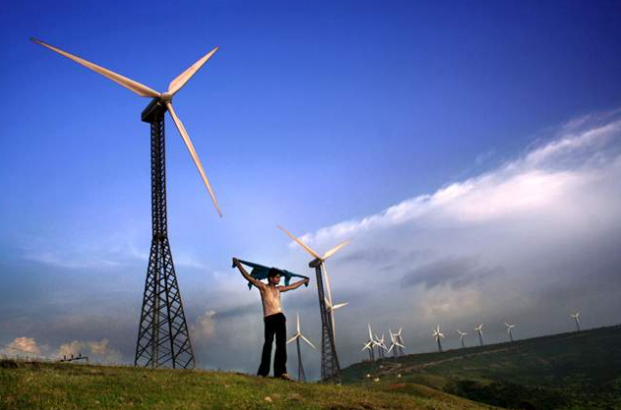
Lecture 7: Architecture of climate change policy

Slide 2
The emergence of climate change as a global policy issue
In the 1970s uncertainties about the nature of climate change led to an expansion of research into the phenomenon (Weart, 2008). By the end of the decade the First World Climate Conference was held and the participants concluded that it was likely that the climate may be altered by increasing emissions of CO₂, although this had almost no effect on public perceptions of the problem. It wasn’t later in the 1980s that significant political concern began to emerge (Weart, 2008).

Slide 3
The Villach workshops marked a shift in impetus for political intervention, arguing that the rate and degree of future warming could be profoundly affected by governmental policies on energy conservation, use of fossil fuels, and the emission of some greenhouse gases (UNEP/WHMO/ISCU Conference 1986).
Concerns about the global atmosphere soon resulted in international government action. However, the first international agreement was focused on stratospheric ozone depletion and the role of chlorofluorocarbons (CFCs) and halons in this process, and not climate change.

Slide 6
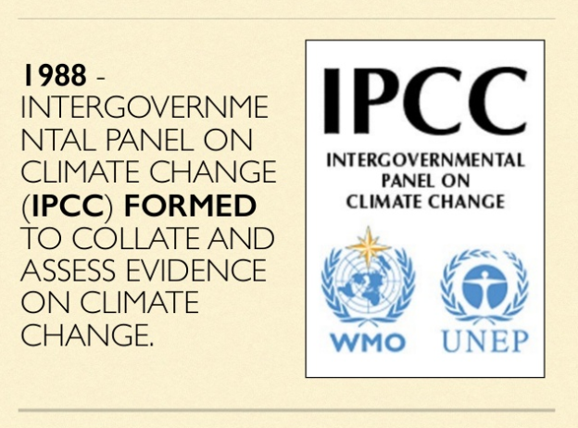

Slide 14
The Kyoto Protocol - background
1992: UN Framework Convention on Climate Change
recognized there is a problem: CO2 emissions are warming the planet
stabilize CO2 at "at a level that would prevent dangerous anthropogenic (human induced) interference with the climate system.“
goals: 1) ensure that ecosystems can adapt to climate change
2) make sure that food production not threatened
3) allow sustainable economic development
requires precise and regularly updated inventories of greenhouse gas emissions from industrialized countries
"Parties to the Convention“ agree to develop national programs to slow climate change; meet at “Conference of Parties” (COP’s); where binding international treaties (i.e. Kyoto) can be made
establishes a "framework" document -- something to be amended
or augmented over time

Slide 15
The Kyoto Protocol - background
1992: UN Framework Convention on Climate Change
places the heaviest burden for fighting climate change on industrialized nations
Annex 1: industrialized economies and economies in transition
Annex 2: the richest Annex 1 countries
(aka the Organization for Economic Cooperation and Development (OECD))
- general target: collectively reduce emissions to 1990 levels by 2000
(but no mechanisms, enforcement proposed)
- support developing countries’ climate change activities (granting body)
- developing countries’ emissions will grow before they shrink
- developing countries will have largest climate change impacts; work to mitigate

Slide 16
The Kyoto Protocol
Dec 1-11, 1997: representatives from 160 countries agreed to enter into
binding limits on emissions of greenhouse gases
TARGETS:
Total: reduce developed nation emissions to 5% below 1990 levels during
“commitment period” 2008-2012
(most countries need -18% reduction in BAU by 2008)
37 industrialized nations and the EU subject to binding emissions targets
Greenhouse gases: CO2, CH4, N2O, HFCs, PFCs, and SF6

Slide 17
Three primary mechanisms
Emissions trading
- trade carbon units between Annex 1 countries (flow is from countries with
carbon credits to countries with carbon overshoots)
- example: Europe’s Emissions Trading System (ETS), National Allocation Plans
Joint Implementation
- Annex 1 countries can invest in a emissions-reduction project in another
Annex 1 country and receive emissions reduction units (ERU)
Clean Development Mechanism
- Annex 1 countries receive ERUs for emissions reductions in developing countries
- must certify reductions (they would not have happened without action by Annex 1)

Slide 18
PROS:
For countries that are ultra-efficient, Kyoto would be cost prohibitive. Such countries
can ‘buy their way out’ by buying carbon credits from other countries
- Developing countries have incentive to reduce emissions by selling carbon credits

Slide 19
Kyoto Rule Book December 2, 2005
Defines how each country’s emissions and sinks (e.g. reforestation) are accounted
Developed countries can invest in other developed countries and earn carbon allowances
Establishes the Clean Development Mechanism which allows developed countries to invest in sustainable development projects (excl. nukes) in developing countries

Slide 20
Paris Agreement
At COP 21 in Paris, Parties to the UNFCCC reached a landmark agreement to combat climate change and to accelerate and intensify the actions and investments needed for a sustainable low carbon future. The Paris Agreement builds upon the Convention and – for the first time – brings all nations into a common cause to undertake take ambitious efforts to combat climate change and adapt to its effects, with enhanced support to assist developing countries to do so.

Slide 21
Aim is to strengthen the global response to the threat of climate change by keeping a global temperature rise this century well below 2 degrees Celsius above pre-industrial levels and to pursue efforts to limit the temperature increase even further to 1.5 degrees Celsius.
the agreement aims to strengthen the ability of countries to deal with the impacts of climate change.
To reach these ambitious goals, appropriate financial flows, a new technology framework and an enhanced capacity building framework will be put in place, thus supporting action by developing countries and the most vulnerable countries, in line with their own national objectives. The Agreement also provides for enhanced transparency of action and support through a more robust transparency framework.

Slide 22
Essential Elements OF Paris agreement
Long-term temperature goal (Art. 2) – The Paris Agreement, in seeking to strengthen the global response to climate change, reaffirms the goal of limiting global temperature increase to well below 2 degrees Celsius, while pursuing efforts to limit the increase to 1.5 degrees
Global peaking (Art. 4) –To achieve this temperature goal, Parties aim to reach global peaking of greenhouse gas emissions as soon as possible, recognizing peaking will take longer for developing country Parties, so as to achieve a balance between anthropogenic emissions by sources and removals by sinks of greenhouse gases in the second half of the century.

Slide 23
Mitigation (Art. 4) – The Paris Agreement establishes binding commitments by all Parties to prepare, communicate and maintain a nationally determined contribution (NDC) and to pursue domestic measures to achieve them. It also prescribes that Parties shall communicate their NDCs every 5 years and provide information necessary for clarity and transparency
Sinks and reservoirs (Art.5) –The Paris Agreement also encourages Parties to conserve and enhance, as appropriate, sinks and reservoirs of greenhouse gases as referred to in Article 4, paragraph 1(d) of the Convention, including forests.

Slide 24
Market and non-markets (Art. 6) – The Paris Agreement establishes a mechanism to contribute to the mitigation of greenhouse gas emissions and support sustainable development, as well as defining a framework for non-market approaches to sustainable development
Adaptation (Art. 7) – The Paris Agreement establishes a global goal to significantly strengthen national adaptation efforts – enhancing adaptive capacity, strengthening resilience and reduction of vulnerability to climate change – through support and international cooperation.

Slide 25
Loss and damage (Art. 8) – The Paris Agreement significantly enhances the Warsaw International Mechanism on Loss and Damage, which will develop approaches to help vulnerable countries cope with the adverse effects of climate change, including extreme weather events and slow-onset events such as sea-level rise. The Agreement now provides a framework for Parties to enhance understanding, action and support with regard to loss and damage.
Support (Art. 9, 10 and 11) – The Paris Agreement reaffirms the obligations of developed countries to support the efforts of developing country Parties to build clean, climate-resilient futures, while for the first time encouraging voluntary contributions by other Parties. Provision of resources should also aim to achieve a balance between adaptation and mitigation.

Slide 26
What is “common but differentiated responsibilities”?
The developed countries such as US,UK have already polluted the atmosphere with greenhouse gases (GHGs) through industrialization. So they’re the one who created/started global warming and all the mess.
While Developing countries (India and Brazil) have started polluting the world only recently.
Therefore, the developing countries such as India, Brazil should share less of the burden of lowering overall emissions.
And Developed countries (US,UK) should bear more responsibility in fixing this global warming mess etc. because they’re the one more responsible for it.
So, while it is the “Common” responsibility of every nation of this world, to reduce Green house gas emission, but there should be some difference between the responsibility given to developed countries and developing countries.
Kyoto Protocol follows that principle and assigns separate responsibilities to the countries.

Slide 27
Emissions Trading / Carbon Trading
Suppose two Annex B parties are Japan and Australia.
Japan was given quota of 100 units
And Australia was given quota of 200 units.
But Australian Government is unable to maintain this limit and Australia emits 210 units of green house gas, in given year.
On the other side, Japanese Government takes very strong steps to control emission and hence they only emit 90 units of Green House gas. So it has spare 10 Kyoto Units.
Now, under Emission trading system, Australia can buy this 10 spare kyoto units from Japan and thus remain within its limit.
In real life scenario, each annex B country makes law giving fixed quota to the companies.

Slide 28
Suppose steel factory cannot emit more than 1 ton of Green house gas
Tire company cannot emit more than 2 tonnes of green house gas.
So if tire company owner buys superfine machinaries that produce less gas so he has some spare credit/quota (say 1 ton)
While Steel factory emits more than its allowed quota (suppose it was allowed 2 tonnes but emitted 3 tonnes)
Then the steel company can pay the tire company and get a certificate that we’ve purchase 1 ton quota from this xyz tire company. This Is the essence of “Carbon Trading.”

Slide 29
2 Clean Development Mechanism (CDM
Suppose Annex B country Australia is given emission quota of 200 units, but it emits 210 units of green house gas.
But Australia can finance a solar power project in some village of India (Non-Annex or developing Country) and get certificate that the solar plant led to reduction of 10 units of green house gas. In this way, Australia will remain in its quota/limit.
Similarly, suppose Australian Government has passed a law that a steel production company with output of 200 tons of steel per a day, must not emit more than 10 units of green house gas in a year.
But this company wants to produce more steel, then its green house gas emission has increased to 11 units. (1 more unit above the quota)
So this company can also do some solar-projects in India, Brazil etc. and get a certificate that it has led to reduction of 1 unit of GHG emission. = problem solved.

Slide 30
Joint Implementation (JI)
This is identical to CDM.
In CDM, Australia can do good project in a non-Annex country (developing country) e.g. India.
In Joint Implementation, Australia can do the good project in another Annex B country e.g. Japan to meet the quota.

Slide 31
Why USA did not ratify Kyoto Protocol
US President George W Bush refused to ratify Kyoto protocol saying that it would gravely damage the US economy.
for example a US steel company would need to either buy Carbon Credits from another company or invest in some projects in a developing country), while an Indian or Chinese Steel company has no such obligation so their cost of production = low, hence they can sell their products @lower MRP = US steel company will loose customers.
So US Government feels is that the treaty is fatally flawed, because it does not require developing countries (especially India and China) to commit to emissions reductions.
After President Bush, President Obama too, didn’t ratify Kyoto protocol for the same reason. (plus we should also understand that the powerful US industrialist lobby may stop election funds to a candidate, if he is in favor of Kyoto protocol, so USA is unlikely to ratify Kyoto or any such future protocols that are legally binding!)

Slide 32
Canada Quits Kyoto protocol
In 2011, Canada, become the first country to quit the Kyoto Protocol on climate change, saying the 1997 accord was handicapped because top green house emitters like the United States and China not covered by it. (Because USA has refused to ratify the treaty and China being an Annex II country –has no compulsory responsibility to cut down emission.)

Slide 33
COP, Convention of Parties
The Conference of Parties (COP) is the apex decision-making body of the United Nations Climate Change Framework Convention (UNFCCC). The UNFCCC was formed in 1994 to stabilize the greenhouse gas emissions and to protect the earth from the threat of climate change.
All States that are Parties to the Convention are represented at the COP, at which they review the implementation of the Convention and any other legal instruments that the COP adopts and take decisions necessary to promote the effective implementation of the Convention, including institutional and administrative arrangements.

Slide 34
Discussion questions/Tutorial
1. What is the ultimate objective of the Convention (UNFCC) on climate change?
Explain carbon trading, clean development mechanism and joint implementation.
In the early years of the Convention, adaptation received less attention than mitigation,Why.
The Kyoto Protocol is based on the principles and provisions of the Convention and follows its annex-based structure. It only binds developed countries, and places a heavier burden on them under the principle of “common but differentiated responsibility and respective capabilities”, Explain what do mean by “common but differentiated responsibility”.
What is the central aim of Paris agreement?
What is technology transfer to support climate action?

